Slide 1
Chronic and Refractory Periodontitis
DR SONA SHETH
MDS
Reader
Dept. of Periodontology

Slide 2
Introduction
Chronic periodontitis is the most prevalent form of periodontitis.
It is considered to start a plaque-induced gingivitis, if left untreated progress into chronic periodontitis.
It was formerly known as adult periodontitis or slowly progressing periodontitis.
In the presence of systemic or environment factors such as diabetes, smoking or stress, disease progression may become aggressive.
Chronic periodontitis lesions include loss of attachment and bone and is regarded as an irreversible condition.
Although this disease is seen more commonly in adults, it can occur in children and adolescents.
Chronic periodontitis has been defined as an infectious disease resulting in inflammation within the supporting tissues, progressive attachment loss and bone loss

Slide 3
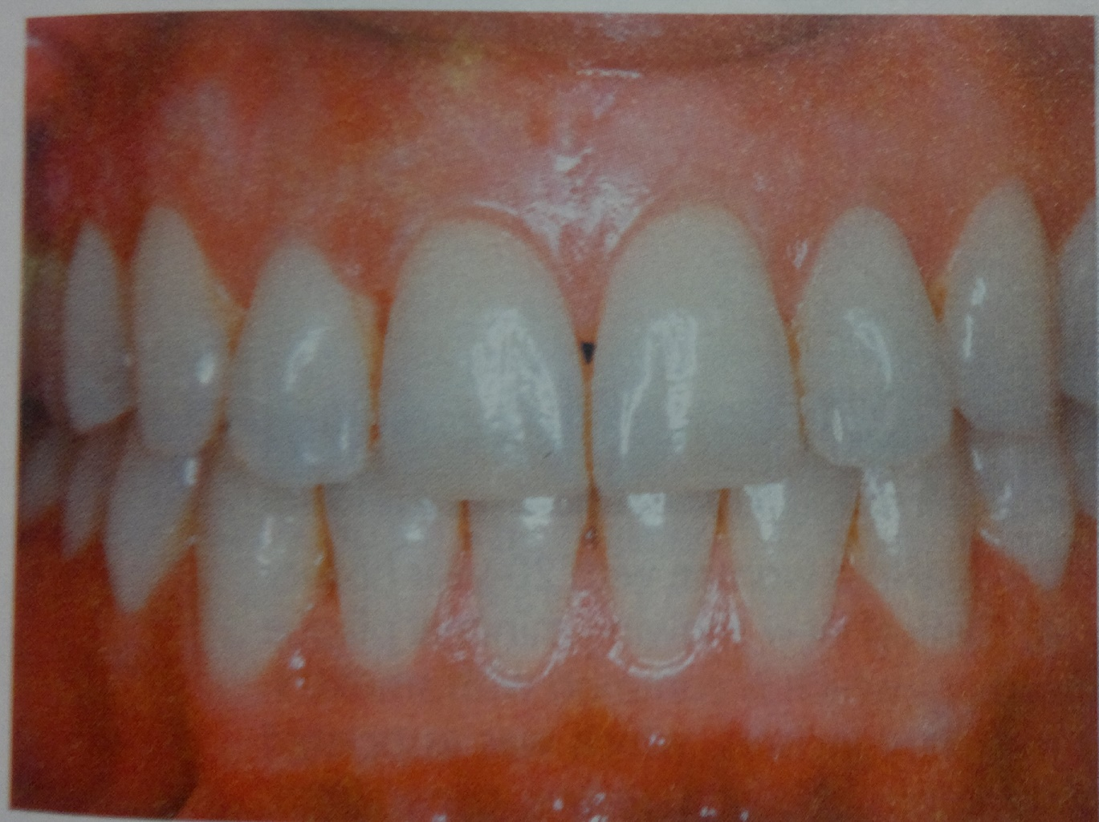

Slide 4
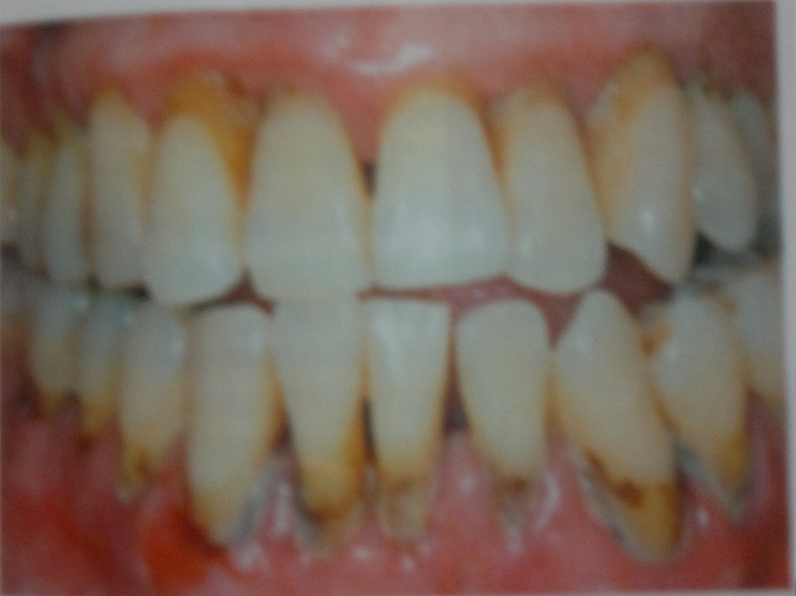

Slide 5
Clinical Feature
Slightly to moderately swollen gingiva with alteration in colour ranging from pale red to magenta.
Loss gingival stippling with blunted or rolled gingival margins and flattened or cratered papilla.
Gingival bleeding either spontaneous or in response to probing
Exudation of crevicular fluid and suppuration from pocket.
Abscess formation in some in some cases when the pocket occludes
Thickened fibrotic marginal tissues obscuring the underlying inflammatory changes in cases of long-standing, low-grade inflammation.
Supragingival and subgingival plaque accumulation.
Presence of suprabony or infrabony pocket formation.
Loss of clinical attachment.
Tooth mobility in advanced cases.

