Slide 1
DENTAL CEMENTS
SECOND YEAR BDS LECTURE
By: Dr. Kinjal Solanki
Department of prosthodontics & crown and bridge
AMC dental college

Slide 2
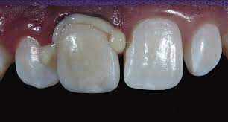
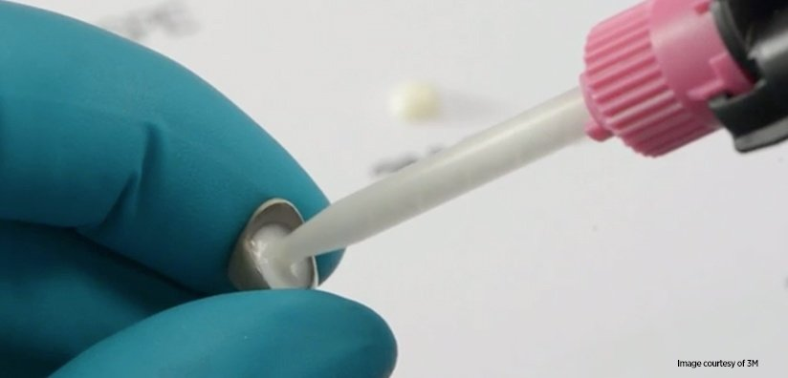
INTRODUCTION
Luting is derived from a greek word LUTUM –meaning mud. Primarily cements were used to fill the gap between restoration and tooth structure. There was no bonding.
CEMENT- Substance that hardens to act as a base, liner, filling material, or adhesive to bind devices and prosthesis to tooth structure or to each other. (Anusavice 12th)
CEMENTATION- Attaching a restoration to natural teeth by means of cement. (GPT 9)
LUTING AGENT- any material used to attach or cement indirect restorations to prepared teeth. (GPT9)
1. Anusavice KJ (1996) Phillips’ science of dental materials, 12th edn. WB Saunders, Philadelphia, pp 307-339

Slide 3
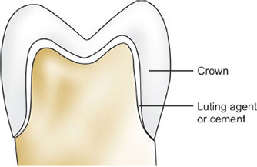
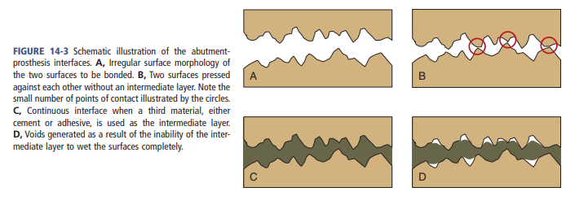
NEED FOR LUTING AGENT
Hold the restoration and tooth together
Act as barrier for microbial intrusion
Seal interface between tooth and restoration

Slide 4
Classifications:
According to Craig (Based on the ingredients)
Water based cements
Glass & Resin modified glass ionomer
Zinc Polyacrylate
Zinc Phosphate
Resin based cements
Composite & adhesive resin
Compomers
Oil based cements
Zinc Oxide Eugenol
Non Eugenol -Zinc Oxide
2. Craig RG. Restorative dental materials, 8th ed. St Louis:Mosby; 1989. p. 189-225.

Slide 5
Luting Mechanism (by schillinburg)
Non- Adhesive/ mechanical bonding:
Cement fills the restoration- tooth gap and holds by engaging in small surface irregularities.
Micromechanical Bonding:
  Surface irregularities are enhanced by air abrasion or acid etching and it improves the frictional retention.
Molecular Bonding:
  Chemical bond formation between cement and the tooth structure.
4. Shillingburg HT, Hobo S, Whitsett LD, Jacobi R, Brackett SE (1997) Fundamentals of fixed prosthodontics, 3rd edn. Quintessence Publishing Co Inc, Chicago, pp 385–415

Slide 6

Ideal requirements of luting Cements
  Long working time, shorter setting time
  Adheres well to both tooth structure and cast alloys
  Provides a good seal
  Nontoxic to the pulp
  Adequate strength
  Can be compressible into thin layers
  Low viscosity
  Low solubility
  Good working and setting characteristics
  Any excess can be easily removed
5. Rosenstiel. Contemporary fixed prosthodontics 4th edition. Luting agents and cementation procedures. Pg no:765-781.

