Slide 1
Errors and solutions in fabrication of removable partial denture
Presented by:
Dr. Ronak Choksi (M.D.S)
Lecturer, Dept. Of Prosthodontics
AMC Dental College.

Slide 2
CONTENTS
INTRODUCTION
FAILURES IN REMOVABLE PARTIAL DENTURE
ESTHETIC FAILURES
MECHANICAL FAILURES
INTEGRATING FIXED AND REMOVABLE PROSTHESES
I-BAR
STRESSBREAKERS
LABORATORY FAILURES(REVIEW BY RUDD AND RUDD)

Slide 3
SUMMARY
REVIEW OF LITERATURE
REFERENCES

Slide 4
INTRODUCTION
Removable partial prosthodontic treatment can offer exceptional satisfaction for both the patient and the prosthodontist.
It can transform an unhealthy, unattractive dentition with poor function into a comfortable, healthy occlusion capable of giving years of further service while greatly enhancing esthetics

Slide 5
To achieve such success, however, requires meticulous attention to every detail from initial patient interview, through the active treatment phase, to a planned schedule of follow-up care.
Failure to achieve the desired specifications for function and esthetics would result in failure of the prosthesis

Slide 6
Murphy’s Laws
There is never enough time to do it correctly in the first place, but always plenty of time to do it over.

Slide 7
Good technique demands that everyone involved give adequate attention to all details required for safe and efficient operations. This means that good dentistry depends on the integrity, knowledge, and skills possessed by the entire dental team.

Slide 8
A great force working against good technique is the habit of taking shortcuts. Shortcuts are risky attempts to save time by modifying a proven procedure.

Slide 9
Classification
Mechanical failure RPD
Failure of solder joints
Distortion
Improper design
Changes in the abutment tooth
Periodontal disease
Problems with the pulp
Caries
Movement of the tooth
Esthetic problems
Flange design
Framework
Occlusal problems
Miscellaneous failures

Slide 10
 | Lack stability | Lack rigidity | Lack retention | Reline/adhesive | Excessive wear
Maxillary RPD | 43.9% | 24.3% | 6.2% | 3.9% | 21.6%
Mandibular RPD | 38.2% | 13.2% | 21.2% | 21.6% | 7.1%

Slide 11
Mechanical failures
Improper design

Slide 12
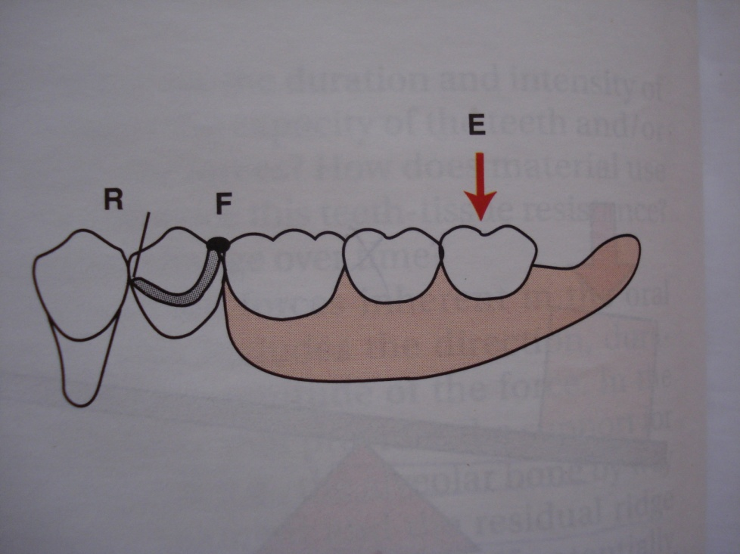
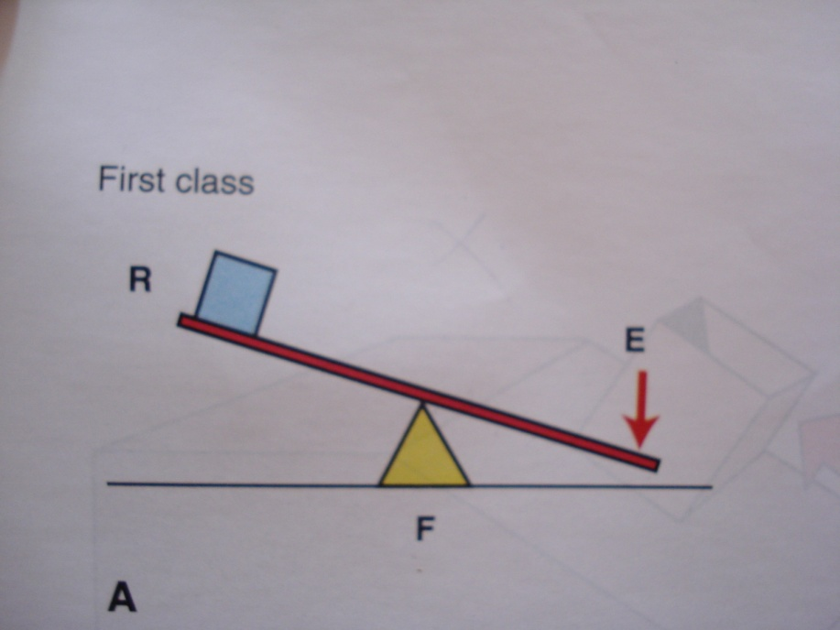
Basic design considerations

Slide 13
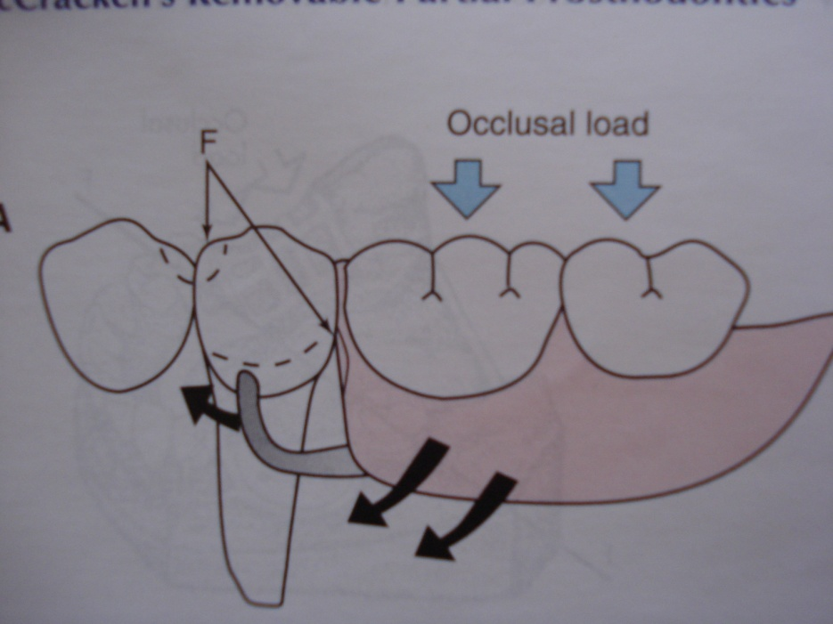
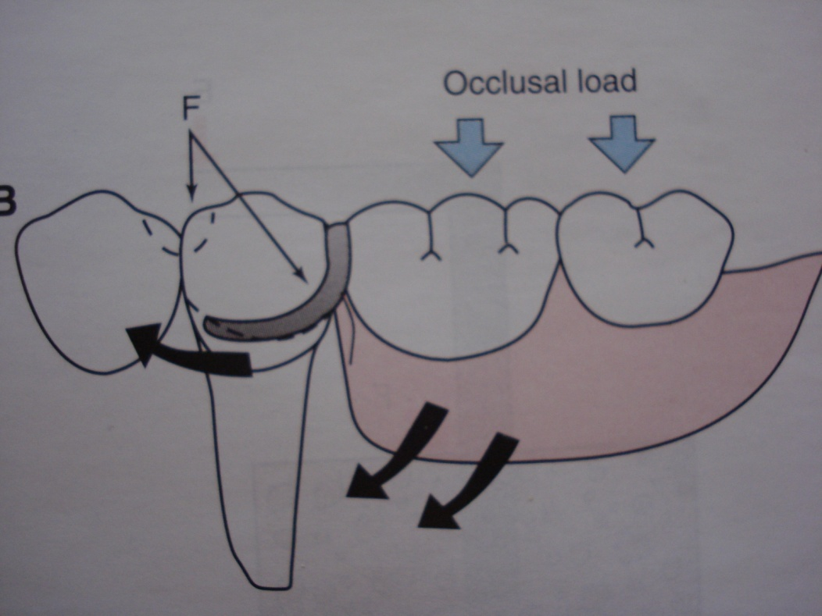

Slide 14
DOS AND DON’TS OF DESIGN
Complete evaluation of every tooth, and the composition and materials of the opposing occlusion
Appraisal of the optimal area for mastication
Proper use of the surveyor in treatment planning as well execution

Slide 15
Proper preparation of the mouth, including: recontouring of teeth for clasping; adequate rest seat preparations and clearance; clearance of and faciolingual preparation for adequate strength for any embrasure clasp; determination of guiding surfaces or guiding planes.
Guiding planes especially on the proximals are frequently made excessively large, resulting in misshapen teeth with “corners” and high survey lines which may cause the retainer to lock and may add leverage and torque to extension abutments

Slide 16
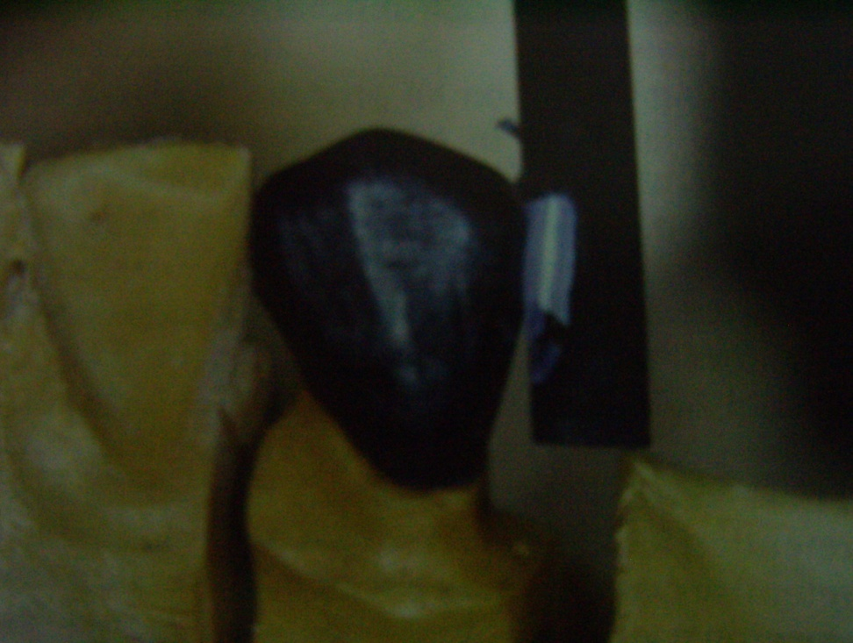
These guiding surfaces may be improved if they are slightly convex but still parallel with the surveyed path, and smaller in area, because the distance traversed in placing the dentures is not great.

Slide 17
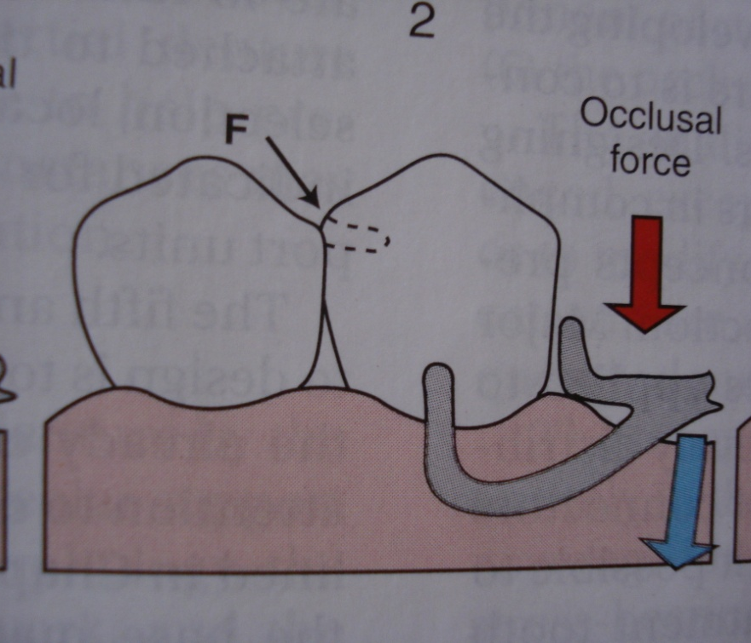
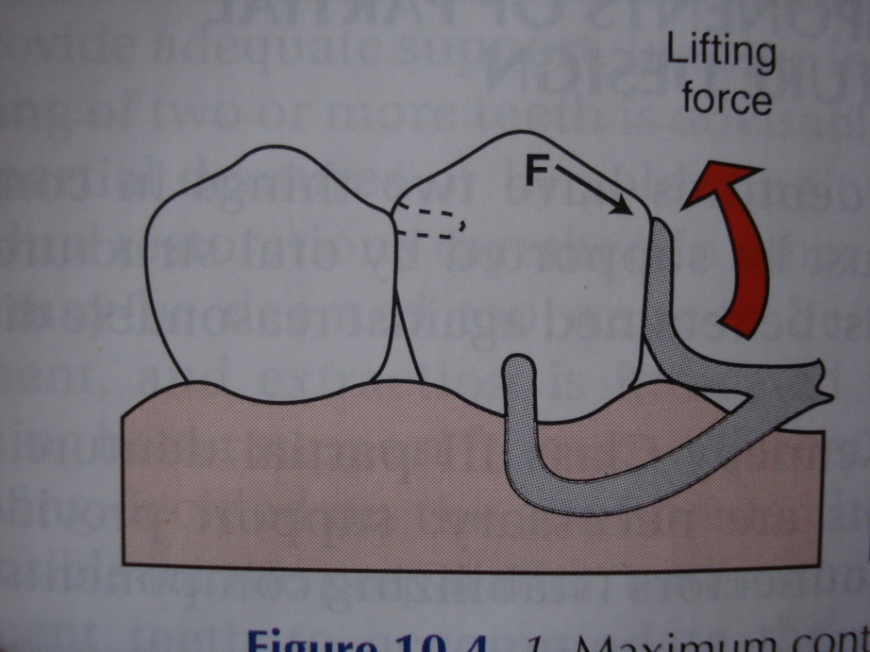

Slide 18
Failure to properly sequence mouth preparation procedures
Inadequate mouth preparations, usually resulting from insufficient planning of the design of the partial denture or failure to determine that mouth preparations have been properly accomplished
Failure to return supporting tissue to optimum health before impression procedure
Inadequate impression of hard and soft tissue

Slide 19
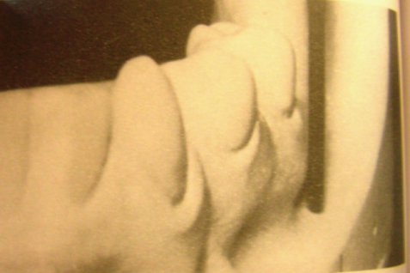
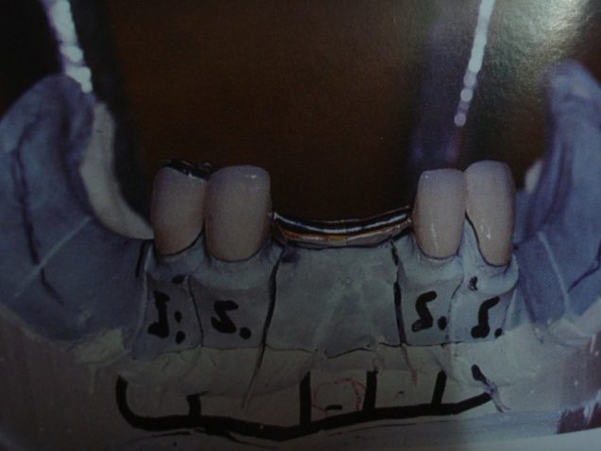
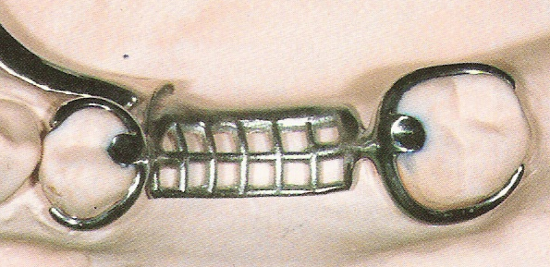
5. Reduction of excessive undercuts – both of teeth and ridge or tori.
6. Double abutting [double rests, double clasp, or fixed splinting of the abutments] adjacent to edentulous areas.

Slide 20
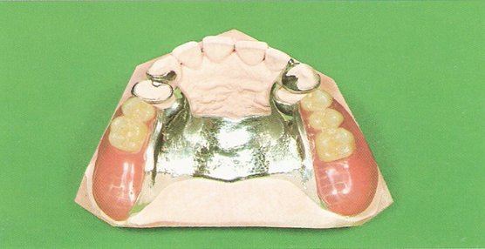
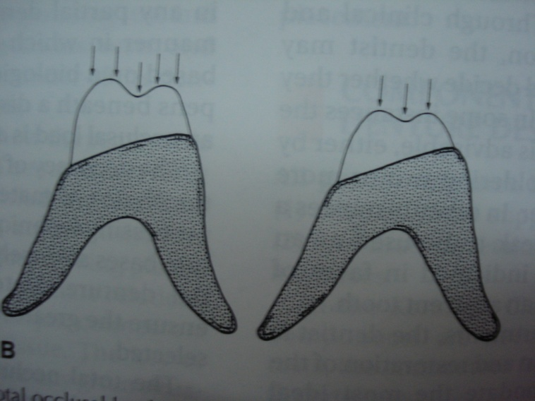
7. Distal extension bases:
There should be as few teeth distally as prudent, and only as many as are necessary to avoid extrusion of opposing teeth [ opposing the mesial half of a molar is adequate]
The buccolingual occlusion table should be narrowed, and deep intercuspation should be avoided. The intention is to minimise torque and leverage on both the abutment and the residual ridges

Slide 21
Support for denture bases:
Inadequate coverage of basal seat tissue
Failure to record basal seat tissue in a supporting form

Slide 22
8. Determination of retention is the least critical of the requirements. A minimum of two opposing retentive areas, appropriately located on each side of the arch, are required

Slide 23
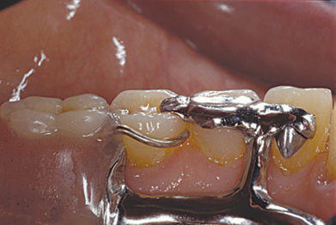
9. Support of vertical dimension.
In any restoration with lost vertical dimension supported by fixed restorations, the equivalent of atleast 3 pairs [upper+lower] of natural teeth must directly occlude.
Otherwise support should be extended by the use of “occlusal pads”, “extended rests” or “onlay rests” incorporated into the partial denture framework.

Slide 24
10. Achievement of idealistic occlusion is commonly impossible in RPD construction, but also is not usually necessary.
Eg., in case of tilted and/or extruded third molar. It can be used in the design to avoid distal extension base but need not be included in occlusion. Its presence preserves bone, and, should it be lost later, the denture is easily altered.
Good centric relation, occlusion, and absence of interferences by denture teeth in all excursions is important.
Adequate mastication is almost always possible

Slide 25
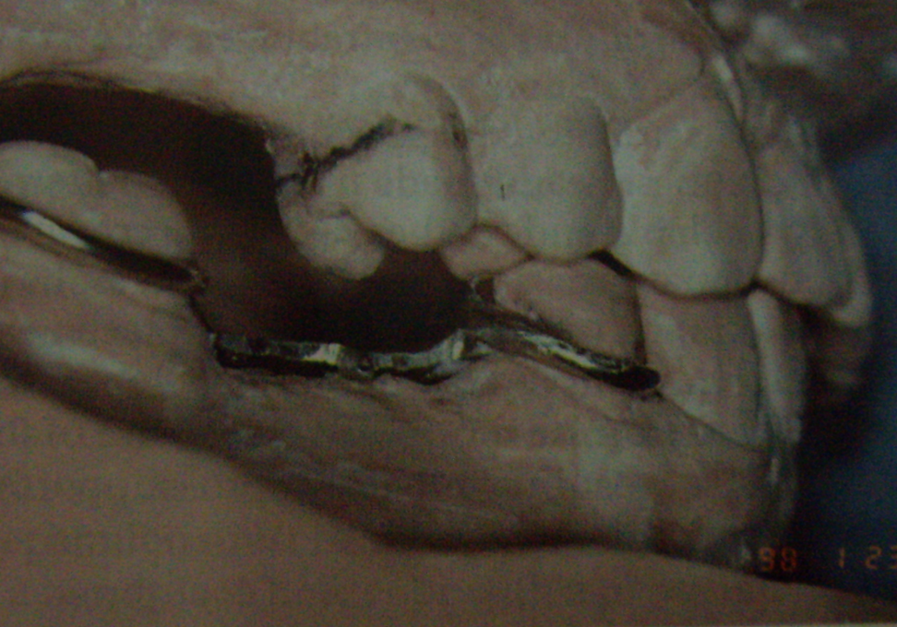
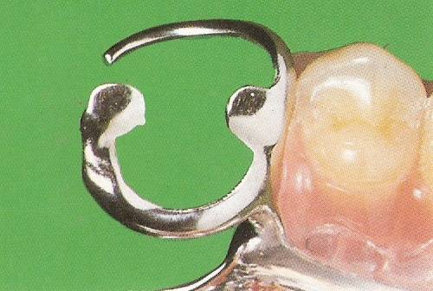
11. Establishment of rest seats is routine and must always be positive. When used, ledge type rest seats should be crescent shaped with an acute angle on the ledge.

Slide 26
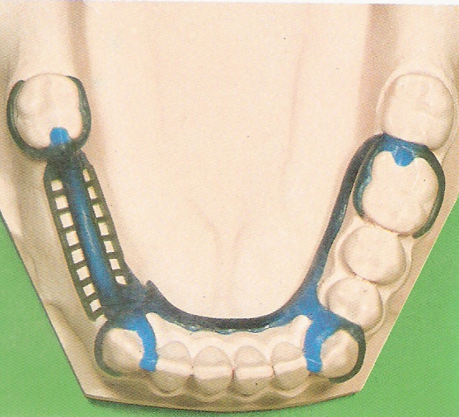
12. Use of multiple clasping in retention.
Too few clasps are of greater concern than too many. If it is apparent that too few clasps are employed, irreversible damage may have already occurred

Slide 27
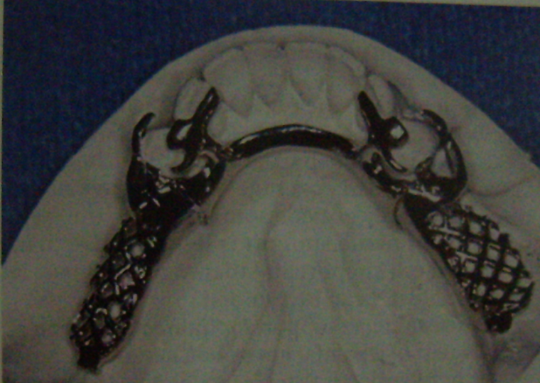
13. Indirect retention should routinely be included in the design . It should be completely positive, so as to preclude the tooth moving off or migrating away from the rest.
An exception may involve the lingual plate type when a group of very stable anterior teeth is deemed capable of withstanding the intermittent force on their inclined planes related to a distal extension base situation.

Slide 28
14. Classification systems vs. design
There are only three types of partial dentures : tooth supported, tooth and tissue supported, and completely tissue supported.
There is no one design that should be used in any particular combination of remaining teeth for there are many factors that contribute to the ultimate design.

Slide 29
14. Proper encirclement or “containments” – components of the clasp must contact the tooth beyond its greatest horizontal diameter.
“More than halfway” or “ more than 180⁰ are not safe rules when the tooth is somewhat misshapen or malpositioned. The abutment tooth may migrate away from the clasp, or the clasp may move off the tooth. This is of particular concern when the I bar approach is used improperly or when the clasp arms are too short.

Slide 30
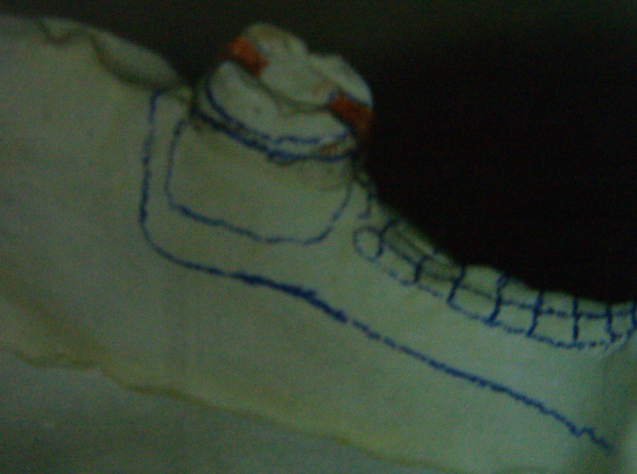
DESIGN OF FRAMEWORK
Failure to use properly located and sized rests
Flexible or incorrectly located major and minor connector
Use of cast clasps that have too little flexibility, are too broad in tooth coverage, and have too little consideration for esthetics

Slide 31
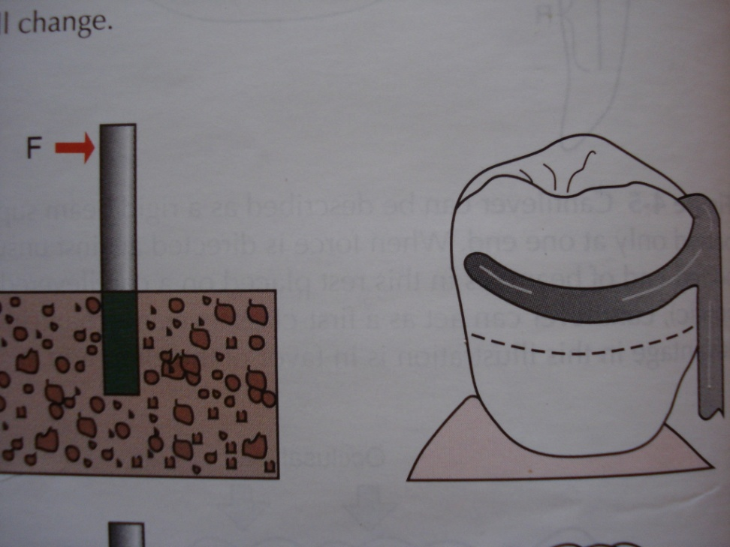
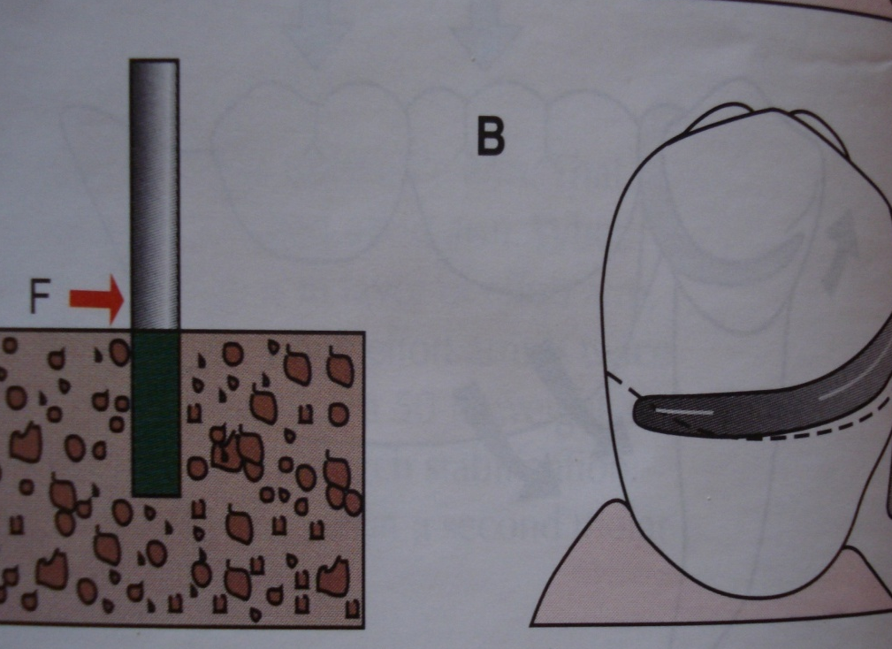
Incorrect use of clasp designs

Slide 32
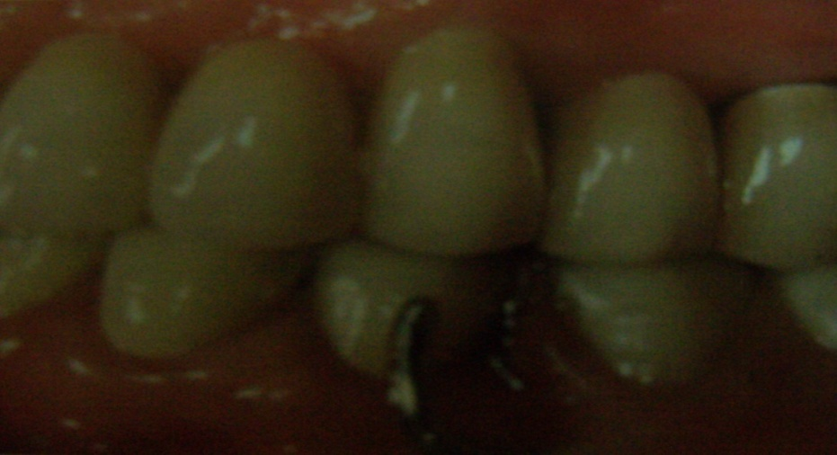
I-BAR
An I –bar is an extracoronal, infrabulge, removable partial denture component that is smoothly tapering from origin to rounded tip, flexible and usually provides retention at its terminus.

Slide 33
As this type of retainer involves very little of the tooth crown, it cannot be expected to provide functions other than retention.
When retention is to be provided with an I bar retainer, functions such as vertical support are still to be provided separately with other primary components of the RPD

Slide 34
ADVANTAGES AND INDICATIONS
Minimal tooth contact resulting in easier adjustment and less cariogenic consequence
Less tooth contour violation leading to less debris impaction and presumably more favorable periodontal response
More favorable esthetics

Slide 35
DISADVANTAGES AND CONTRAINDICATIONS
With very short teeth and/or lack of provision for the guiding planes, the I-bar retainers may be found lacking in overall retention. The horizontal part of the I bar that extends from the denture base area should be adapted across the attached soft tissue areas with only slight relief.

Slide 36
Soft tissue attchments close to an abutment tooth and frenulae may be barriers to usual I bar placement.
The alternatives to such a situation are extending the rest out and down the buccal surface of the tooth to reciprocate the lingual retainer or placement of a buccal circumferential type arm originating at the proximal plate.

Slide 37
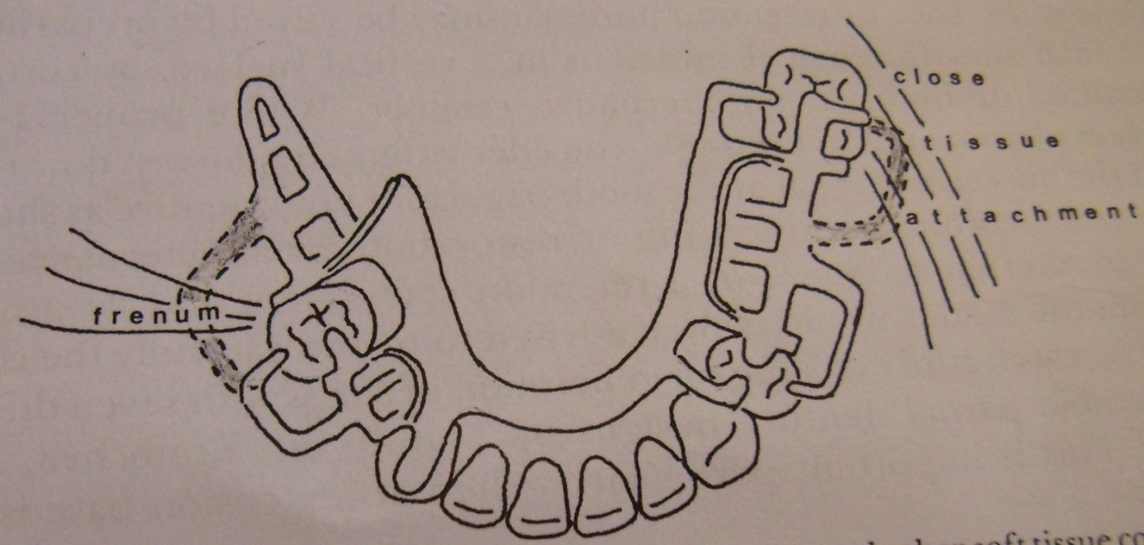
Where an I bar crosses a frenum, the lab must add block out relief in this area to raise the bar or the I bar is designed to engage the same tooth area by an approach from a different direction
The design may be influenced by frenulae and other soft tissue contours that interfere with placement of some components

Slide 38
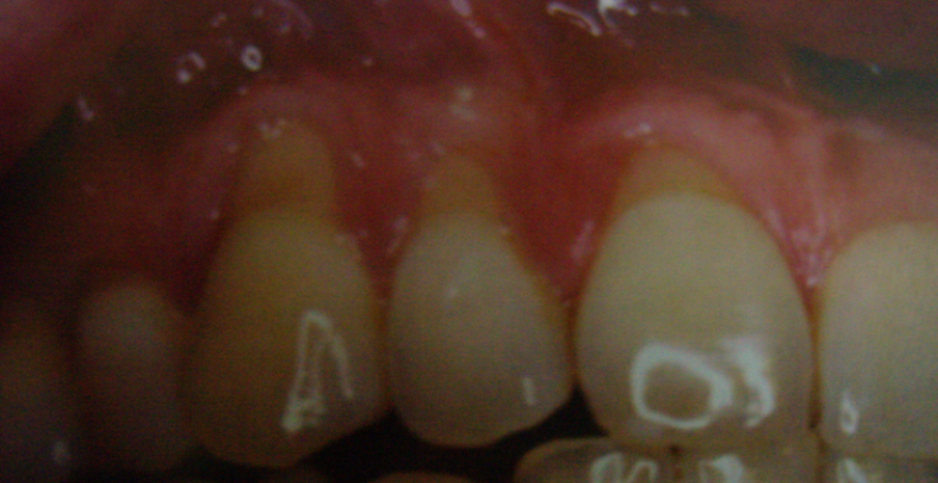
The envisioned optimal periodontal contour of the I bar would seem debatable in advanced gingival recession. Other design benefits should be reviewed before considering a substitute

Slide 39
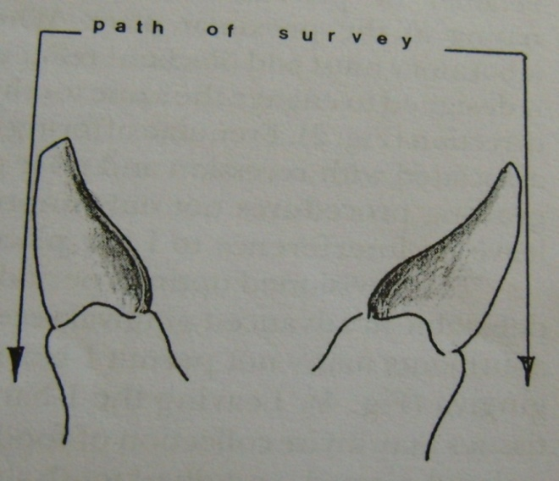
Opposed, severely tilted abutments may not permit I-bar retention placement near the attached gingiva.
Leaving the I-bar several mm out from the cheek tissues may invite collection of food debris and irritation of the cheek.
Different survey path, enamel contouring, and crowns often overcome this situation

Slide 40
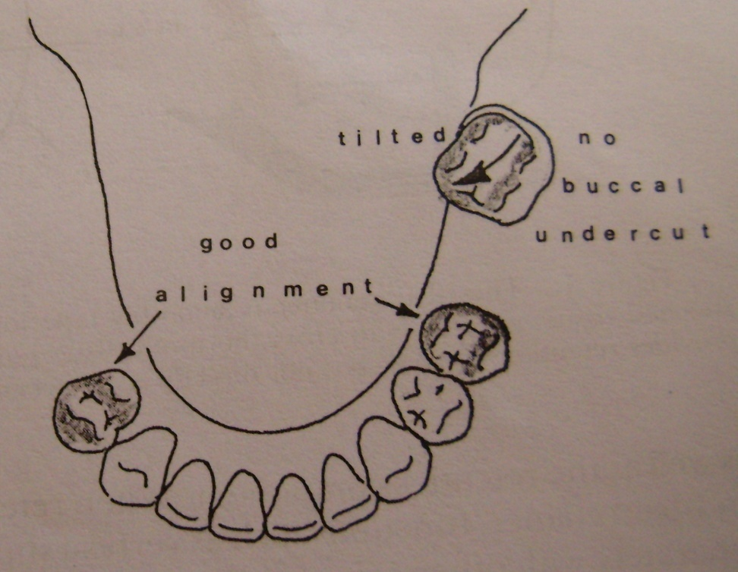
One isolated , tipped , and tilted tooth should not be allowed to distract from an overall advantageous survey path and insertion placement of the prosthesis.
Lack of retentive undercut may be solved by preparing a 0.001 inch smooth enamel undercut in a vertical surface, by coronal restoration, or by using an alternative retainer.

Slide 41
STRESS BREAKERS
One of the most common prosthodontic problems is failure of distal extension partial dentures, especially the mandibular.

Slide 42
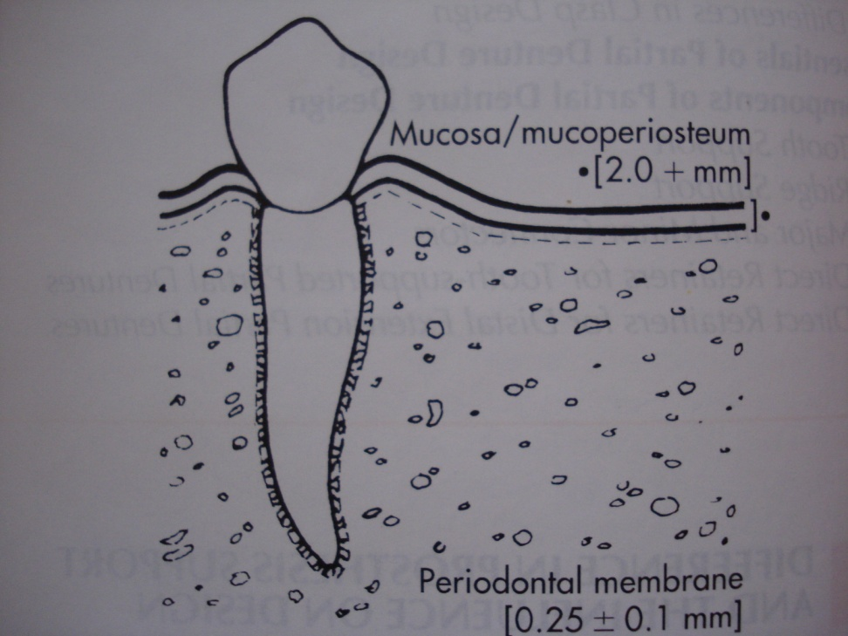
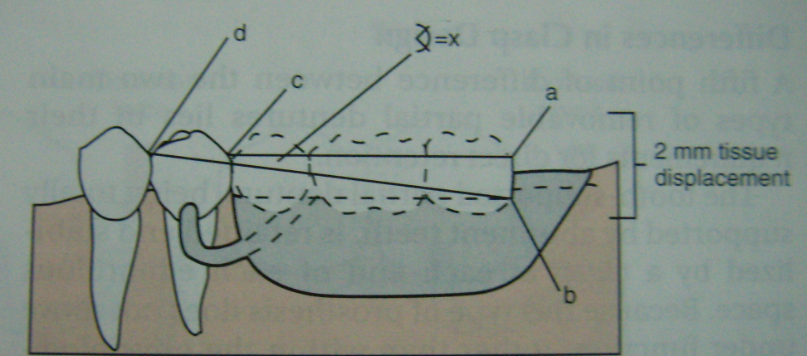
The resiliency of the average tooth under load is 0.1mm, whereas the alveolar ridge, which is 4 to 20 times as displaceable as a natural tooth, may be displaced between 0.4 to 2 mm.

Slide 43
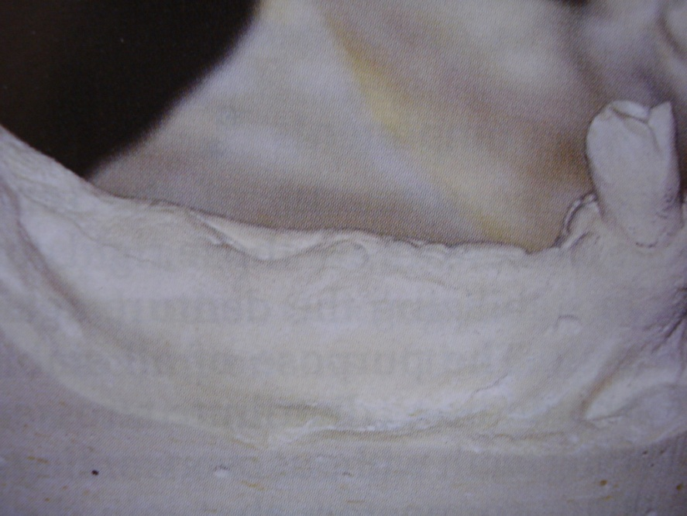
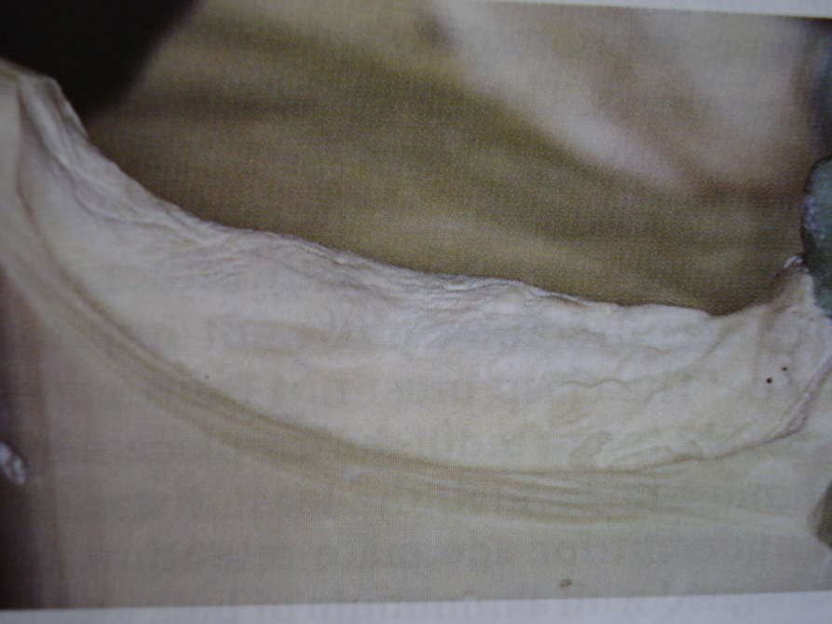
Holmes, demonstrated that movement occurred least with the altered cast technique and Korecta wax impressions.

Slide 44
However, no matter how the impression is made, there will be more movement when the prosthesis is supported by soft tissue. The stress breaker is suggested as a means to allow the base to move slightly with less strain to the abutments.

Slide 45
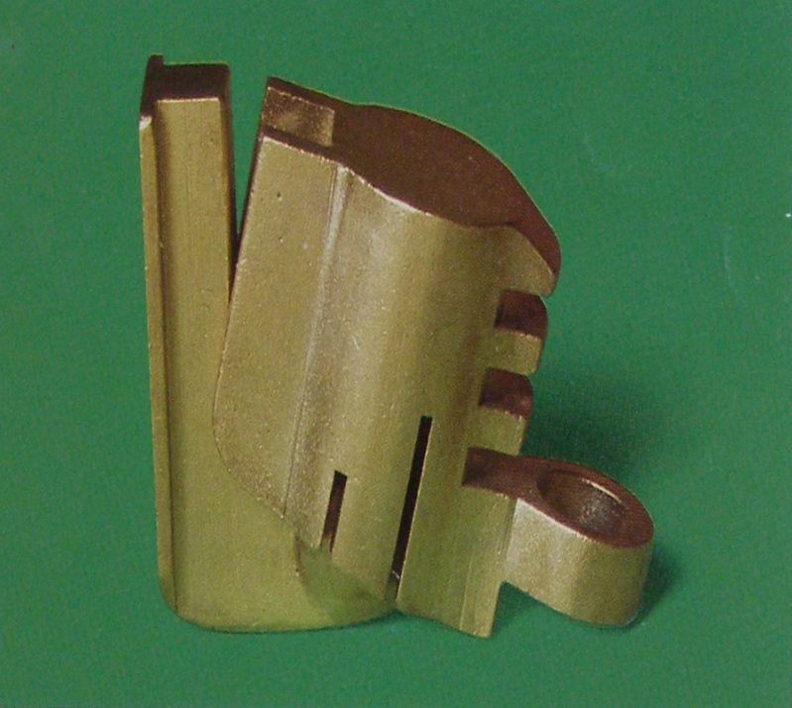

Complexities of stress breaker design
A multitude of stress breaker designs are available including hinges, sleeves and cylinders, ball and sockets, split major connectors etc.

Slide 46
The hinge type stressbreaker has been used extensively and continues to be a popular choice. As the hinge is of a rigid design, the soft tissue absorbs a minimum of load adjacent to the hinge and maximum of load toward the distal of the ridge.

Slide 47
Repair and maintenance of any stressbreaker is difficult, costly and frequently required

Slide 48
STRESS BREAKER OR RIGID DESIGN
Whether or not a stressbreaker should be used continues to be a subject for dispute.
McCrackens states “it is only the improperly designed or ineffectively fabricated rigid restoration that has proved to be harmful to abutment teeth. There is little question that some form of mechanical stressbreaker is preferrable to a poorly designed and ineffectively fabricated rigid restoration”
Conversely, a correctly designed rigid appliance is preferrable to an improperly designed stress breaker

Slide 49
Esthetic factors in RPD
The majority of RPD’s make a significant contribution to the patient’s appearance. A good esthetic result will motivate the patient to wear a new denture.
For the patient, it is the most important reason to seek treatment.

Slide 50
Esthetics in RPD
Denture base
Artificial teeth
Framework design

Slide 51
DENTURE BASE
FLANGE DESIGN
Since the flange replaces the lost alveolar tissue, it should be no thicker than necessary and the borders should be thin rather than thick.
Lateral extension of the flange should be onto the adjacent root eminence tapering to almost knife edge.
The best results when matching flange and mucosa is to use a shade guide of the common brands.

Slide 52
Artificial teeth
When anterior teeth are involved, the partial denture may need to replace all of them. It may replace only one or two.
In the former situation, the problem of selection and arrangement of the teeth are similar to those occuring in complete denture, whereas in the latter situation the basic problem is that of achieving a satisfactory match with the appearance of the surrounding teeth.

Slide 53
Framework design
The individual’s “smile line” is a vital part in judging the visibility of metal components.
It is incumbent on the dentist to properly plan and execute the framework design. This involves recontouring of teeth, surveying and choosing retainer elements that will not be too apparent.

Slide 54
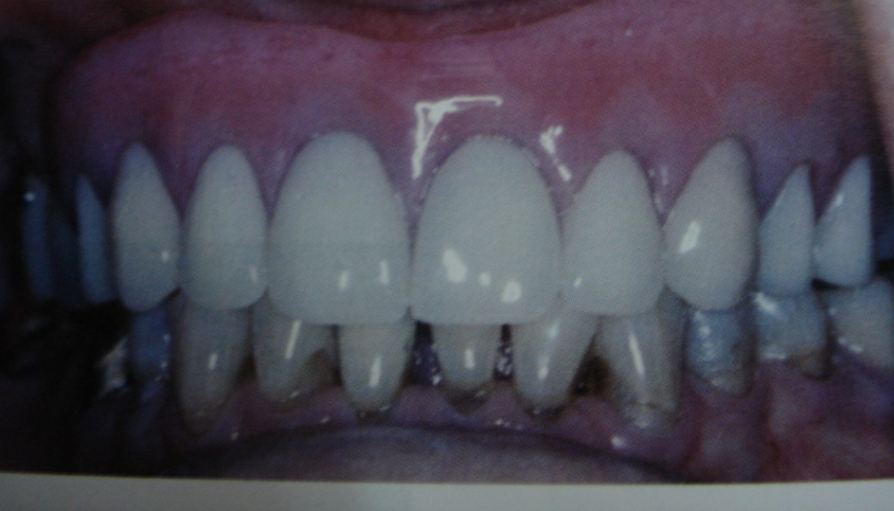
Carefully executed circumferential clasp should be completely cervical and not unnecessary long.
In high lip line patient’s, they are less identifiable

Slide 55
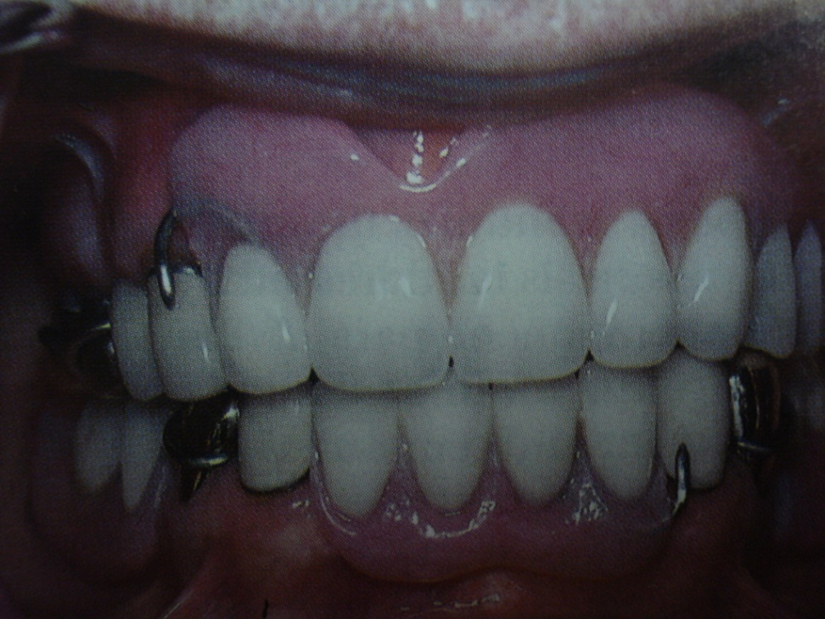
With a low lip line an I-bar may indeed be satisfactory.
Though the standard position of I-bar is midfacial for distal bases, it can often be placed in a distal facial one-third of a bicuspid for better esthetics.

Slide 56
Integrating fixed and removable prostheses
The crowned abutment
When restoration of an abutment with a cast crown is indicated, a decision must be made regarding material to be used.

Slide 57
Undoubtly, the best results will be gained from the simplest unit- the all gold veneer crown.
The ceramo-metal unit should be used only when the esthetic demands warrants use of a veneer material.
All ceramic restorations should not be employed as an integrating abutment.

Slide 58
A partial veneer retainer may provide an adequate cingulum or occlusal rest but doesn’t allow any modification of the retentive area.
If a resin veneer is used, then the retentive tip must rest on a metal pad or the clasp tip will erode the resin after repeated placement and removal. This doesn’t happen when ceramic veneer is used.
Clasp arm should not abrade any margin of the partial veneer and the retentive tip should not functionally engage any marginal area.

Slide 59
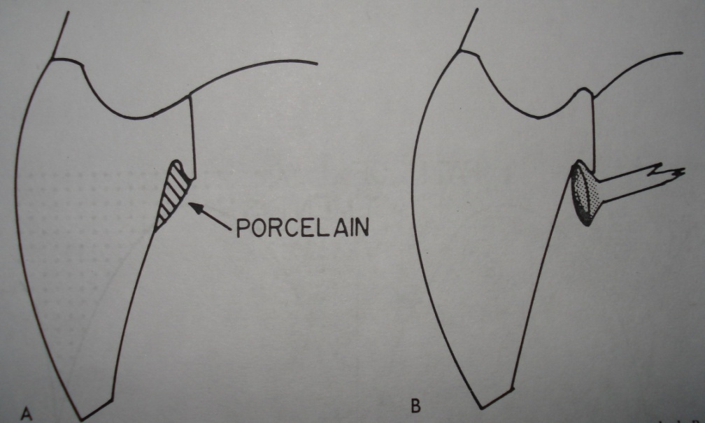
Anterior lingual rest
Cingulum rest seat may be incorporated into any anterior teeth that is being restored with a metal-ceramic unit.
When such seats are required for possible later use, they may be filled with porcelain to restore smooth, normal contours.

Slide 60
Robert W. Rudd and Kenneth D. Rudd reviewed 243 errors possible during the fabrication of a removable partial denture.
They listed the errors in the order that they would occur during the fabrication of an RPD.
J Prosthet Dent 2001;86:251-61

Slide 61
DIAGNOSIS/TREATMENT PLANNING
IMPRESSIONS:
INDEXING AND MOUNTING CASTS IN AN ARTICULATOR
SURVEYING, DESIGNING, AND BLOCKING-OUT CASTS
DUPLICATING CASTS
WAXING AND INVESTING
CASTING AND FINISHING
FITTING THE FRAMEWORK TO THE CAST AND MOUTH
SET-UP AND TRIAL PLACEMENT OF THE REMOVABLE PARTIAL DENTURE

Slide 62
FLASKING THE RPD
ELIMINATING WAX
MIXING AND PACKING ACRYLIC RESIN
PROCESSING THE ACRYLIC RESIN
DEFLASKING AND POLISHING THE RPD
FITTING AND ADJUSTING THE RPD TO THE MOUTH

Slide 63
Each of these procedures can bring about changes in the dimensional accuracy.
Compounding of dimensional change naturally occurs as one progresses through the steps of fabrication

Slide 64
IMPRESSIONS: ERRORS, PROBLEMS,
AND SOLUTIONS
Error: Failing to detect movement of the impression during setting of the irreversible hydrocolloid.
Problem: If the impression tray moves after the impression is seated in the mouth, during the approximately 30-second period required for the irreversible hydrocolloid to change from the fluid to the solid state, the impression will be distorted

Slide 65
Solution: If movement is suspected, the only safe course of action is to remake the impression. The dentist must make a habit of lightly supporting the tray during impression making until the initial set of the irreversible hydrocolloid has occurred

Slide 66
Verify fit of the framework
If the framework fits the cast perfectly but does not
seat properly in the mouth, then the dentist has committed an error and a new impression must be made.

Slide 67
Test for final set of irreversible hydrocolloid
There are 2 reliable ways to determine when to remove an impression from the mouth:
(1) When the irreversible hydrocolloid material remaining in the mixing bowl is no longer tacky, set a timer for 1 minute. At the end of the timed interval, remove the impression.
(2) The most reliable method is to leave some of the mix of irreversible hydrocolloid in the mixing bowl to set. When it is no longer tacky, remove a piece from the mixing bowl, fold it over onto itself, and squeeze it between a thumb and forefinger. If the material breaks cleanly, the impression is ready to remove from the mouth. If it mashes slightly, leave it longer and test the mix again

Slide 68
Error: Leaving the impression in water or other
liquid for more than 12 minutes before pouring it.
Problem: When the impression is left in water for more than 12 minutes before it is poured, the irreversible hydrocolloid absorbs water and expands unevenly and therefore is inaccurate. Thicker areas will expand more than thinner areas.
Solution: Do not try to store an irreversible hydro-colloid impression. Pour it within the required total time of 15 minutes measured from the beginning of mixing. This allows 3 minutes for mixing the irreversible hydrocolloid and making the impression

Slide 69
Error: Leaving an impression for more than 12
minutes in a humidor with 100% humidity.
Problem: The irreversible hydrocolloid may not shrink or expand in a humidor at 100% humidity, but humidity cannot stop syneresis or the release of strains built up in the impression procedure. Thus, the impression will be inaccurate.
Solution: Rather than attempting to store the impression in a humidor, take time to pour it immediately.

Slide 70
Procedure for verifying jaw relation records
After the casts have been mounted in an articulator, check the accuracy of the jaw relation record by inserting a piece of 0.0005 ̋shim stock between 2 opposing teeth of the casts. Close the articulator, and feel how firmly the shim stock is held when it is pulled. Repeat this procedure between the same teeth in the mouth. Check several other occluding teeth on each side of the arch in the same way

Slide 71
If the resistance to the pull of the shim stock feels the same in the mouth as it does on the casts, the jaw relation probably has been transferred correctly to the mounted casts. If the resistance is not the same, remake the jaw relation record, and remount the mandibular cast

Slide 72
CASTING AND FINISHING
Error: Placing a dry investment mold in the
burn out furnace.
Problem: If the investment surrounding the wax pattern is dry as the temperature increases, the molten wax and plastic will soak into the surrounding investment. Some of the residue may solidify and prevent the molten metal from entering the smaller portions of the mold. Moreover, if the investment mold is allowed to dry excessively, the mold may crack during burn out and cause fins on the casting.

Slide 73
Solution: Place molds with invested patterns in a pan of water deep enough to cover the mold half way. Allow the investment to become soaked before placing it in the burn out oven. As the mold is heated, the moisture will create steam to flush the plastic and wax out of the mold.

Slide 74
Error: Improperly positioning the mold in the
casting machine.
Problem: If the mold is positioned in the casting machine so that the thinner sections of the framework are toward the rotating direction of the spinning machine, a negative pressure may cause some parts of the pattern to miscast.

Slide 75
Solution: Take advantage of the centrifugal force. Orient thin sections away from the rotating direction of the casting arm (toward the trailing edge). Additional centrifugal pressure will be placed on the molten metal when it enters the mold. When investing the framework, mark the position of the thin framework sections so that they can be identified easily when the mold is placed in the casting machine.

Slide 76
Methods for attaching denture base resin and denture teeth to the removable partial denture framework
Two basic methods for attaching the denture base resin and denture teeth to the framework are:
open retention and solid metal retention
If the wrong retention method is used, the resin may fracture prematurely, the soft tissues may become inflamed, or the patient may require a reline sooner than expected.

Slide 77
Ladder-type open retention is preferred for use on immature ridges because the widely spaced ladder bars permit relatively easy access for painting irreversible hydrocolloid separating medium on the cast without contacting the metal and because, after it is in service, the RPD can be easily relined at chairside.

Slide 78
Solid metal retention is the preferred choice for mature ridges where the extraction site has healed and recontoured and thus does not require relining soon. This method has several advantages over the open retention methods:
It is stronger; is less likely to fracture (because the resin is placed on top of the metal to give it more support);
and does not require internal finish lines, a relief pad, or placement of irreversible hydrocolloid separating medium underneath the metal

Slide 79
Error : Using dental plaster to invest the RPD
for processing.
Problem: When plaster is used in the place of stone to invest a partial or complete denture, the force of packing and polymerizing the resin may crush the plaster, particularly when a hydraulic press is used. Plaster has a crushing strength of 1300 to 1500 psi. Most hydraulic presses are capable of applying more than 5000 psi very rapidly. If the investing plaster is compressed or crushed, it will cause an increase in the vertical dimension of occlusion.

Slide 80
If plaster is used for investing, the base of the cast must touch the metal bottom of the flask. Seat the cast forcefully to make certain that it is in contact

Slide 81
Error: Using a hydraulic press to close the flask
when packing acrylic resin.
Problem: A hydraulic press closes the flask so rapidly that the excess resin does not have time to flow out of the mold; tremendous pressure thus builds. This may increase the vertical dimension of occlusion or fracture the stone investment.

Slide 82
Solution: A hydraulic press is capable of applying approximately 20 times more pressure than the flask and investing stone can withstand. Use a hand press for trial packing. It will not be possible to apply as much pressure, and the slower operation will allow the excess resin to flow out of the mold.

Slide 83
Error: Using a hand press improperly.
Problem: Even when a hand press is used, the flask in the press can be closed too rapidly and thus not allow the acrylic resin to flow out of the mold. Pressure buildup may result in an increased vertical dimension of occlusion.
Solution: To eliminate excess pressure, close the hand press until it meets resistance. Wait a minute for the resin to flow before giving it another turn. Repeat this until the hand press cannot be turned any more. Allow time for the resin to flow before opening the flask to trim the flash.

Slide 84
Error: Failing to show the patient how to seat
and remove the RPD.
Problem: If the patient does not seat the RPD correctly, he/she may warp the RPD or be injured by it.
Solution: Demonstrate how to place the RPD in the patient’s mouth so that it is centered on top of the teeth and how to push the RPD into place with the fingers. Warn the patient about the destruction that may result if he/she bites on the RPD to seat it.

Slide 85
SUMMARY
The secret to a successful RPD is attention to minute details. It takes no longer to do it right the first time than to correct mistakes down the road
The most important step in making a removable partial denture is the step being done at any given moment.
The dental team’s ultimate goals should be to produce RPDs that are a credit to the dentist and technician, improve the patient’s well-being, and satisfy the patient’s needs.

Slide 86
REFERENCES
Symposium on Common Failures In Removable Partial Prosthodontics. Vol.23, No.1, January 1979
Alan B Carr, Glen P, David T Brown. Mc Cracken’s Removable Partial Prosthodontics. 11th edition
Kenneth Stewart , Kenneth Rudd. Clinical Removable Partial Prosthodontics. Second edition

Slide 87
Ramadan FA. The linear effectiveness of dental tissue displacement materials. St. Louis University Graduate School. 1969
Holmes JB.: Influence of impression procedures and occlusal loading on partial denture movement. J Prosthet Dent;15:474, 1965
Dennis J Abere. Post placement care of removable partial dentures. J Prosthet Dent;23:115-117, 1979
William Heintz. Factors influencing the success of removable partial dentures. J Prosthet Dent;31:48-52, 1986

Slide 88
Robert W. Rudd, Kenneth D. Rudd.A review of 243 errors possible during the fabrication of a removable partial denture: Part I, II,III. J Prosthet Dent;86:474, 2001
M. Saito, K. Notani, Y. Miura & T. Kawasaki. Complications and failures in removable partial dentures: a clinical evaluation
Journal of Oral Rehabilitation, Volume 29, Issue 7, Page 627-633, Jul 2002
C. Vanzeveren, W. D'Hoore, P. Bercy, G. Leloup (2003).Treatment with removable partial dentures: a longitudinal study.
Journal of Oral Rehabilitation 30 (5), 447–458.

