Slide 1
ETHICS AND DENTISTRY
- DR. ASHISH SHARMA

Slide 2


Slide 3
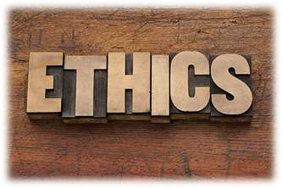
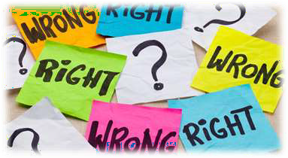
DEFINITION
▶ Ethics is the philosophy of human conduct, a way of stating and evaluating principles by
which problems of behaviour can be solved.
▶ Ethics is concerned with standards judging whether actions are right or wrong.

Slide 4
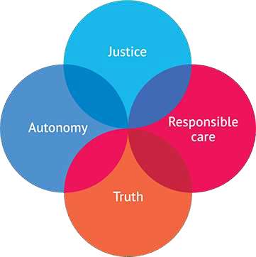
EHICAL PRINCIPLES
to do no harm[non-maleficence]
to do good[beneficence]
respect the person
Justice
veracity or truthfulness
confidentiality

Slide 5

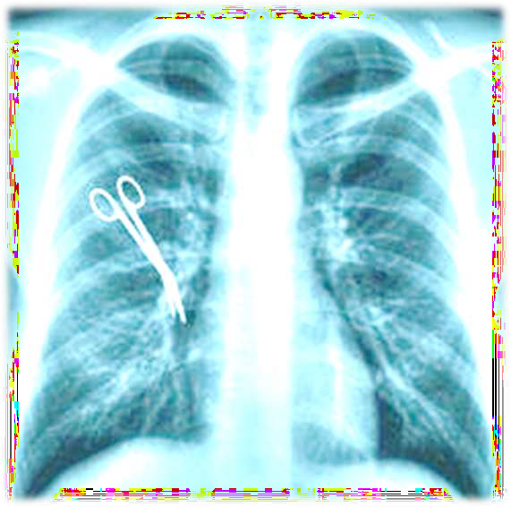


TO DO NO HARM
▶ considered to be the foundation of social
morality even though dental professionals
know they tend to break rules.
▶ Iatrogenic diseases-doctor induced illness.
▶ When patient is in pain the doctor should
attempt to
minimise the pain minimal treatment
if not
or no
alternative
treatment is to be given.

Slide 6



TO DO GOOD
▶ Dentist role is to benefit the patients not to inflict them harm
▶ Attempts to maximise the benefits and minimize harm

