Slide 1
FIBROOSSEOUS LESIONS
DR. BHADRA SHAH
Head of the Department
Dept of oral medicine and radiology

Slide 2
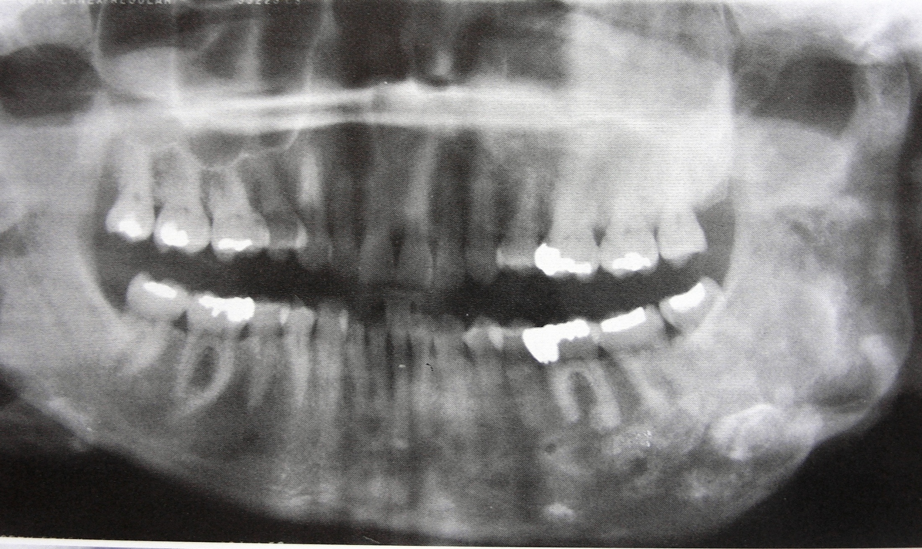
Fibrous Dysplasia

Slide 3
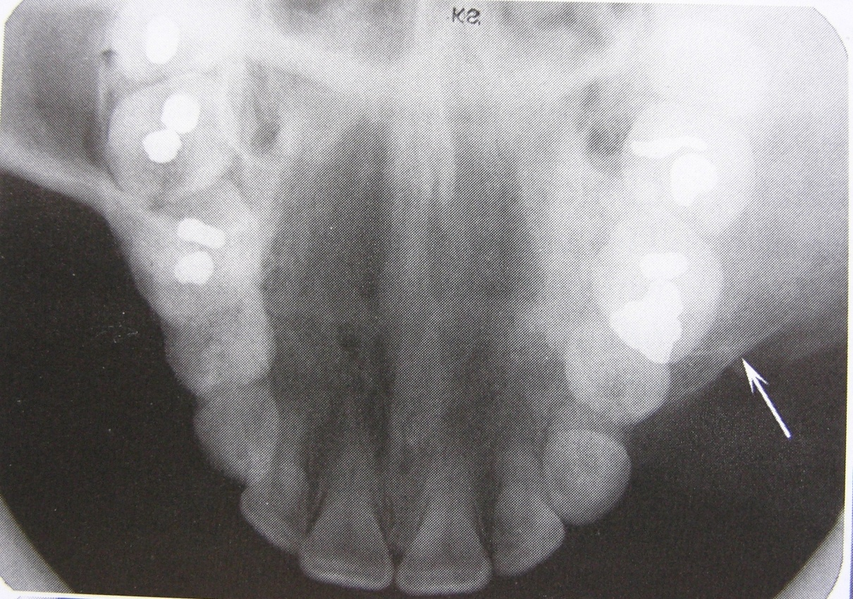
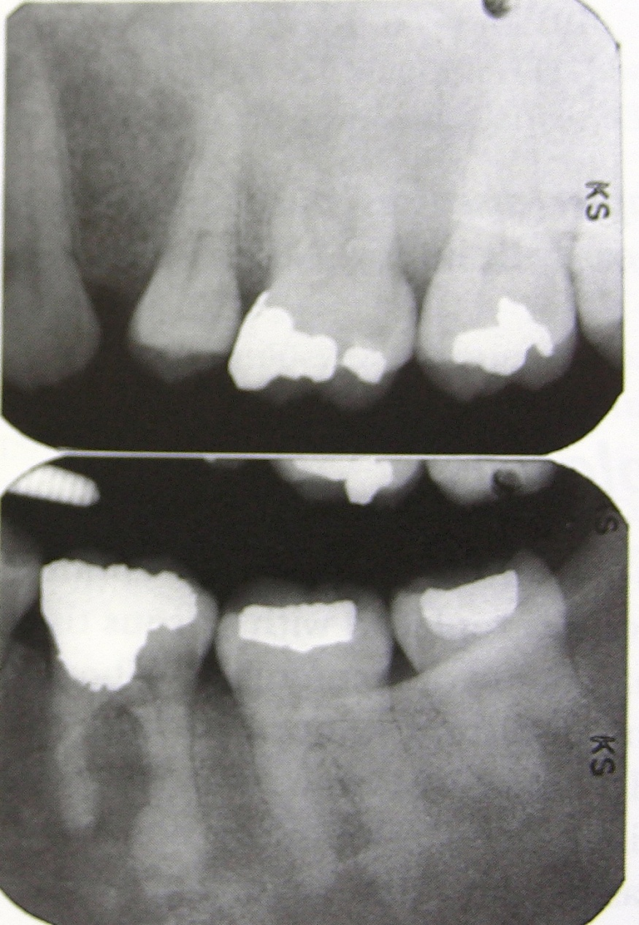
Cystlike, ground glass (granular),
orange peel, Fingureprint,
whispy (cotton wool), amorphous
Dense pattern

Slide 4
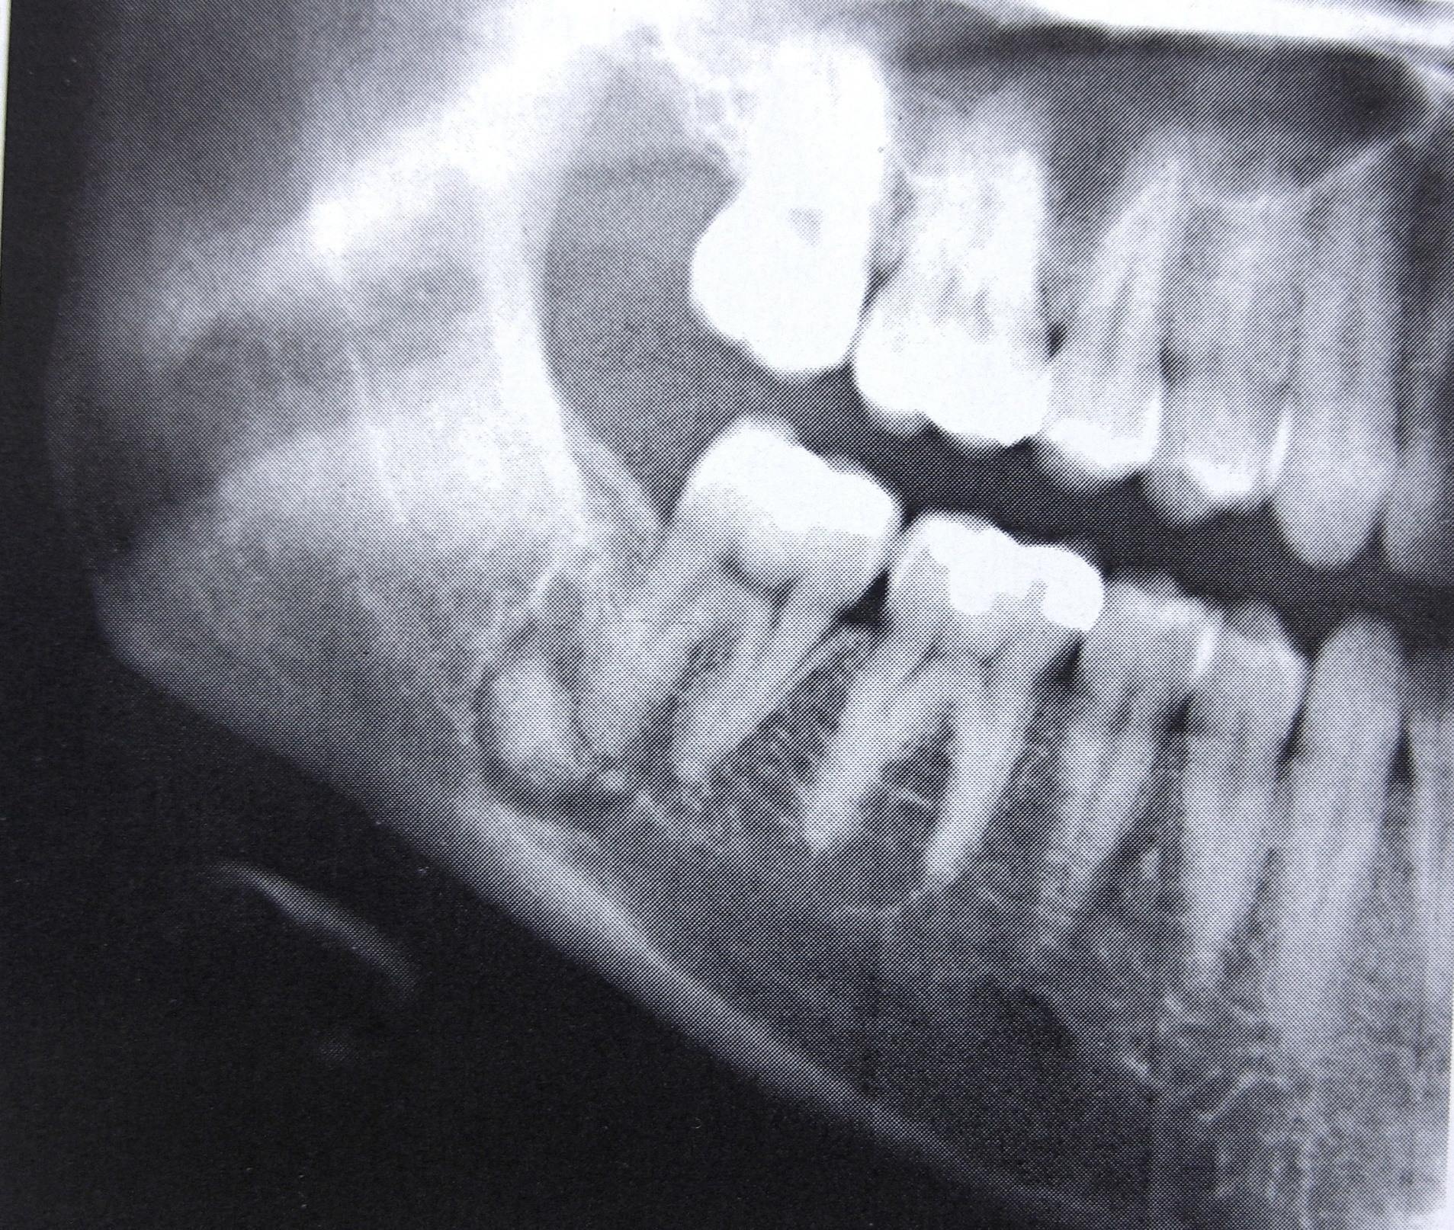

Slide 5
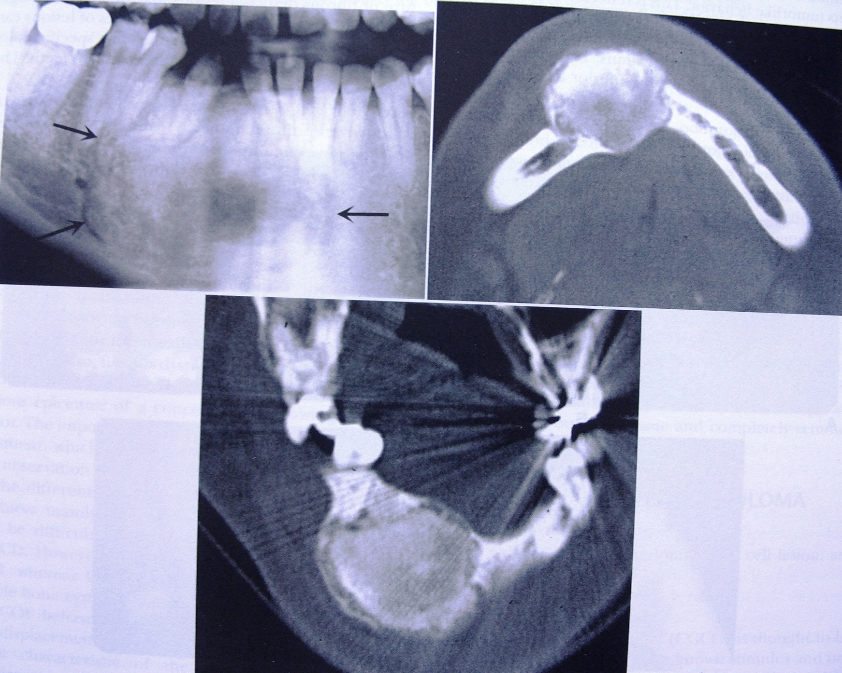
Cementifying Fibroma
Homogenous
RO str
Fibrous
Capsule
RL

Slide 6
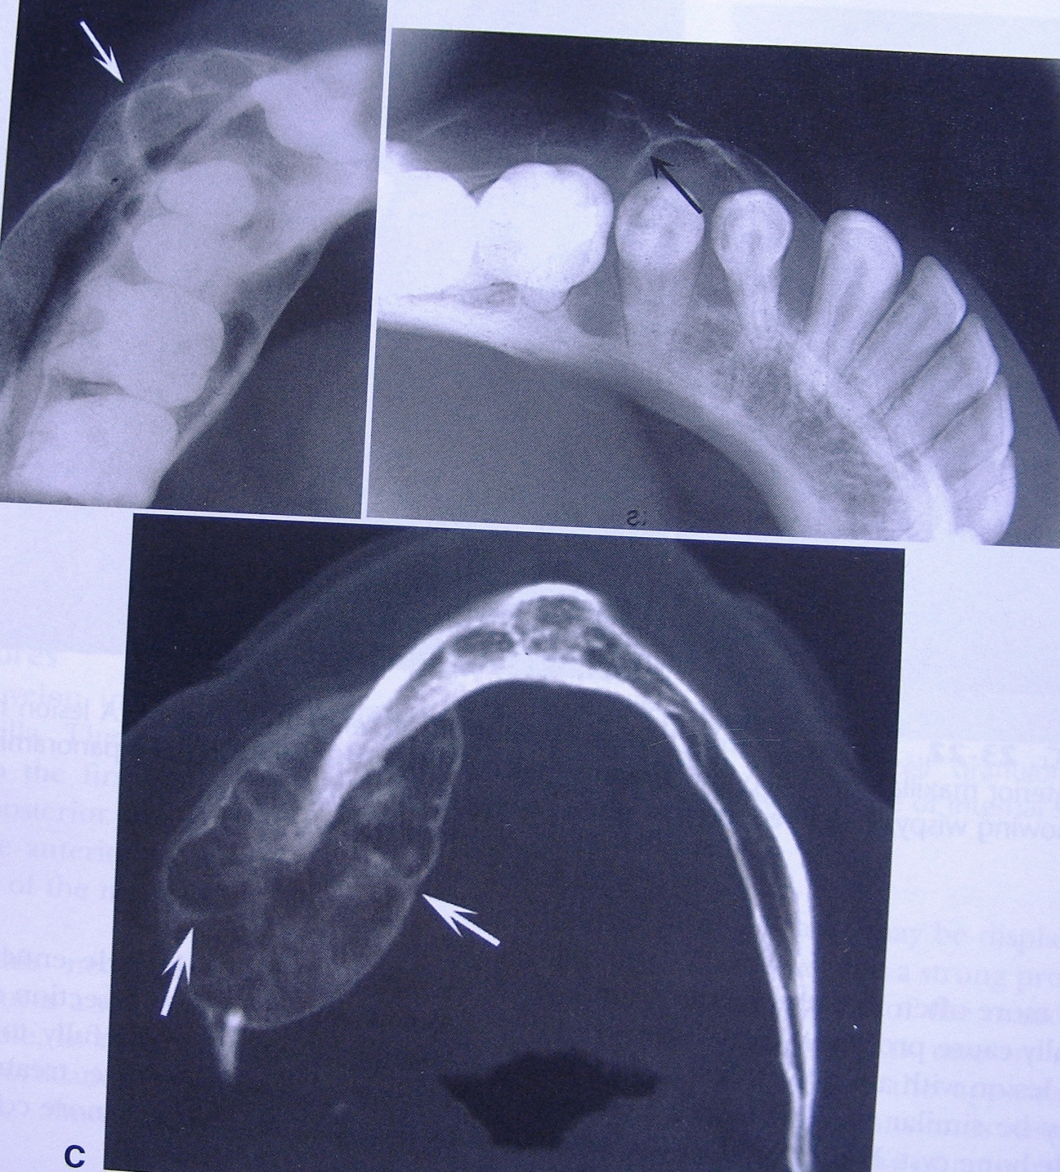
A-Uneven expansion
B- Indentation of
the expansion
with right angled
septa
C- Axial CT, two
right angled septas
Creating multilocular appearance.

