Slide 1
Inlay and modifications
Dr Urvashi Ujariya

Slide 2
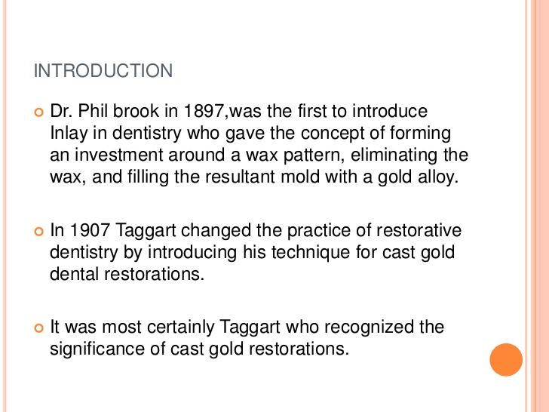

Slide 3
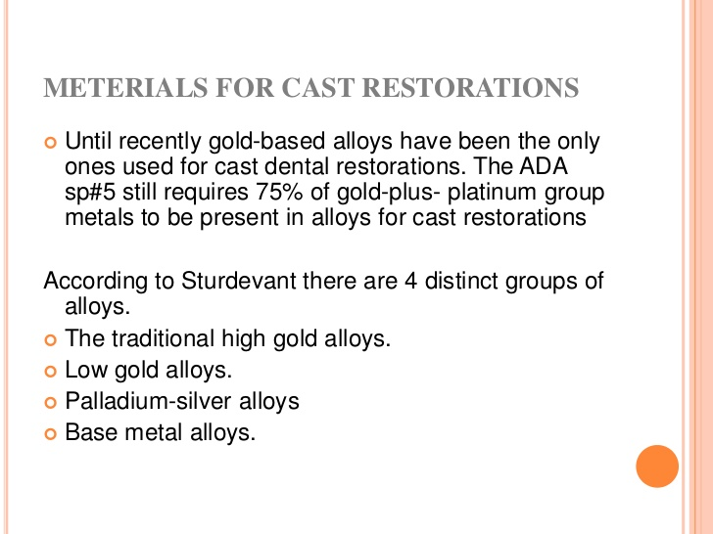

Slide 4
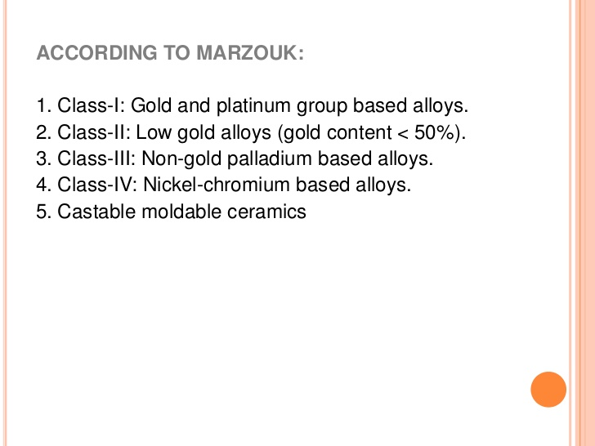

Slide 5
