Slide 1
Introduction:Dental Anatomy
Dr.Kinnari H.Patel,
Prof and Head,
Dept of oral Pathology,
AMC Dental College and Hospital, Ahmedabad

Slide 2

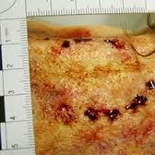

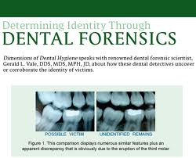
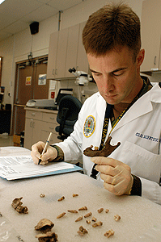
Functions of Teeth
1.Mastication :Primary function which includes cutting, shearing and chewing.
2.Growth:Skull and many facial structures along with development of teeth.
3.Deglutition/Swollowing
4.Phonation
5.Aesthetics
6.Protection:To soft tissue of mouth
7.Defence:In animals
8.Forensic odontology

Slide 3
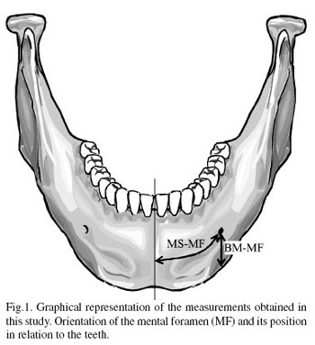
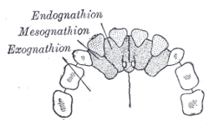
Mandible:made up of a single pair of bones,complete lower jaw.
Maxilla:Part of upper jaw that contains canines,premolars and molar teeth.
Premaxilla:Paired bone in front of maxilla,which contains incisors.

Slide 4
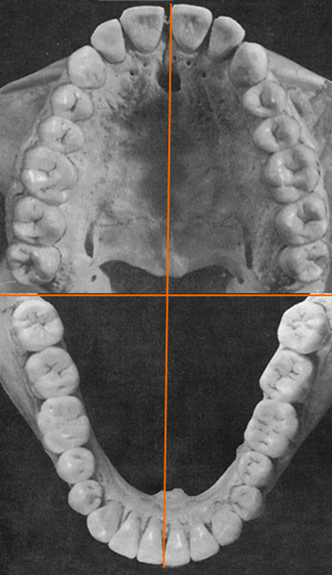
Division in to quadrants

Slide 5
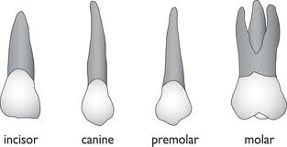

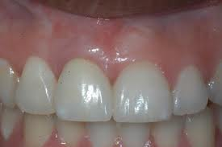
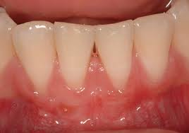
Types of teeth
Based on – Function
Appearance
Position/location
1.Incisors :used to incise or cut food.
Located in front of the oral cavity
Sharp, thin edges for cutting.

Slide 6
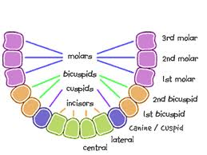
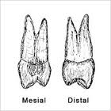
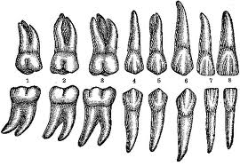
2.Canines/Cuspids :Cutting/tearing
single cusp instead of incisal edge
3.Bicuspids/Premolars: two cusps
cutting,tearing and crushing
Anterior to molars
4.Molars: Located posteriorly
Size becomes smaller from 1st to 3rd
Shorter
Provide broad surface for grinding

Slide 7
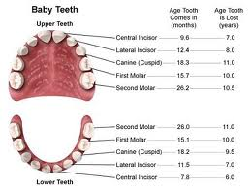
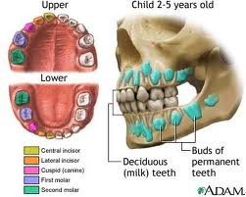
Deciduous dentition
(Milk teeth,baby teeth,primary teeth,temporary teeth,lacteal teeth,Juvenile teeth)

