Slide 1
LASERS IN PERIODONTICS
Dr Bela Dave (MDS)
Professor and Head
Department of Periodontology
AMC Dental College and Hospital, Ahmedabad

Slide 2
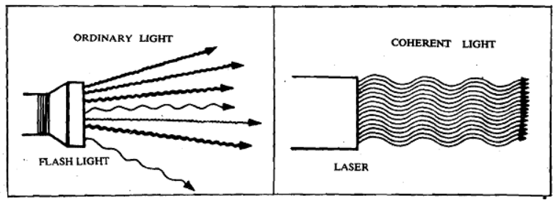
Introduction
A laser is a device that emits light (electromagnetic radiation) through a process of optical amplification based on the stimulated emission of photons.
• L – Light
• A – Amplification by
• S – Stimulated
• E – Emission of
• R – Radiation

Slide 3
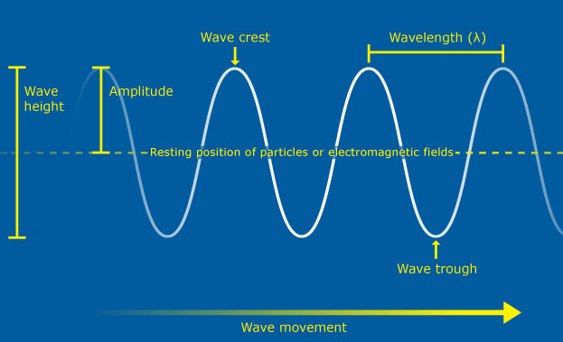
Light
• Light is a form of electromagnetic energy that behaves as both particle and wave.
• Basic unit or quanta of light is called Photon.
• Important terms
– Velocity - speed of light
– Amplitude – height of wave of oscillation
– Wavelength – distance a photon travels when the electric field completes one complete oscillation
– Frequency – Frequency is the number of complete oscillations of the wave per second.

Slide 4
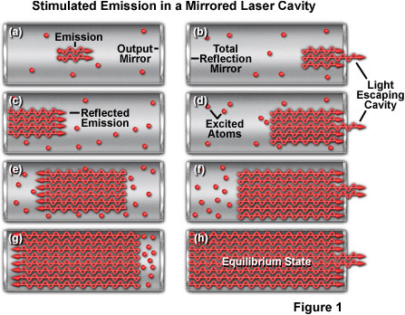
Amplification
It means that a very bright intense beam of light can be created.
The laser may be activated by a few photons, but then many, more are generated.
Population inversion occurs while a system (such as a group of atoms or molecules) exists in a state in which more members of the system are in higher, excited states than in lower, unexcited energy states.
Notes:
Population inversion can be achieved by optical pumping at a suitable wavelength

Slide 5
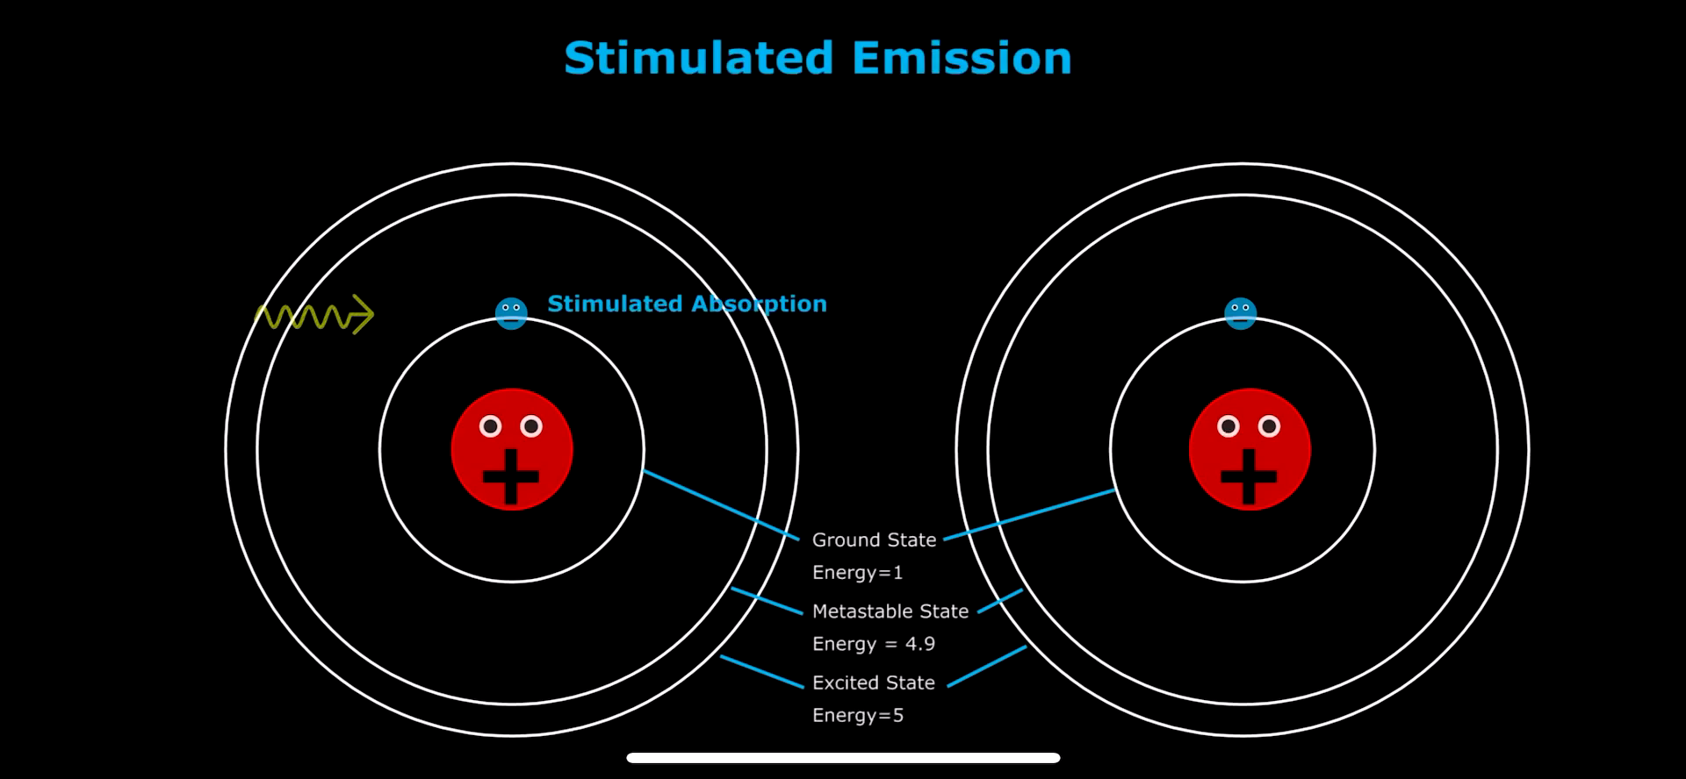
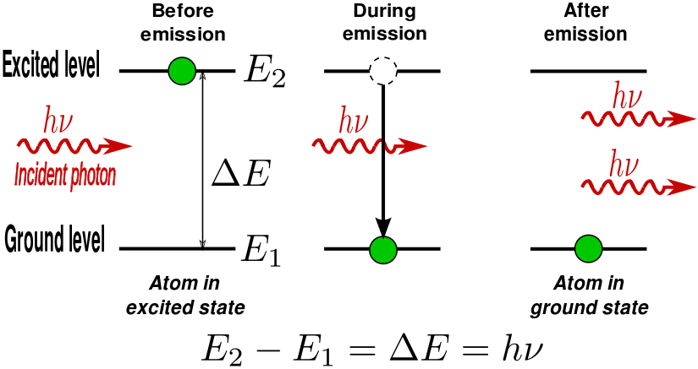
Stimulated
It means that the photons are amplified by stimulating an atom to release more photons.
• An atom can exist in an excited state, similar to a bow when it is stretched.
• When the atom relaxes it emits a photon.

Slide 6
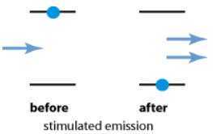
Emission
It refers to the giving off of photons.
The excited atom emits a photon when another photon comes by.
In 1917, Einstein described this process as Stimulated Emission

Slide 7
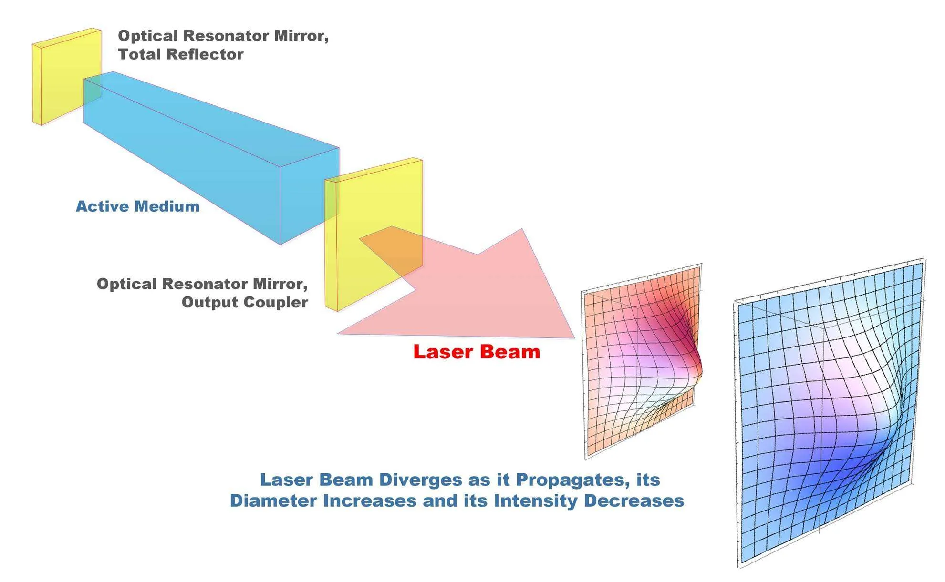
Radiation
It is a term for anything that is radiated, or given off by an object.
For lasers, radiation refers to the PHOTONS which are being emitted.

Slide 8
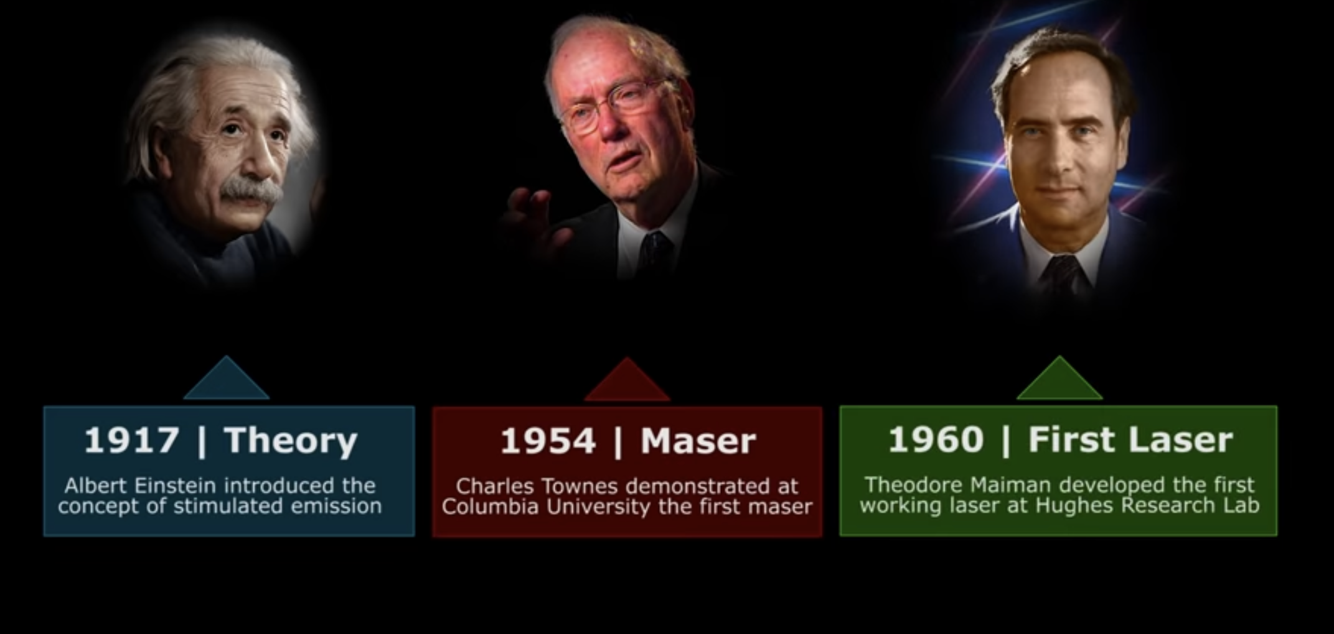
History of Lasers

Slide 9
Date | Name | Achievement
1916 | Albert Einstein | Theory of light emission. Concept of stimulated emission
1951 | Charles H Townes | The inventor of the MASER (Microwave Amplification of Stimulated Emission of Radiation) at Columbia University - First device based on stimulated emission, awarded Nobel prize 1964
1957 | Gordon Gould | First document defining a LASER; notarized by a candy store owner. Credited with patent rights in the 1970s.
1960 | Theodore Maiman | Invented first working LASER based on Ruby. May 16th 1960, Hughes Research Laboratories.
1961 | Lloyd G. Cross | First commercial laser company, Trion Instruments, Third Ruby Laser, Trion became Lear-Siegler, Laser Systems Center in 1962
1964 | J.E.Geusic, H. M. Markos, L.G.Van Uiteit, Bob Thomas | Inventor of first working Nd:YAG LASER at Bell Labs
1964 | Kumar N. Patel | Inventor of CO2 LASER at Bell Labs.
1964 | William Bridges | Invention of Argon Ion LASER at Hughes Labs

Slide 10
Components of Laser
Components
Active Medium
Pumping Mechanism
Optical resonator

Slide 11
Active Medium
Active Medium is the material in the core of the laser, can be gas, solid, liquid, or crystals and are usually the name of the laser.
A material, capable of absorbing the energy produced by an external extension source through the subatomic configuration of its component molecules, atoms or ions which can subsequently give off this excess energy as photons of light.
Gas lasers use carbon dioxide, argon, krypton, and mixtures, such as helium-neon.
Solid lasers use crystals and glasses.
Liquid lasers use liquid dye.

Slide 12
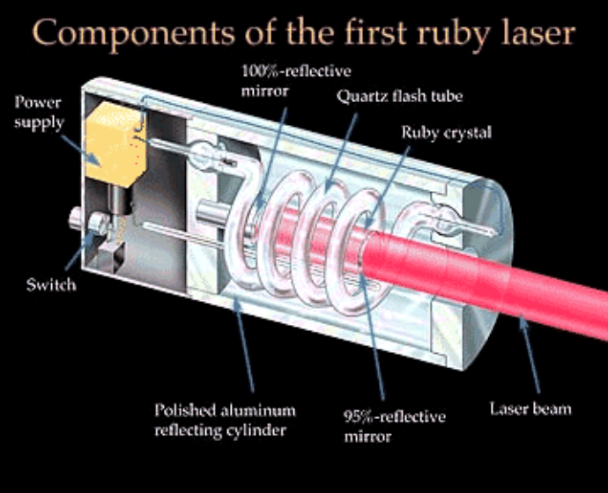
Pumping Mechanism
An energy source is used to excite or pump the atoms in the lasing medium. (Flash light, arc light, diode laser unit, electromagnetic coil)

Slide 13
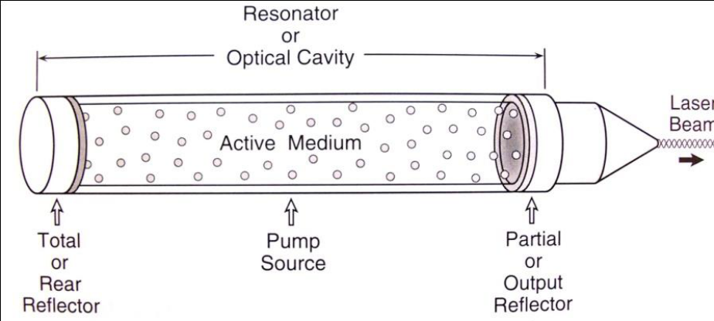
Optical Resonator
Laser light produced by the stimulated active medium is bounced back and forth through the axis of the laser cavity, using two mirrors placed at either end, thus amplifying the power. The distal mirror is partially transmissive, so that at a given energy density, laser light will escape to be transmitted to the target tissue.

Slide 14
Properties of Laser Beam
Properties
Monochromaticity
Coherence
Brightness
Directionality

Slide 15
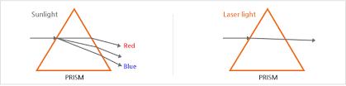
Monochromaticity
It means that all the light waves have the same wavelength & frequency when they are emitted from the same source.

Slide 16
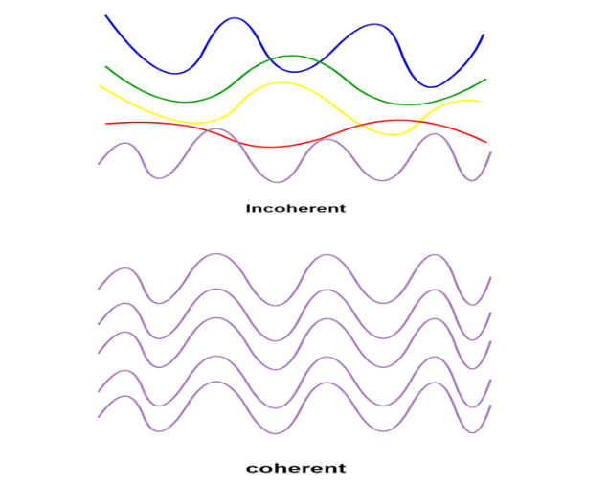
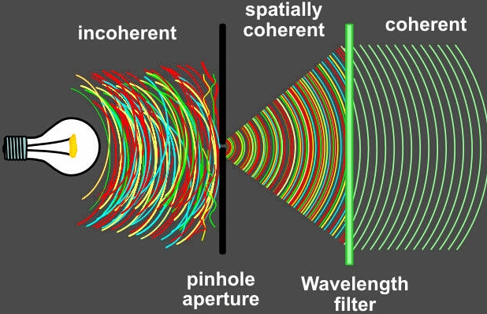
Coherence
When two waves are exactly ―in step with each other & remain exactly ―in step with each other; they are said to be coherent.

Slide 17
Directionality
Laser beam is highly directional, which implies laser light is of very small divergence. This is a direct consequence of the fact that laser beams come from the resonant cavity, and only waves propagating along the optical axis can be sustained in the cavity.
Directionality of the laser correlates with the emission of an extremely narrow beam of light that spreads slowly. Within the laser apparatus, efficient collimation of photons into a narrow path results in a divergence factor of approximately 1 mm for every meter traveled. Directionality allows the laser beam to be focused on a very small spot size.

Slide 18
Brightness
A laser has brightness many times in magnitude greater than that of conventional source due to high directional property of laser beam.

Slide 19
Laser-Tissue Interaction
Depending on the optical properties of the tissue, the light energy from laser may have 4 different interactions with target tissue as follows:
Reflection
Transmission
Scattering
Absorption

Slide 20
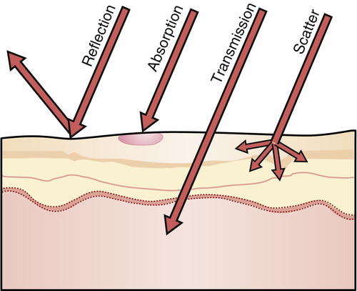

Slide 21
REFLECTION:
Here the beam is being redirected off the surface with no effect on target tissue. Laser beam generally becomes more reflective as the distance from the handpiece increases.
TRANSMISSION:
Here laser energy is transmitted directly through the tissue with no effect on target tissue. This effect is highly dependent on the wavelength of laser light.

Slide 22
SCATTERING:
Scattering causes the photons to change directions, leading to increased chances of interactions with predominant chromophores of those wavelengths. Scattering of laser beam could also cause heat transfer to tissue adjacent to the surgical site and cause unwanted damage.
ABSORPTION:
Absorption of laser energy by intended target tissue is the usual desirable effect. Amount of energy absorbed by the tissue depends on tissue characteristics such as pigmentation and water content.

Slide 23
Categories of Interaction
Interaction
Photothermal
Photochemical
Photoablation
Photodisruption

Slide 24
Photochemical
Photons excite molecules or atoms, making the molecules more likely to undergo chemical reactions with other molecules. In photodynamic therapy, for instance, a photosensitizers (a molecule that becomes reactive when it absorbs light and can therefore induce chemical reactions within other molecules or tissue) causes the formation of reactive oxygen species which lead to both necrosis (cell death) and apoptosis (‘programmed’ cell death).
Photodynamic therapy is increasingly widely used in oncology to destroy cancerous tumors.

Slide 25
Photothermal
Photons are absorbed by a chromophore (a light-absorbing molecule) and converted into heat energy, which can cause a range of thermal effects from tissue coagulation to vaporization.
Applications include tissue cutting and welding in laser surgery.

Slide 26
Photoablation
High-energy, ultraviolet (UV) photons are absorbed and, because they are more energetic than the chemical bonds holding the molecules together, it causes the dissociation of the molecules. This is followed by rapid expansion of the irradiated volume and ejection of the tissue from the surface. In plasma-induced photoablation a free electron is accelerated by the intense electric field in the vicinity of the laser beam. By colliding with a molecule and freeing another electron, it initiates a chain reaction of similar collisions, resulting in a plasma: a soup of ions and free electrons.
This mechanism is used in corneal surgeries in Ophthalmology.

Slide 27
Photo Disruption
The final set of related mechanisms, grouped under the term photo disruption, are the mechanical effects that can accompany plasma generation, such as bubble formation, cavitation, jetting and shockwaves.
These can be used in lithotripsy (breaking up kidney or gallstones).

Slide 28
Types of Laser
A. According to their power:
a) High power laser
b) Medium power laser
c) Low power laser
B. According to their mode of emission:
a) Fractioned
b) Continuous
c) Pulsed

Slide 29
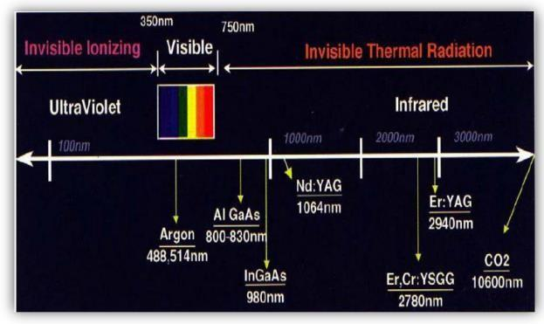
C. According to the emitting material:
a) Gas laser
b) Solid state laser
c) Dye laser
d) Semiconductor diode laser
e) Ring laser
D. According to the wavelength (nanometers):
a). UV (ultraviolet) range – 140 to 400 nm
b). VS (visible spectrum) – 400 to 700 nm
c). IR (infrared) range – more than 700 nm.

Slide 30
E. According to the type of tissue being acted upon:
a) Hard tissue lasers- The hard tissue lasers are used to cut precisely into bone and teeth, to prepare teeth surfaces for bonding, to remove small amounts of tooth structure, and to repair certain worn down dental restorations.
b) Soft tissue lasers- Soft tissue lasers penetrate soft tissue while sealing blood vessels and nerve endings. This is the primary reason why many people experience virtually negligible bleeding and no postoperative pain following the use of a laser. Also, soft tissue lasers allow tissues to heal faster.

Slide 31
Emission Modes
Continuous wave: The beam is emitted at one power level continuously as long as the device is activated by pressing the foot switch.
Gated pulse mode: There are periodic alterations of the laser energy being on and off, similar to a blinking light. This mode is achieved by the opening and closing of a mechanical shutter in front of the beam path of a continuous wave emission. Duration of on and off times normally is as small as a few milliseconds.
Free running pulsed mode: This mode is unique in that large peak energies of laser light are emitted for an extremely short time span, usually in micro seconds, followed by a relatively long time in which the laser is off.

Slide 32
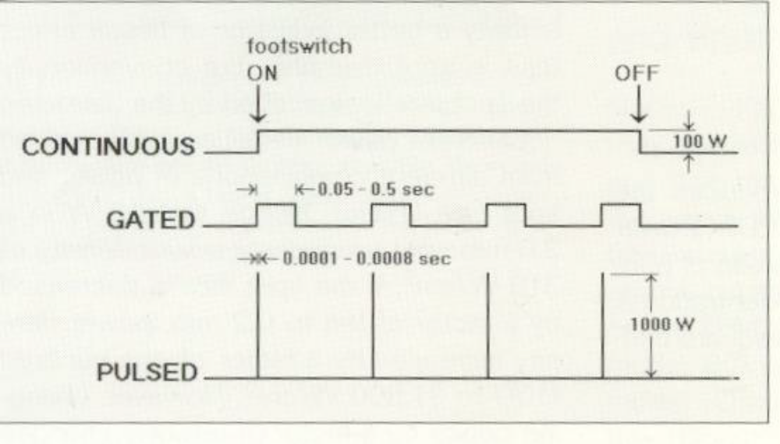

Slide 33
Commonly Used LASERs
Argon
Diode
Erbium Family
Carbon Dioxide
Neodymium:YAG

Slide 34
Argon
Argon is a laser with an active medium of argon gas.
It is fiber optically delivered in continuous wave and gated pulsed modes.
It is surgical laser device whose light is radiated in the visible spectrum.
There are two emission wavelengths used in dentistry: 488 nm, which is blue in color, and 514 nm, which is blue green.

Slide 35
The 514-nm wavelength has its peak absorption in tissues containing hemoglobin, hemosiderin, and melanin; thus, it has excellent hemostatic capabilities.
Acute inflammatory periodontal disease and highly vascularized lesions, such as a hemangioma, are ideally suited for treatment by the argon laser.
The wavelength is poorly absorbed in both dental hard tissues and in water. The poor absorption into enamel and dentin is advantageous when using this laser for cutting and sculpting gingival tissues because there is minimal interaction and thus no damage to the tooth surface during those procedures.

Slide 36
DIODE
Diode is a solid active medium laser, manufactured from semiconductor crystals using some combination of aluminum or indium, gallium, and arsenic.
The available wavelengths for dental use range from about 800 nm for the active medium containing aluminum to 980 nm for the active medium composed of indium.
Each machine delivers laser energy fiber optically in continuous wave and gated pulsed modes and is used in contact with soft tissue for surgery or out of contact for deeper coagulation.
Some clinicians prefer to initiate the end of the fiber with a small amount of carbon pigment and refer to this as a ‘‘hot tip.’’ This method focuses a large amount of laser energy at the contact point and accelerates tissue incisions.

Slide 37
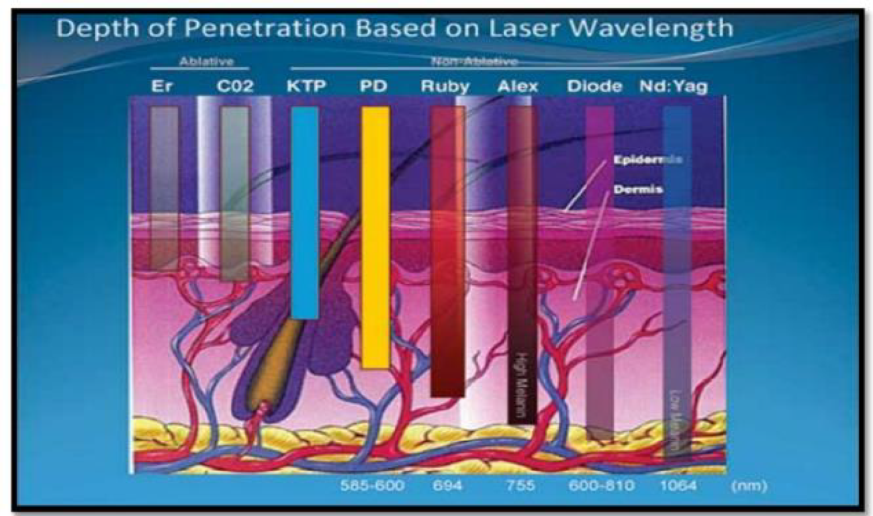
All of the diode wavelengths are highly absorbed by pigmented tissue and are deeply penetrating, although hemostasis is not as rapid as with the argon laser.
The diode is an excellent soft tissue surgical laser and is indicated for cutting and coagulating gingiva and mucosa and for sulcular debridement.
The chief advantage of the diode lasers is one of a smaller size, portable instrument.

Slide 38
NEODYMIUM:YAG
Nd: YAG has a solid active medium, which is a garnet crystal combined with rare earth elements yttrium and aluminum, doped with neodymium ions.
The available dental models have an emission wavelength of 1064 nm, which is in the invisible near-infrared portion of the electromagnetic spectrum.
These instruments operate only in a free-running pulsed mode.
The laser energy is highly absorbed by melanin but is less absorbed by hemoglobin than the argon laser and is approximately 90% transmitted through water.
Nd: YAG laser energy is slightly absorbed by dental hard tissue, but there is little interaction with sound tooth structure, allowing soft tissue surgery adjacent to the tooth to be safe and precise.

Slide 39
ERBIUM FAMILY
There are two distinct wavelengths that use erbium; Erbium, chromium: YSGG (2780 nm) and Erbium: YAG (2940 nm).
Both of these wavelengths are placed at the beginning of the mid infrared, invisible, and nonionizing portion of the spectrum.
Used in free-running pulsed mode.
These two wavelengths have the highest absorption in water of any dental wavelength and have a high affinity for hydroxyapatite.
Clinical use is caries removal, cavity preparation, osseous surgery, soft tissue debridement.

Slide 40
CARBON DIOXIDE (CO2)
The CO₂ laser is a gas-active medium laser that incorporates a sealed tube containing a gaseous mixture with CO₂ molecules pumped via electrical discharge current.
Wavelength: 10,600nm
Mode: Pulsed and continuous , non-contact mode.
Absorption by water: very effective for the surgery of soft tissues, which have a high water content.
This wavelength is well absorbed by water. It can easily cut and coagulate soft tissue, and it has a shallow depth of penetration into tissue, which is important when treating mucosal lesions.

Slide 41
CLINICAL APPLICATIONS
Frenectomy,
Gingivectomy and Gingivoplasty,
Removal of granulation tissue,
Second-stage exposure of dental implants,
Incisional and excisional biopsies of both benign and malignant lesions,
Irradiation of aphthous ulcers,
Gingival depigmentation.
Treatment of Dentinal hypersensitivity

Slide 42
ADVANTAGES
Hemostasis
Accuracy
Rapid healing
Reduced inflammation
Lack of scar tissue formation
Low level of discomfort
Sterilization of wound due to reduction in amount of microorganism.

Slide 43
DISADVANTAGES
Technical difficulties
Lack of precision in depth of cut
Tissue not available for histopathology
Hazardous
The cost and size of laser device

Slide 44
ROOT SURFACE MODIFICATION
Surface modification of cementum and dentin has been studied using a variety of laser wavelengths, primarily CO2, Nd:YAG, Er:YAG and to a lesser extent, the diode laser.
A major conceptual consideration in laser-induced root surface modification is selection of a wavelength that will effectively remove calculus while suppressing both thermal damage to the pulp tissue and undesired removal of sound root structure.
Consequently, of the laser wavelengths studied, the Er:YAG laser would appear to be the instrument of choice.

Slide 45
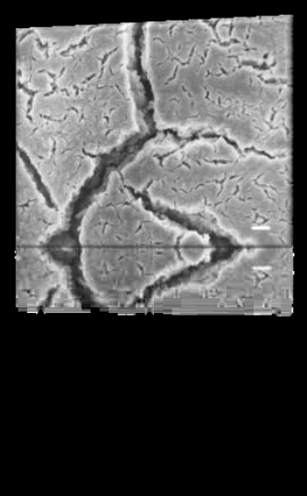

The continuous wave laser readily produces
➢ carbonization,
➢ melting, and
➢ cracking of root cementum and dentin. ( Sasaki 2002)
However, when used with relatively low energy output in a pulsed and/or defocused mode, laser may have:
➢ Root conditioning,
➢ Detoxification and
➢ Bactericidal effects on the contaminated root surfaces. (Israel et al. 2007)
Co2 Laser
Er:YAG Laser

Slide 46
Pulse Er:YAG with water irrigation causes
➢ effective calculus removal
➢ little temperature increase and
➢ minimum cementum ablation. (Aoki 2003)
Partial removal and detachment of the calculus from the root surface with the Nd:YAG laser at 2.0 or 2.75Wand 20 Hz
Disadvantage: 1) melting of calculus, 2) thermal damage in localized areas of the
original cementum and even dentin after irradiation at high power.
Use of higher energy levels may ablate calculus more efficiently but may be inappropriate for clinical usage due to increased thermal side effects.

Slide 47
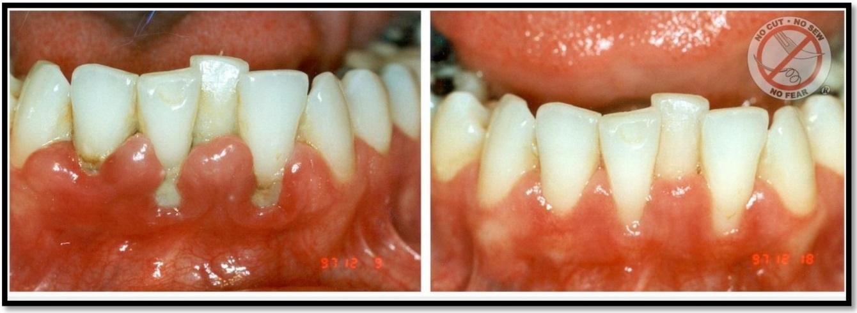
NON SURGICAL PERIODONTAL THERAPY (NSPT)
One essential criterion for selection of an appropriate wavelength for nonsurgical periodontal therapy is definitive proof of a bactericidal effect on periodontal tissues. Another essential criterion is the delivery system. A third criterion is the effect of the wavelength on the surrounding tissue.
The only two soft tissue wavelengths that currently meet the criterion are the Nd:YAG and Diode laser.

Slide 48

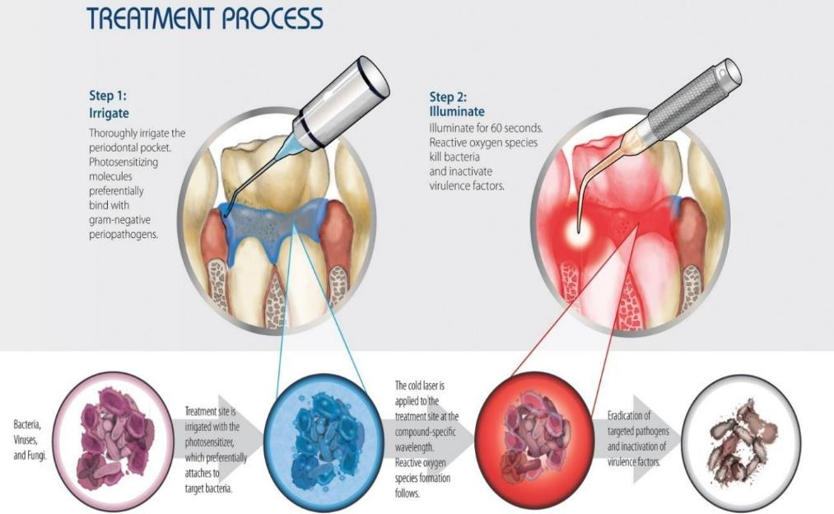
Lasers are to be used as an adjunctive therapy to conventional SRP procedure.
Never can lasers be used as single treatment protocol for NSPT protocol.
SRP is followed by laser application only on the soft tissue wall of the diseased site.
Acts as bactericidal agent.

Slide 49
Photodynamic therapy:
It involves the application of dye to the treatment area.
The dye is photosensitizer because dye after absorbing the light sensitizes the organisms to visible light inducing damage.
Application of light results in production of free oxygen redicals. they are cytotoxic & destroy cellular constituents

Slide 50
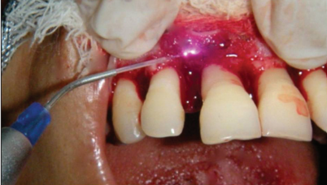
SURGICAL PERIODONTAL THERAPY
Several lasers such as the carbon dioxide (CO2 ), Ho: YAG, Nd: YAG, diode, Er: YAG have been experimentally utilized for soft tissue periodontal procedures.
The diode laser is an effective soft tissue laser for incision, hemostasis and coagulation. At a wavelength in the range of 800-980 nm it is well-absorbed by pigmented tissues. In fact some trials have confirmed the bactericidal effect of the diode laser.
Lobo, Tanya Marguerite; Pol, Dilip Ganpat. Evaluation of the use of a 940 nm diode laser as an adjunct in flap surgery for treatment of chronic periodontitis. Journal of Indian Society of Periodontology: Jan–Feb 2015 - Volume 19 - Issue 1 - p 43-48
doi: 10.4103/0972-124X.145808

Slide 51
FRENECTOMY
The traditional approach uses profound anesthesia, scalpel and sutures. There usually is a considerable amount of hemorrhage during the procedure, and the postoperative period is quite uncomfortable.
A laser frenectomy is bloodless and requires minimal anesthesia, and the char layer left over the ablated frenum area allows for little or no discomfort.
A laser frenectomy is bloodless and requires minimal anesthesia, and the char layer left over the ablated frenum area allows for little or no discomfort.
Yadav RK, Verma UP, Sajjanhar I, Tiwari R. Frenectomy with conventional scalpel and Nd:YAG laser technique: A comparative evaluation. J Indian Soc Periodontol. 2019 Jan-Feb;23(1):48-52. doi: 10.4103/jisp.jisp_352_18. PMID: 30692743; PMCID: PMC6334537.

Slide 52
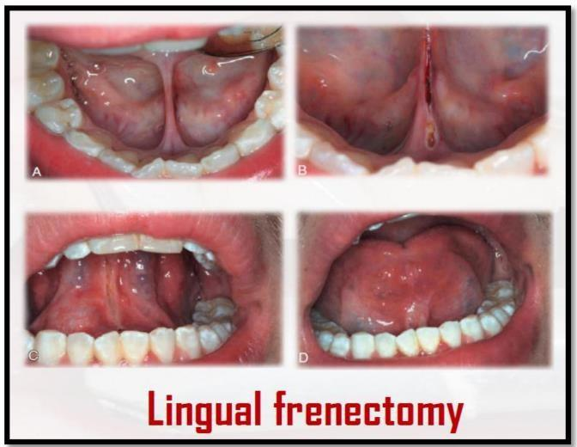
Er:YAG, Diode, Nd:YAG lasers are soft tissue lasers which can be used for the frenectomy procedure.
In case of maxillary midline frenum or lingual frenum Co2 laser is beneficial. As soft tissue has high water content and this frequency is well absorbed by water.
Another effective laser is Nd:YAG, because of its deeper penetration.
Yadav RK, Verma UP, Sajjanhar I, Tiwari R. Frenectomy with conventional scalpel and Nd:YAG laser technique: A comparative evaluation. J Indian Soc Periodontol. 2019 Jan-Feb;23(1):48-52. doi: 10.4103/jisp.jisp_352_18. PMID: 30692743; PMCID: PMC6334537.

Slide 53
DEPIGMENTATION
The efficiency of melanin hyperpigmentation removal with laser was evaluated by several researchers. The laser is capable of excellent soft tissue ablation, which makes it suitable for this kind of pigmentation removal.
Clinically results indicated safe and effective melanin pigmentation ablation.
Two lasers; Diode and Er family lasers are used for depigmentation procedure.
On comparison diode lasers are more effective in removing melanin pigmentation, avoiding repigmentation and in wound healing.
Bakhshi M, Mojahedi SM, Asnaashari M, Rahmani S, Namdari M. Gingival depigmentation by Er,Cr:YSGG laser and diode laser: a split mouth, clinical trial study. Laser Ther. 2018 Sep 30;27(3):203-213. doi: 10.5978/islsm.27_18-OR-19. PMID: 32158066; PMCID: PMC7034251.

Slide 54
GINGIVECTOMY and GINGIVOPLASTY
Soft-tissue lasers offer a superior degree of operator control while exhibiting decreased biologic side effects. Very fine incisions and surgical revisions are easily achieved with a degree of hemostasis that results in a clean surgical field.
Diode lasers operate at a wavelength that is easily absorbed by the gingival tissues, while posing little risk of damaging the tooth.
The excessive tissue is easily vaporized away or cut away with Argon , Nd : YAG or Co2 laser.

Slide 55
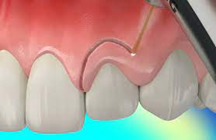
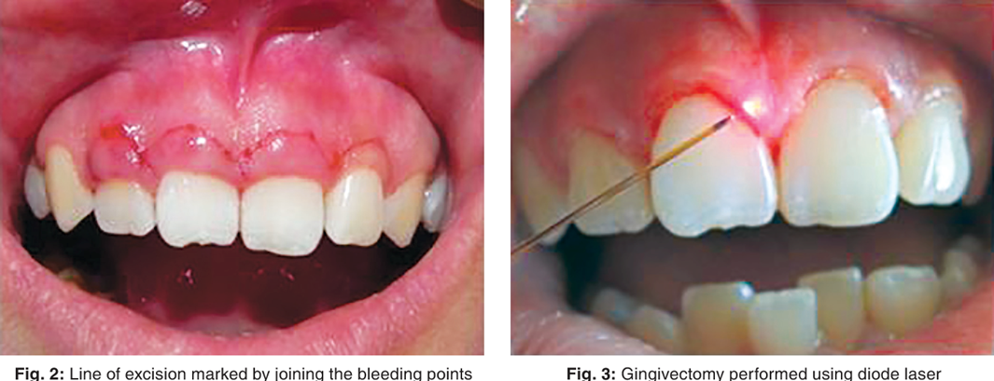

Slide 56
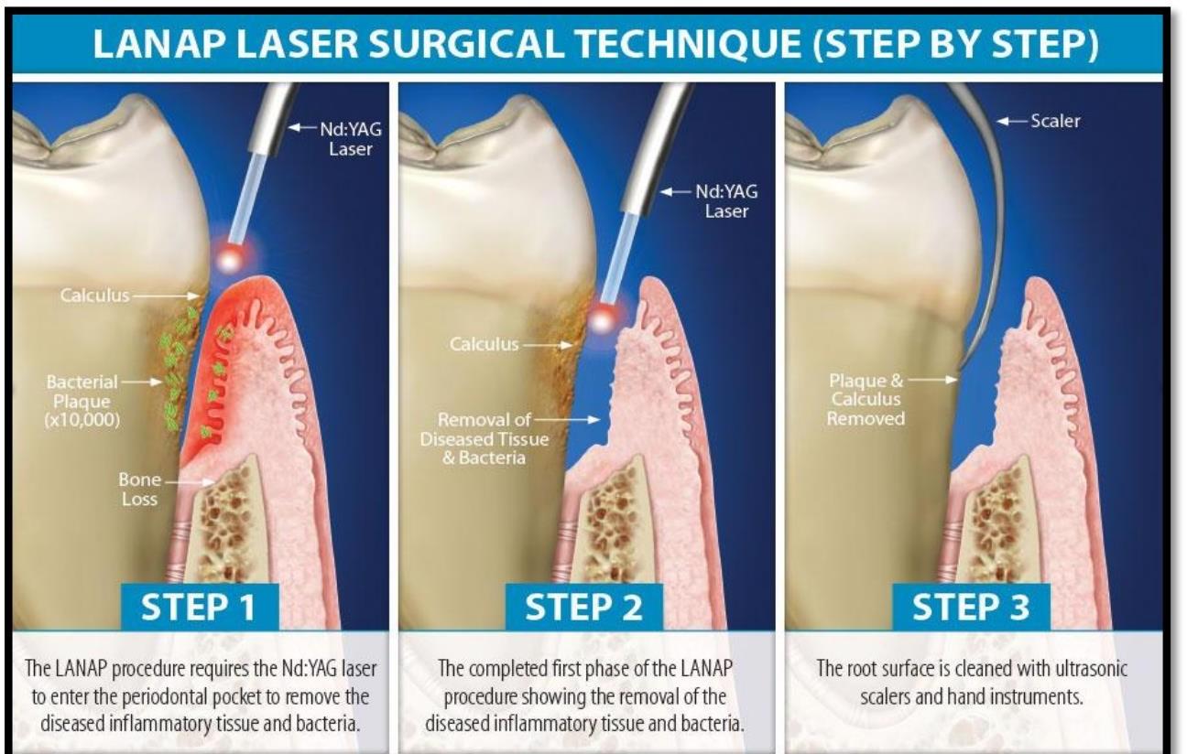
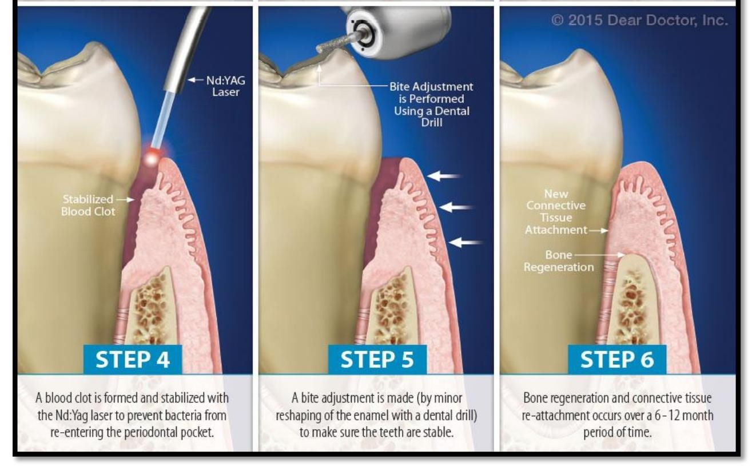
LANAP

Slide 57
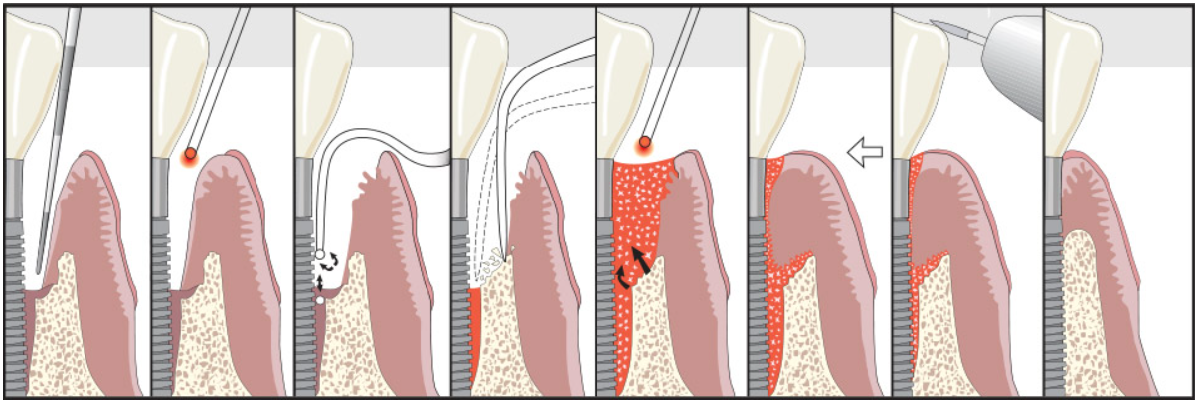
LAPIP
A. Perio probe indicates excessive pocket depth. B. Laser vaporizes bacteria, diseased tissue, pathologic proteins, and titanium corrosion contaminants in soft tissue. C. Ultrasonic scaler tips are used to remove surface accretions. D. Bone is modified at time of surgery. E. Laser is used to form a stable fibrin blood clot containing stem cells from bone. F. Adhesion to clean surface, with a stable fibrin clot at the gingival crest to create a ‘closed system’. G. Occlusal trauma is adjusted. H. New attachment is regenerated.

Slide 58
Lasers in Diagnosis
Caries detection:
Works on principle of differential florescence between healthy & diseased tooth.
Commercially available system diagnodent operates at a wavelength of 655 nm.
At this wavelength, clean healthy tooth exhibits little or no fluorescence, resulting low scale while carious tooth displays high scale.

Slide 59
Calculus detection
655 nm laser wavelength can also be used for calculus detection.
Commercially available device for caries detection provides a separate tip for the detection of calculus in the subgingival area.

Slide 60
Mobility assessment
Laser doppler vibrometry can be used for the assessment of the mobility of teeth.

Slide 61
Lasers in prevention
Laser toothbrush:
Designed to provide antibacterial effect in oral cavity using an irradiating laser beam of 630 nm low output semiconductor laser.
It does not need toothpaste but directly radiates laser on teeth.. It helps to decrease plaque, relieves dentinal sensitivity, toothache, inflammation.

Slide 62
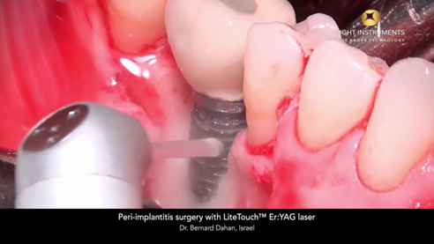
Lasers in implants
Second stage recovery
Peri-implantitis: Er-YAG laser can be used

Slide 63
Laser Safety Officer
Operation characteristics of the laser being used
Biological effects and potential hazards
Requirements of ANSI and OSHA
Practical safety control measures for lasers
Provide laser safety training for all in the working environment
Protective equipment - laser-specific glasses
Warning signs and labels

Slide 64
Laser Safety Officer
Combustible materials
Determination of the potential hazard zone - nominal hazard zone (NHZ)
Establish the standard operating procedure for the operation of the laser within the facility
Actively involved in assurance of safe practices and policies
Keeper of the keys
Implementing medical surveillance and accident reports

Slide 65
Dental laser safety
Laser hazard classification according to ANSI & OSHA standards:
Class I- low powered lasers that are safe to view
Class IIa- low powered visible lasers that are hazardous only when viewed directly for longer than 1000 sec.
Class IIb- low powered visible lasers that are hazardous when viewed for longer than 0.25 sec.

Slide 66
Class IIIa- medium powered lasers or systems that are normally not hazardous if viewed for less than 0.25 sec without magnifying optics.
Class IIIb- medium powered lasers that can be hazardous if viewed directly.
Class IV- high powered lasers that produce ocular, skin & fire hazards.

Slide 67
Type of hazards
Ocular injury: manifested as injury to sclera, cornea, retina, aqueous humor & cataract formation.
Tissue damage: temperature elevation above normal body temp can produce cell destruction by denaturation of cellular enzymes & structural proteins.
Environmental hazards: chemicals like formaldehyde, methane benzene are present in laser & can be injurious.

Slide 68
Thermal Effect of Laser on Tissue
Tissue Temp (ºC) Observed Effect
40-50 Hyperthermia
60-70 Coagulation, Protein Denaturation
70-80 Welding
100-150 Vaporization, ablation
>200 Carbonization

Slide 69
Safety precautions
Beam alignment:
Aligned properly to prevent undue injuries to patient as well as practitioner.
Laser control:
Foot pedal control of laser should have protective hood to prevent accidental depression.
Reflected energy:
- Anodized instrument should be used to prevent reflection of light.

Slide 70
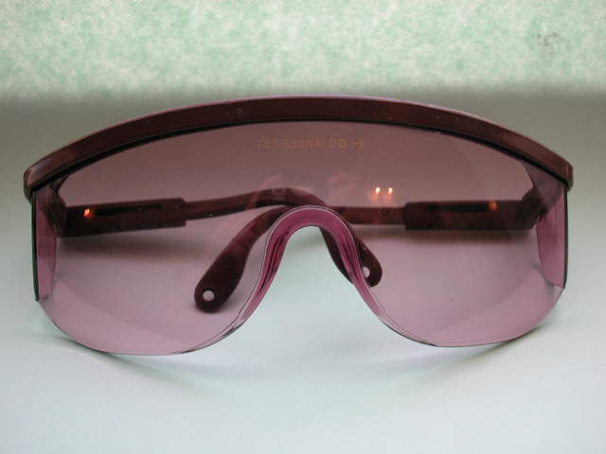
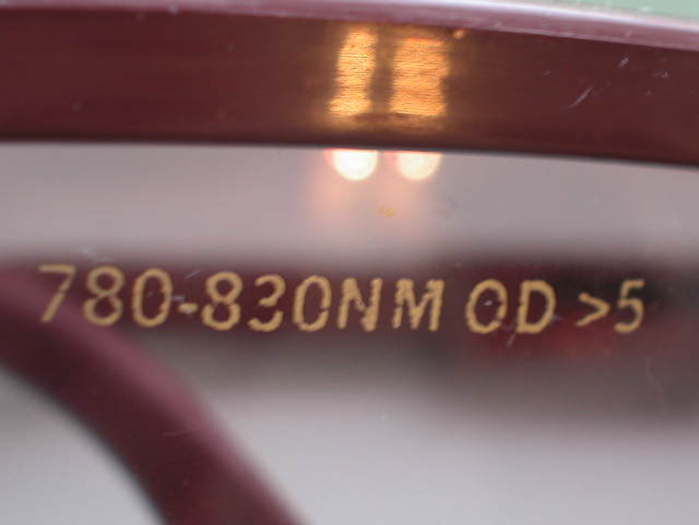
Eye Protection

Slide 71
Fire protection:
- All flammable substances should ne kept away from operating area.
Eye protection:
Safety goggles should be worn.
Plume control:
Laser infiltration mask should be worn by the clinician as well as assistant.
Pore size of 0.1 um has been shown to be effective.

Slide 72
CONCLUSION
As understanding of the nature of laser light evolves, lasers will be used more effectively in the treatment of periodontal diseases. Currently, among the different types of lasers available, Er: YAG / Er,Cr:YSGG and Nd:YAG are the most promising ones which possess characteristics suitable for dental treatment, due to dual ability to ablate soft & hard tissues.

