Slide 1
MODEL ANALYSIS

Slide 2
CONTENTS:-
INTRODUCTION
DENTAL ARCH,ALVEOLAR ARCH & BASAL ARCH
ARCH PERIMETER, ARCH LENGTH & ARCH WIDTH.

Slide 3
MIXED DENTITION ANALYSIS:-
Moyers analysis
Tanaka and Johnston prediction value
Hixon and Oldfather analysis
Radiographic method
Ballard and Wylie analysis

Slide 4
TOOTH SIZE ARCH LENGTH DISCREPANCY ANALYSIS IN MIXED DENTITION
– TOTAL SPACE ANALYSIS
Conventional method
Tweed method
Total space analysis of Merrifield

Slide 5
ANALYSIS IN PERMANENT DENTITION
RELATIONSHIP OF TOOTH SIZE TO SIZE OF SUPPORTING STRUCURES
Pont’s analysis
Ashley Howes analysis
Linder Harth analysis
Korkhaus analysis
Diagnostic set-up

Slide 6
B) TOOTH SIZE ARCH LENGTH ANALYSIS
Arch perimeter analysis
Carey’s analysis
Rees analysis

Slide 7
C) SIZE RELATIONSHIP OF GROUP OF TEETH
Bolton tooth ratio analysis
Sanin-Savara analysis

Slide 8
D) TOOTH SHAPE DISHARMONY
Peck & Peck index

Slide 9
Introduction

Slide 10
Orthodontic Diagnosis
It is established by use of certain diagnostic aids.
1.Intraoral examination
2.study models
3.radiographs
4.photographs
Study casts are essential diagnostic aids, provide 3D view of dental arches.

Slide 11
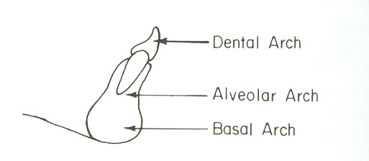
‘Arch’
Basal arch – arch formed by the corpus mandibularis or maxillaris. It is the arcal measurement of apical base.
Alveolar arch – arcal measurement of alveolar process.
Dental arch – measured through the contact points and represents a series of points where the muscle forces acting against the crowns of the teeth are balanced.

Slide 12
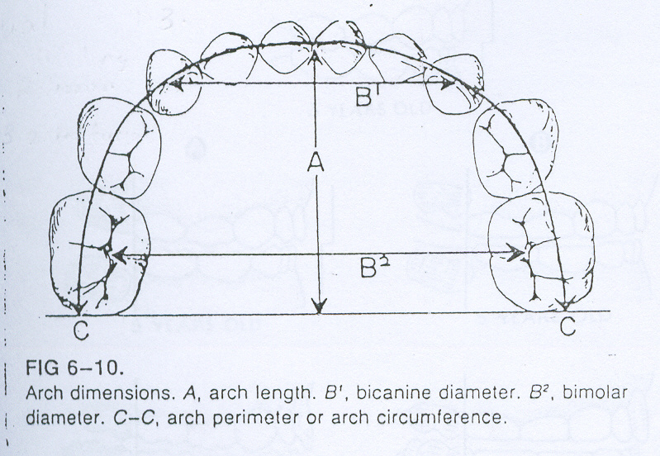
Arch width / inter canine distance
& Arch length/arch depth

Slide 13
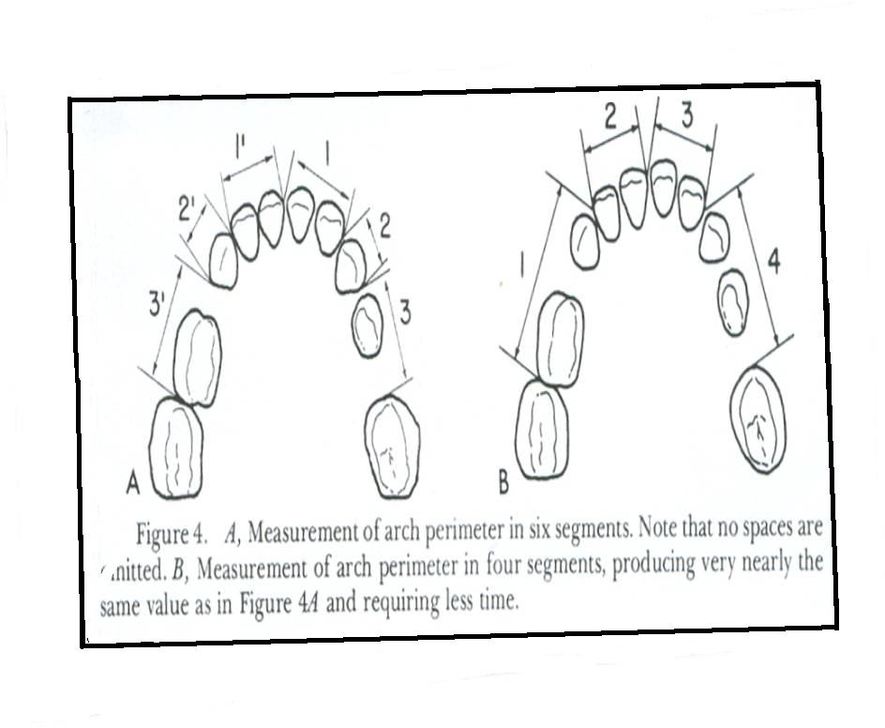
Arch perimeter

Slide 14
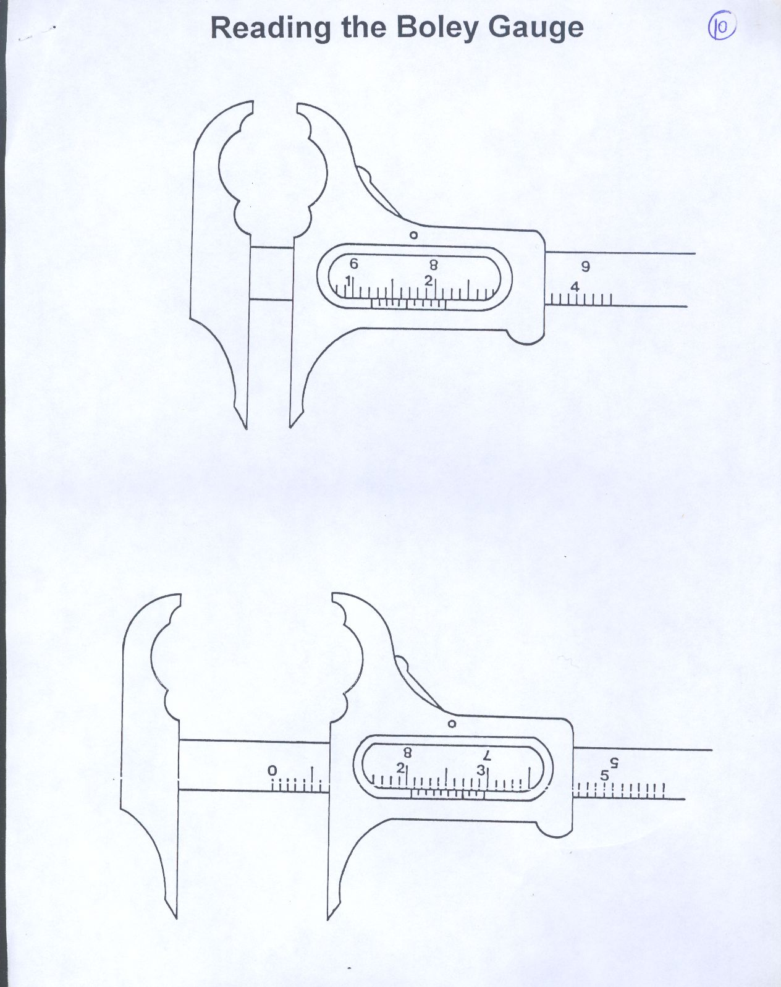

Slide 15
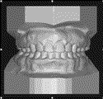
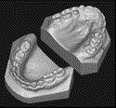
Study models

Slide 16
Orthodontic study models are accurate plaster reproductions of the teeth and their surrounding soft tissues.
They provide three di-mentional view of the dentition.

Slide 17
Parts of a study model
Anatomic portion:-
It is the actual impression of dental arches and surrounding soft tissue structures.
Artistic portion:-
Plaster base that supports the anatomical portion.

Slide 18
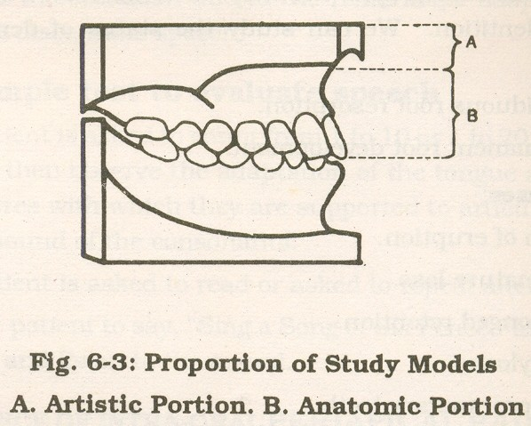
Parts Of Study Models

Slide 19
Model analysis
Model analysis involves the study of max. & mandibular. Arches in all 3 planes of space (sagittal, vertical and transverse).
It is a valuable tool in orthodontic diagnosis & treatment planning.

Slide 20
MIXED DENTITION ANALYSIS

Slide 21
Purpose:-
The purpose of the mixed dentition analysis is to evaluate the amount of space available in the arch for succeeding permanent teeth & necessary occlusal adjustments.

Slide 22
Three factors must be considered to complete the mixed dentition analysis:
1) The sizes of all the permanent teeth anterior to the first permanent molar.
2)The arch perimeter
3) Expected changes in the arch perimeter which may occur with growth %development.

Slide 23
Advantage:-
The mixed dentition analysis helps one to estimate the amount of spacing or crowding which would exist for the patient if all the primary teeth were replaced by their successors, the very day the analysis is done, not 2 or 3 years later.

Slide 24
Disadvantage:-
It does not predict the amount of natural decrease in perimeter which may occur during the transitional period without the loss of teeth.

Slide 25
Moyer’s Mixed Dentition Analysis
Is advocated for the following reasons:-
It has minimal systematic error & the range of such errors is known.
It can be done with equal reliability by the beginner & expert.
It is not time consuming.
doesn’t require special equipment / radiographic projections
Although best done on dental casts,it can be done with reasonable accuracy in the mouth.
It may be used for both dental arches.

Slide 26
Mandibular incisors are selected, as they erupt early & can easily be measured accurately & are directly in the midst of most space management problems
Maxillary incisors are not used in any of the predictive procedures,since they show too much variability in size,and their correlations with other groups of teeth are of lower predictive value.

Slide 27
Method
Procedure in mandibular arch
Greatest M-D width of 4 mandibular incisors measured with Boley gauge
Determine the amount of space needed for alignment of the incisors.
Set the Boley gauge to a value equal to sum of the widths of the left central & lateral incisors.
Place one point of the guage at the midline of the alveolar crest between the central incisors and let the other point lie along the line of the dental arch on the left side.
Mark on the tooth or the cast the precise point where the distal surface of the lateral incisor will be when it has been aligned.

Slide 28
Repeat this for the right side of the arch.
If incisors are tipped labially, the gauge is placed at the midline,but moved lingually to simulate the expected uprighting of the incisors.

Slide 29
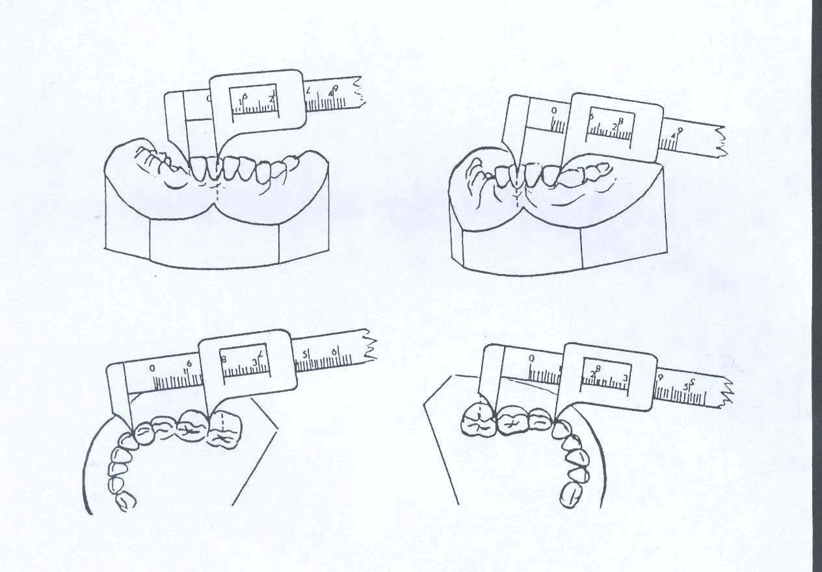
Space for incisor alignment
Space available

Slide 30
3) Compute the space available after incisor alignment.
To do this measure the distance from distal of the
lateral incisor to the mesial of permanent 1st molar. This is the available space for the canine & 2 premolars.
4) Predict the size of the combined width of the mand. canines & premolars.

Slide 31
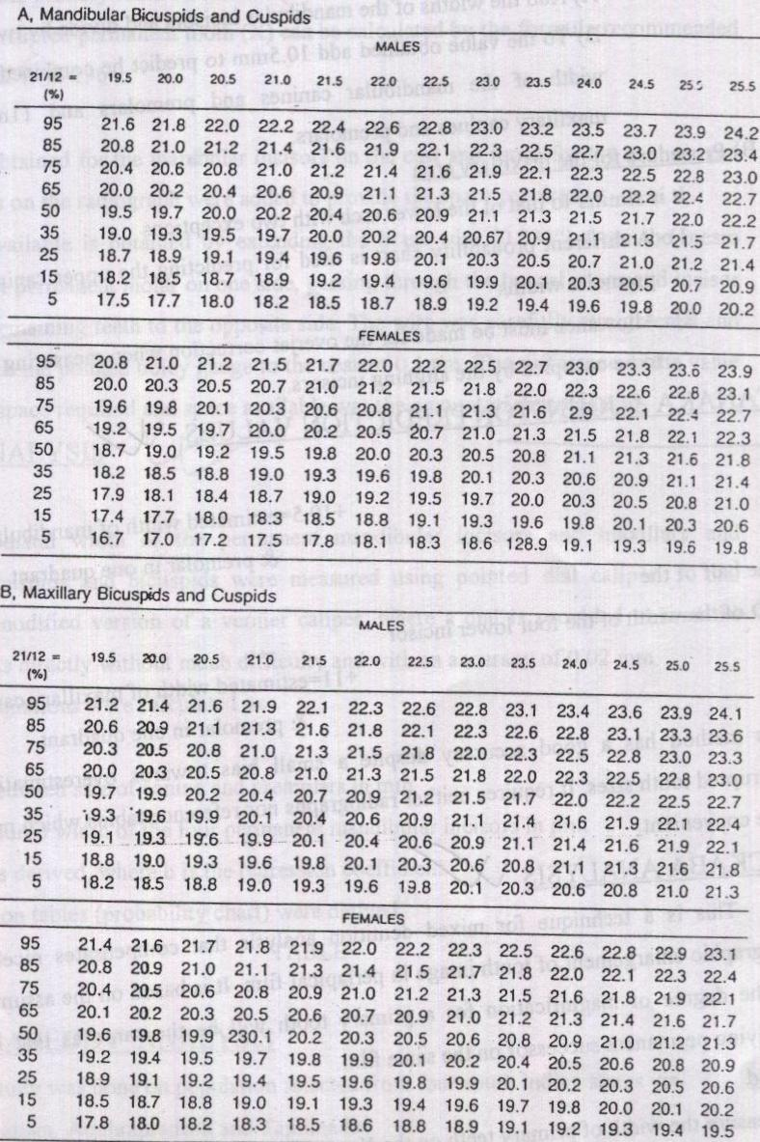
Moyers probability chart

Slide 33
Long method:-
50% prediction more precise – experienced clinician
75% prediction – inexperienced / beginners
Short method :- (less precise)
Add the widths of the mandibular incisors & divide by 2.
Value obtained + 10.5 mm → the combined width of mandibular canines & premolars.
Value obtained + 11 mm → the combined width of maxillary canines & premolars.

Slide 34
Always record the estimated values for the combined cuspids and bicuspids widths in the mixed dentition analysis form for both sides and each arch.
5)Compute the amount of space left in the arch for molar adjustment by subtracting the estimated cuspids and bicuspid size from the measured space available in the arch after alignment of the incisors.
Record these values for each side.
From all recorded values,a complete assessment of the space situation in the mandible is possible.

Slide 35
Procedure for maxillary arch :-
Similar to lower arch with two exceptions :
Different probability chart for prediction
Allowance must be made for overjet correction when measuring this space to be occupied by the alignined incisors.
(Remember the width of the lower incisors are used to predict upper cuspid &bicuspids.)

Slide 36
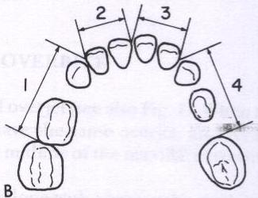
Tanaka – Johnston analysis
Most clinically useful because it doesn’t require additional radiographs / tables to predict tooth size.
Determine the available arch length.
from mesial of 1st permanent molar – mesial of contra lateral 1st molar.
segmental measurement
segments added =total arch
length (approx)

Slide 37
Width of 4 mandibular incisors added to predict
  the amount of room necessary for ideal alignment
sum of incisors + 10.5 mm = estimated width of
2 mandibular canine & 2 premolars of one quadrant.
Total arch length – sum of incisors -2 x predicted width = available arch length
+ ve value – surplus space
- ve value – deficient space

Slide 38
Maxillary arch ;
sum of incisors + 11mm = estimated width of
2 maxi canine & 2 premolars
of one quadrant.
Total arch length – sum of incisors - 2 x predicted width = available arch length

Slide 39
Factors to be considered
It over predicts the width of the unerupted teeth, this makes the extent of crowding appear more severe.
Alternative method for determining available space is to measure arch length & incisor width & then obtain periapical radiographs of canine & premolars
The MD widths of the unerupted teeth are measured on the periapical films & then corrected for magnification by comparing the widths of erupted teeth on films with actual width on cast.

Slide 40
Disadvantage
Patient exposure to ↑ radiation
Difficult to obtain undistorted radiographs

Slide 41
Hixon & OldFather Mixed Dentition Analysis
Combination technique to estimate the total MD width of unerupted canine & premolars, by using both cast & radiiograph.
Method
The width of one of the mandibular central & lateral incisor + unerupted 1st & 2nd bicuspids of the same side,measured on the radiograph taken by paralleling technique gave a strong relationship clinically in predicting the size of canine & premolars on that side

Slide 42
The Hixon & Oldfather prediction table
Measured value (mm) | Estimated value (mm) 3,4,5
23 | 18.4
24 | 19
25 | 19.7
26 | 20.3
27 | 21
28 | 21.6
29 | 22.3
30 | 22.9

Slide 43
Radiographic method
IOPA of the unerupted teeth and of the overlying primary teeth are taken.
The enlargement ratio for each unreupted permanent tooth is computed by measuring the nearest first tooth in the mouth and then in the radiograph.

Slide 44
Erupted tooth size in mouth x unerupted tooth
Erupted tooth size in X-ray size in x-ray
=correct tooth size

Slide 45
Ballard & Wylie Method
Based on the harmony in the tooth size
Measured the MD width of every mandibular tooth back up to & including the 1st permanent molar.
Method
Sum of all 4 mandibular incisors, as well as sum of canine, 1st premolar & 2nd premolar of one side
was determined.
Coefficient of correlation was calculated & a
formula was derived which was plotted in a
graph.

Slide 46
X = 9.41 + 0.527 Y
X – sum of 3 + 4 + 5
Y – sum of 4 mandibular incisors ( on one side)
A graph was plotted on this formula
Mandibular permanent 1st molars were also included
X = 5.52 + 0.431Y + 0.552Z
Z – MD width of mandibular permanent 1st molars
Both formulas gave the same measurement of
canine & premolars

Slide 47
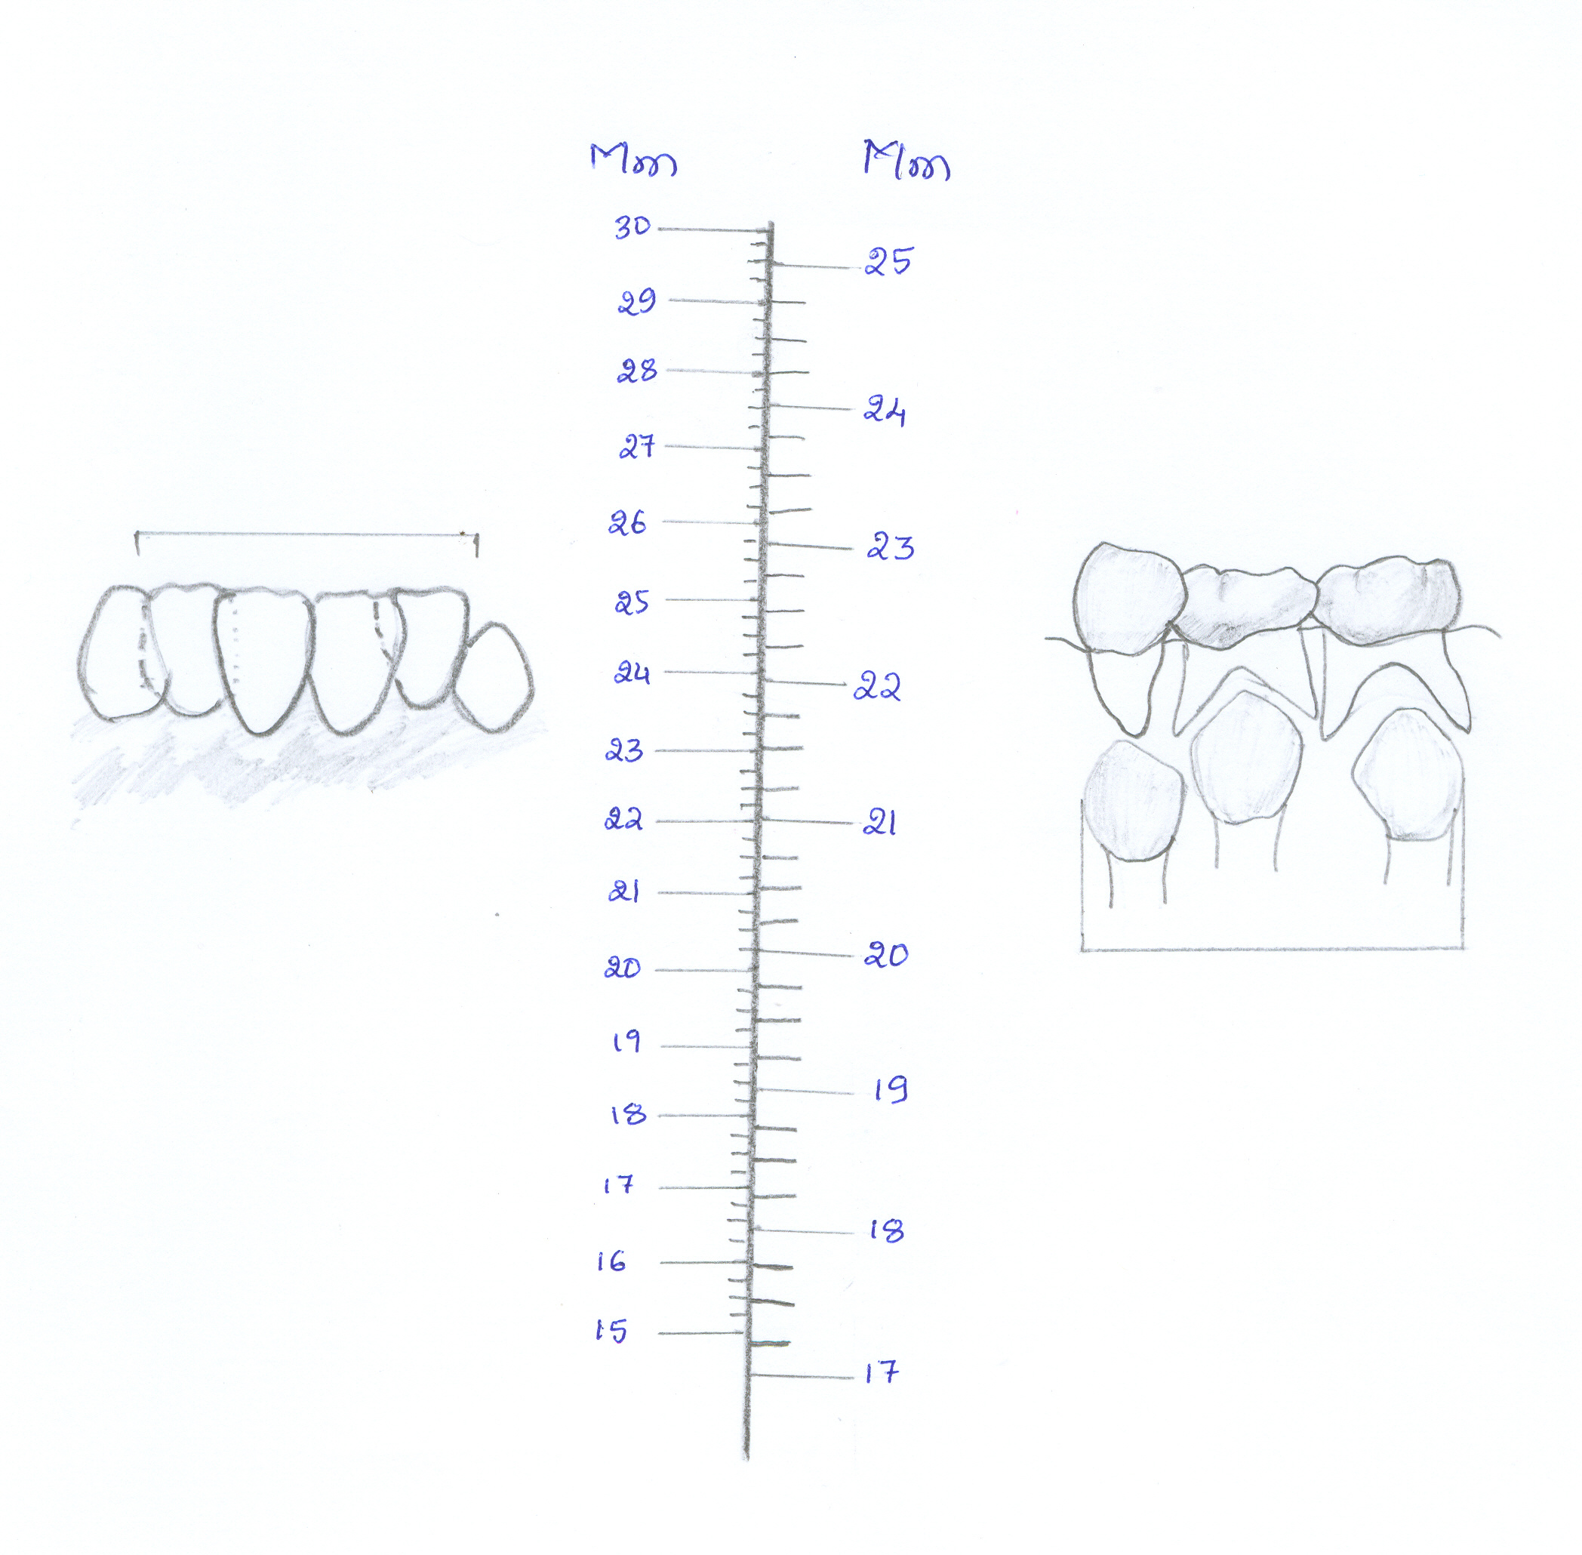
Graph
Measure individual width of these teeth
Locate sum of these four on this side of the graph
Sum of unerupted 3,4,5 on this side

Slide 48
TOOTH SIZE ARCH LENGTH DISCREPANCY ANALYSIS
IN MIXED DENTITION
– TOTAL SPACE ANALYSIS

Slide 49
1.Conventional method
– Huckaba’s method.
Compensates for radiographic enlargement of tooth
image in the periapical film
(degree of magnification for primary tooth will be
same as that of the underlying permanent successor)
Method
Y¹→ width of primary teeth on the x-ray
X¹→ width of underlying successor on the x-ray
Y → width of primary tooth on cast
X → width of unerupted permanent tooth ??????

Slide 50
YX¹
X =
Y¹
Eg ; X¹ – 8.2 mm 9 x 8.2 = 8.02 mm
Y – 9 mm 9.2
Y¹ – 9.2 mm arch length – 64 mm
canine - 8.2
1st premolar - 8.12 24.4 mm
2nd premolar - 8.3
S.R – S.A = 2(24.4) + 21= 69.8 – 64 = 5.8 mm
Deficit - 5.8 mm

Slide 51
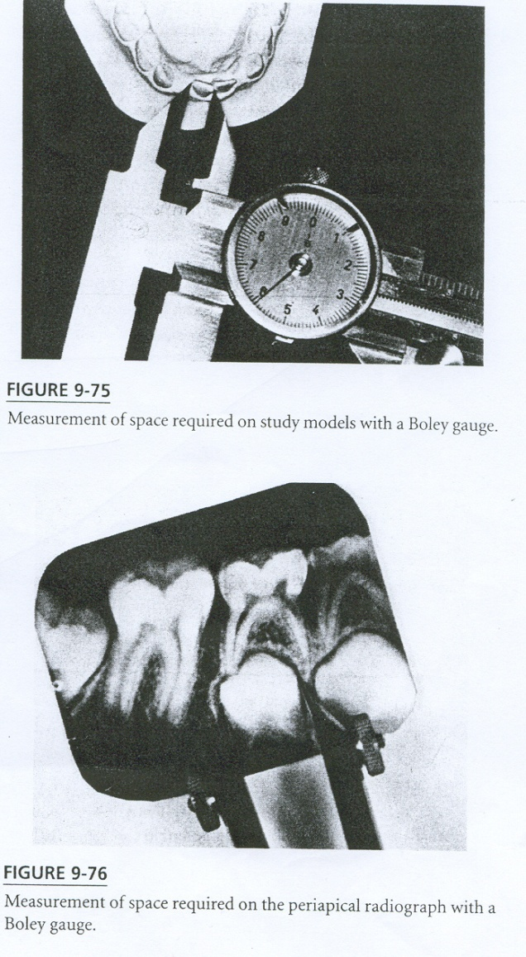
Space Required :
Values obtained for the mandibular incisors on the cast & those for canine & premolars on the radiograph were added

Slide 52
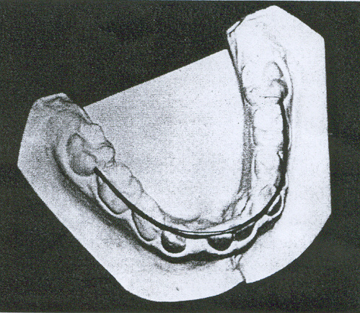
Space Available :
Extending a brass wire (0.033 inch) from
mesiobuccal of 1st permanent molar on one side to the contralateral side.
Straighten the wire & measure with a pointed Boley gauge.
S.R – S.A = Discrepancy

Slide 53
Tweed method
A facial oriented analysis, incorporating the relations of incisor teeth to basal bone.
Method
The values for space required & space available are determined as described earlier.
-Lateral cephalogram tracing is done.

Slide 54
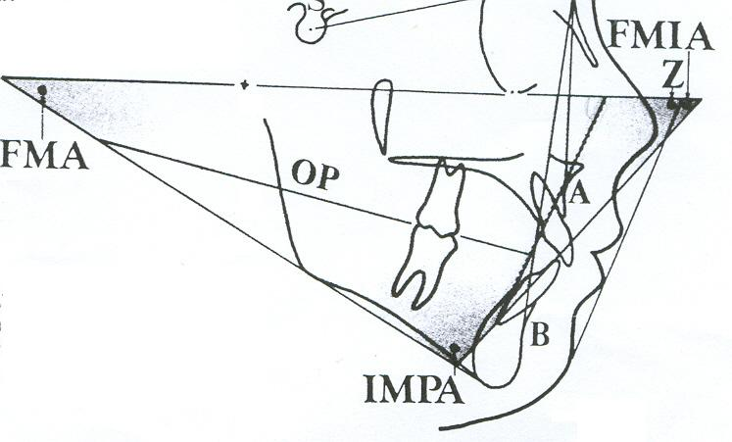
Tweed foundation has established following relationships:-
When FMA=21⁰-29⁰ -------FMIA should be=68⁰
When FMA=30⁰ or more ----FMIA should be=65⁰
When FMA=20⁰ or less ----IMPA should be < 92⁰

Slide 55
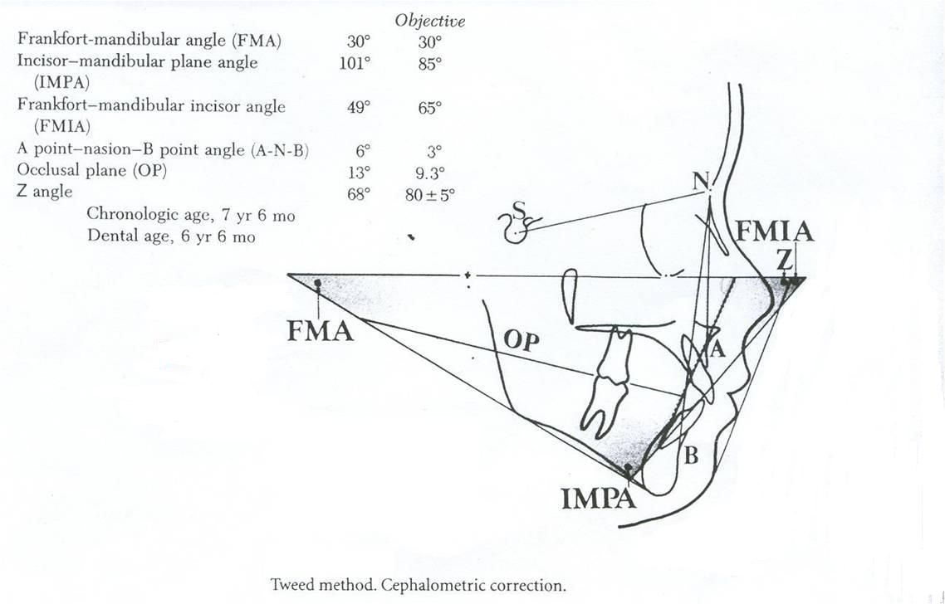
Cephalometric correction
=distance from objective line & the line forming actual FMIA on the occlusal plane (a), for both sides = 2a

Slide 56
Case 1: 7.6 yrs: dental age:6.6 yrs
Space required - 71mm Space available - 65mm
Discrepancy = -6mm ceph correction = 2a= -12mm
Total discrepancy = -18mm
Frankfort-mandibular angle (FMA) | 30⁰ | Objective 30⁰
Incisor-mandibular plane angle (IMPA) | 101⁰ | 85⁰
Frankfort-mandibular incisor angle (FMIA) | 49⁰ | 65⁰
ANB angle | 6⁰ | 3⁰
Occlusal plane (OP) | 13⁰ | 9.3⁰
Z angle | 68⁰ | 80±5⁰

Slide 57
ANALYSIS IN PERMANENT DENTITION

Slide 58
RELATIONSHIP OF TOOTH SIZE TO SIZE OF SUPPORTING STRUCTURES

Slide 59
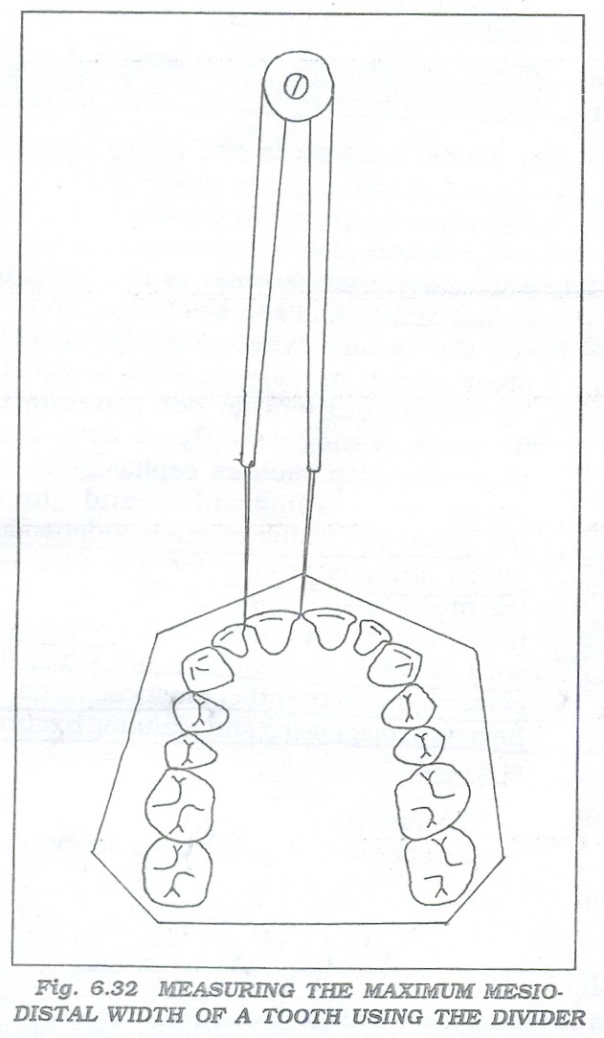
Pont’s Index (1909)
Determining the ideal dental arch width from the combined M-D width of the max, 21|12

Slide 60
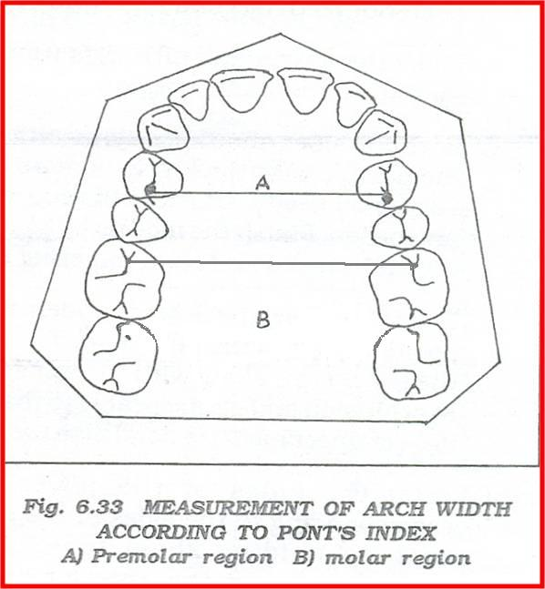
Procedure
Measure the M-D widths of 21|12
Sum up = X.
Measure arch width in PM region.
Measure arch width in molar region.
-Calculate Ideal arch width in PM region = X/80 x 100
-Calculate Ideal arch width in molar region = X/64 x100

Slide 61
1] If calculated value > measured value,
Arch is narrow & needs expansion.
2] If measured value > calculated value,
Arch is wider & no scope for expansion.
Drawbacks
Designed for french population
Alignment of teeth was not considered
Malformation of teeth were not considered
eg, peg lateral

Slide 62
Ashley Howe’s Analysis
Crowding is due to deficiency in arch width rather than arch length
Relationship b/w total M-D width of 12 teeth [6-6] & width of dental arch in the 1st pm region.

Slide 63
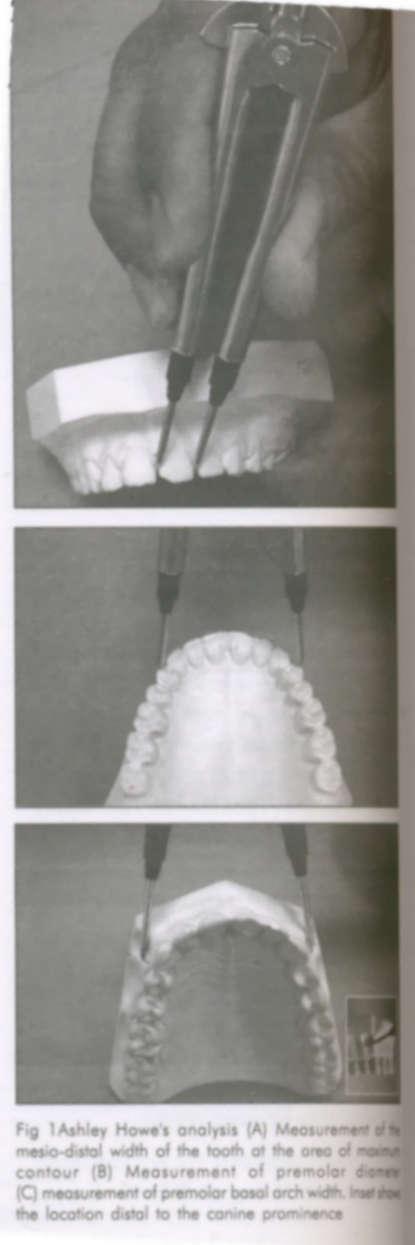
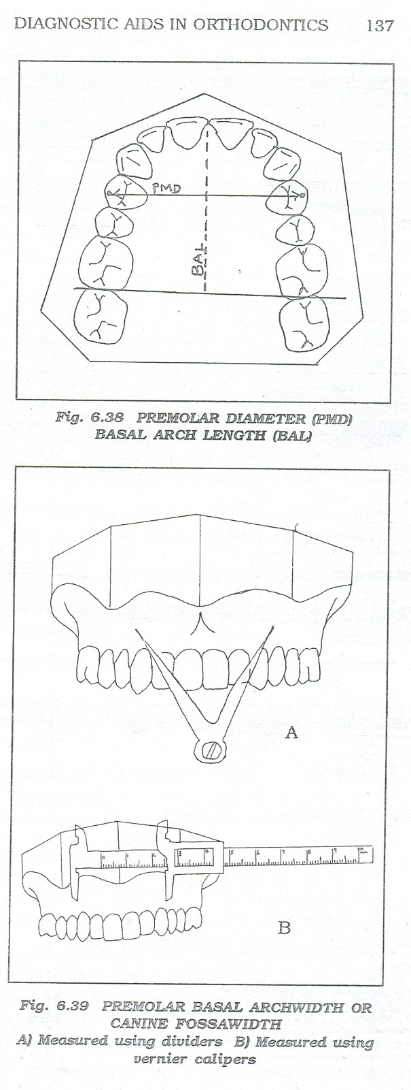
Procedure:-
1] Measurement of total tooth material(TTM); -measure the M-D width of all teeth ant. to 2nd molar & sum up.
2] Measurement Of Premolar Diameter(PMD) ;
-Arch width from tip of buccal cusp of 4 to 4.

Slide 64
3] Measurement Of premolar basal arch width(PMBAW)/ Canine Fossa Width ;
- Canine fossa on one side to the other side
- 8mm below the crest of the interdental papilla distal to the canine.

Slide 65
Inference;
PMBAW & PMD are compared
If PMBAW >PMD ; arch can be expanded
If PMBAW < PMD ; arch can’t be expanded
According to Howe to achieve normal occlusion
PMBAW should be 44% of the TTM.
So, PMBAW % = PMBAW/TTM x 100 = 44%
A] PMBAW%= 37% or less; need for extraction
B] PMBAW% = 44% or more; no need for extraction
C] PMBAW% = 37%-44% ; borderline case.

Slide 66
Linder Harth Index
Similar to pont’s index except --
Ideal arch width in PM region = X/85 x 100
Ideal arch width in molar region = X/64 x 100

Slide 67
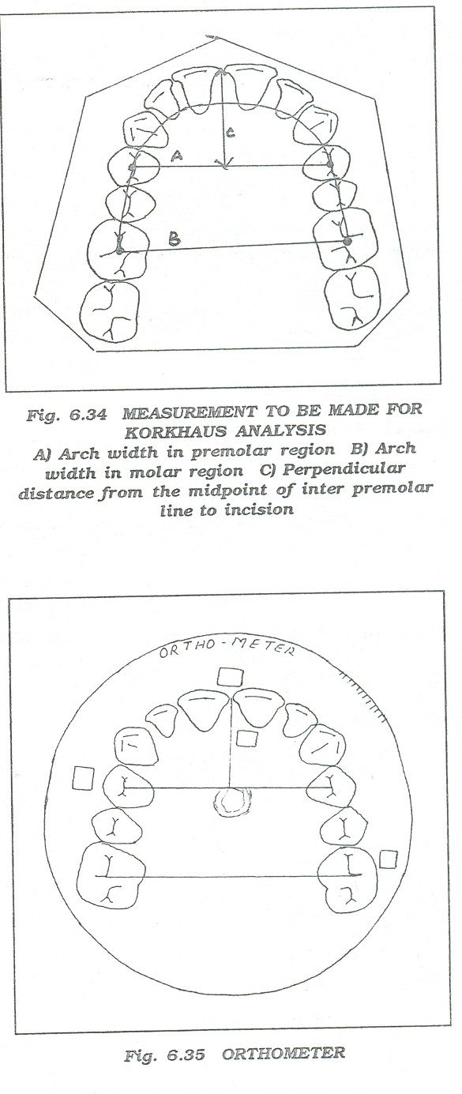
Korkhaus Analysis
According to Korkhaus for a particular width of incisors there is a specific value of the distance from thepoint between maxillary incisiors to the midpoint of inter-premolar line.
Korkhaus used Linder Harth’s measurements & introduced a third measurement.

Slide 68
ORTHOMETER
Korkhaus devised it with which we can directly read-
Ideal arch width in pm & molar region & also
The perpend, distance from the inter-premolar line to the incision for a given sum of M-D width of the max, incisor 21| 12

Slide 69
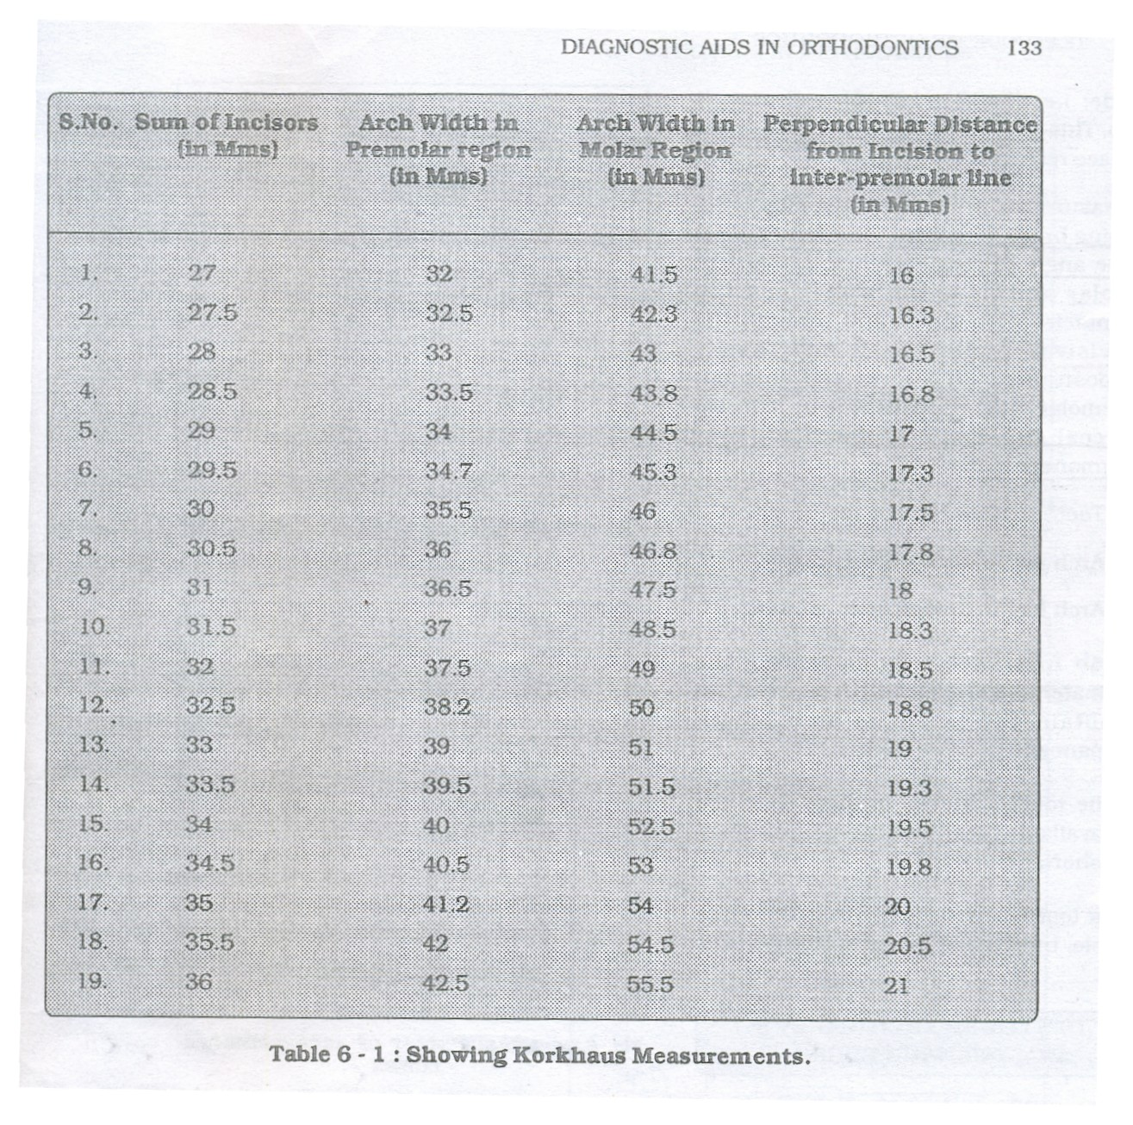

Slide 70
Inference
Tells about arch width
Ideal positioning of the ant, teeth.
If perpend dist > ideal, then ant, teeth are proclined.
If perpend dist < ideal, then ant, teeth are retroclined.

Slide 71
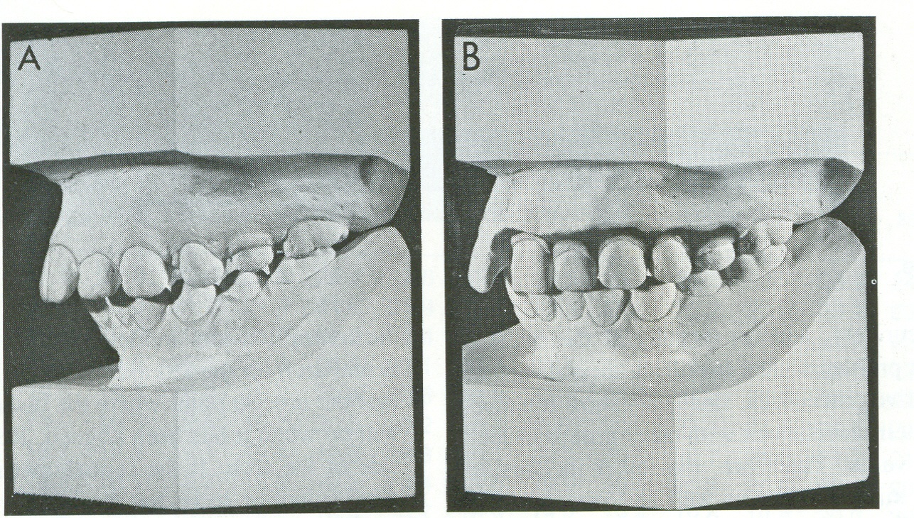
Diagnostic setup
Helps to ascertain amount and direction of tooth movement
Steps:- 1). Wax bite 2). Separation of teeth 3). Align in desired position
Only for permanent dentition

Slide 72
After aligning teeth,
If the remaining space on each side is adequate to receive the permanent first molar,then extraction is not required.
If space is inadequate and amounts to more than can be gained by uprighting permanent second molars,then some teeth must be removed usually the first premolar.

Slide 73
TOOTH SIZE ARCH LENGTH
DISCREPANCY

Slide 74
Arch Perimeter Analysis
Many malocclusions occur due to ;
Discrepancy between arch length & tooth material.
This analysis helps in determining the extent of discrepancy ie, to find out the difference between the basal bone & the tooth material.

Slide 75
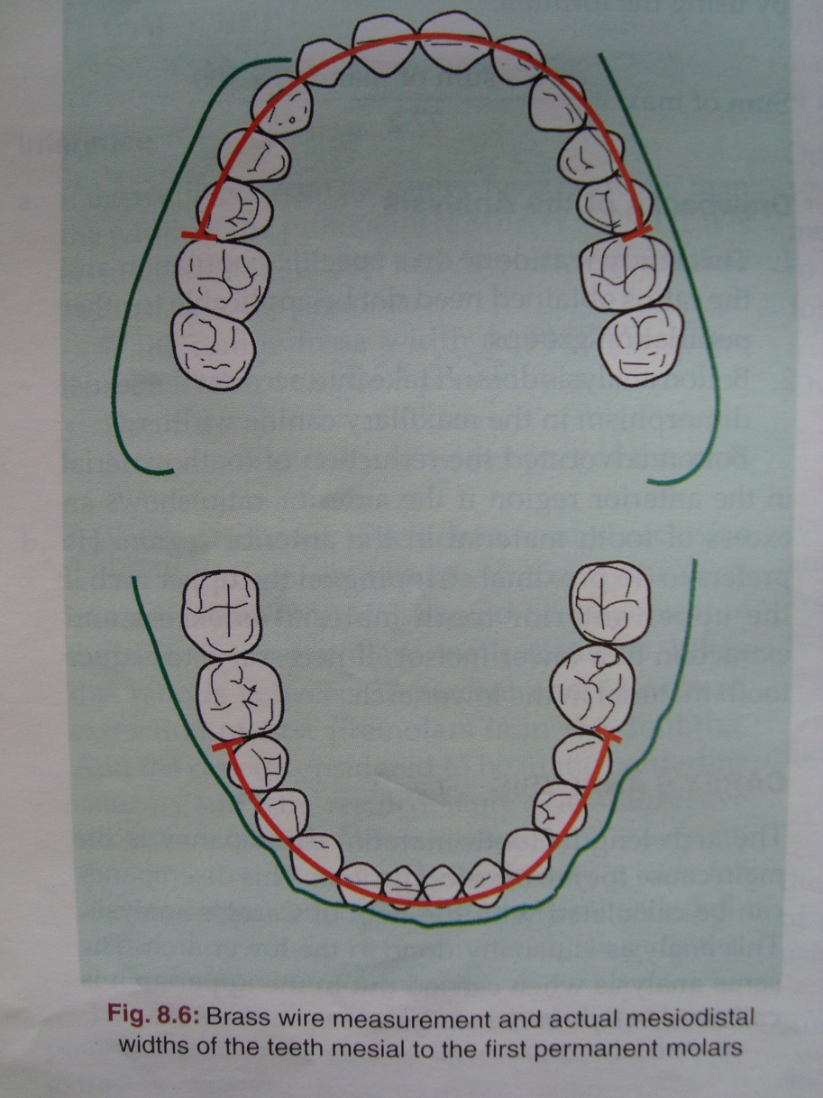
Upper Arch; Procedure
Measurement Of Tooth Material-[A] The M-D width of all the teeth from the 5 to 5 on other side & sum it up.
2. Measurement Of Arch Perimeter [B] soft brass wireis placed contacting mesial surface of first molar to mesial surface of 6 on other side;
-along the Buccal-cusps of 4s and along the incisors.

Slide 76
If ant.teeth are well aligned-wire passes over Incisal edges of anterior teeth
If proclined anteriors-wire passes along the Cingului of anterior teeth
If retroclined anteriors-wire passes labial to anterior teeth.
3]Determination Of Discrepancy =
[A-B]

Slide 77
Inference;
a] If tooth material is excess by 0-2.5mm; proximal
stripping
b] If tooth material is excess by 2.5-5mm; 2nd pm extraction
c] If tooth material is excess by > 5mm ; 1st pm extraction

Slide 78
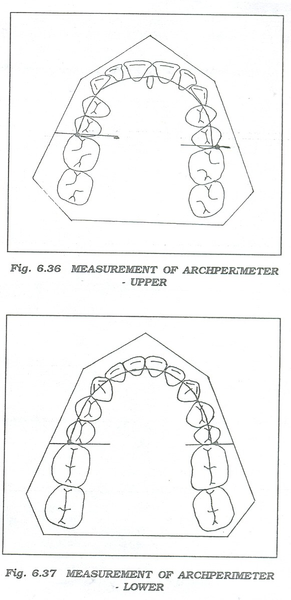
Lower Arch Primeter Analysis [Carey’s Analysis]
Measurement Of Tooth Material; [A]
Measurement Of Arch Perimeter ;[B]
Determination Of Discrepancy; [A-B]
Inference;
If t-mat is excess by 0-2.5mm; prox strip
If t-mat is excess by 2.5-5mm; 2nd pm
If t-mat excess by > 5mm ; 1st pm extn.

Slide 79
Size relationships of groups of teeth

Slide 80
Bolton’s Analysis
Many malocclusions occur as a result of abnormalities in tooth size.
According to bolton, there exists a ratio betn the M-D widths of max, & mand, teeth.
Procedure;
1] sum of M-D widths of 12 mand, teeth [36-46] ;
2] sum of M-D widths of 12 max, teeth [16-26] ;
3] sum of M-D widths of 6 mand, ant teeth [33-43] ;
4] sum of M-D widths of 6 max, ant teeth [13-23] ;

Slide 81
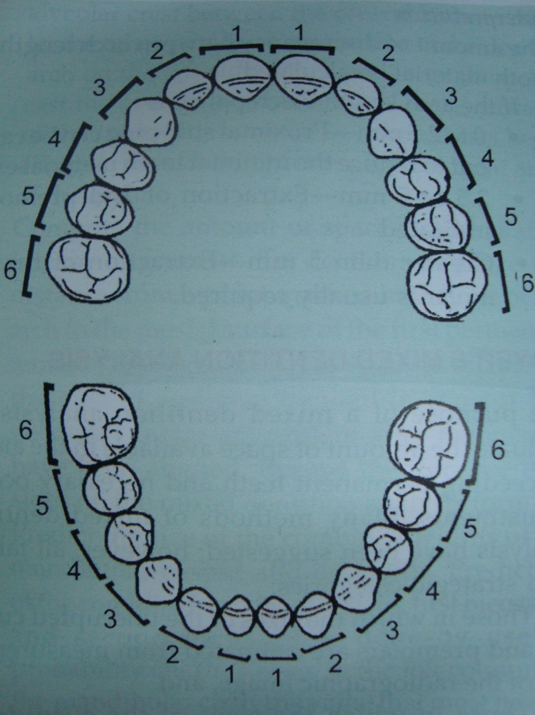
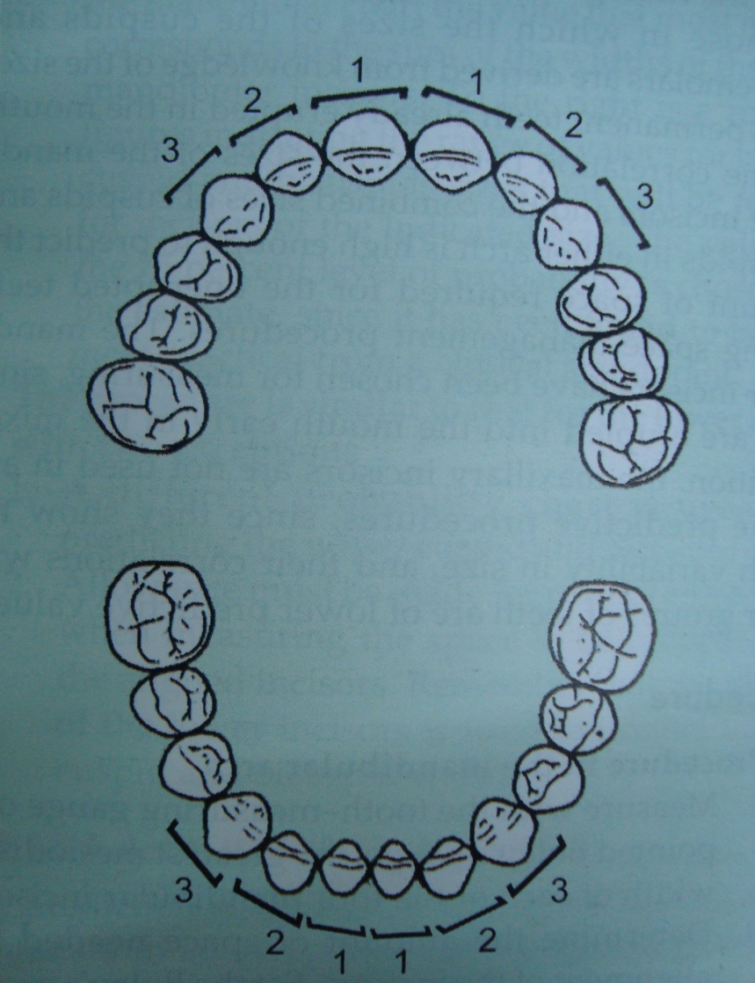
Sum of the mesiodistal widths of the maxillary and mandibular arches:-

Slide 82
Determination Of Overall Ratio
Overall ratio= sum of M-D widths of 12 mand teeth x 100
sum of M-D widths of 12 max, teeth
= 91.3%
If overall ratio is < 91.3% ; max, tooth material is excess.
If overall ratio is > 91.3% ; mand, tooth material is excess.

Slide 83
Determination Of Anterior Ratio
Anterior ratio = sum of M-D widths of 6 mand.ant teeth x 100
sum of M-D widths of 6 max. ant teeth
= 77.2%
If the ant,ratio is < 77.2 ; maxillary anterior tooth material excess.
If the ant,ratio is > 77.2 ; mandibular anterior tooth material excess.

Slide 84
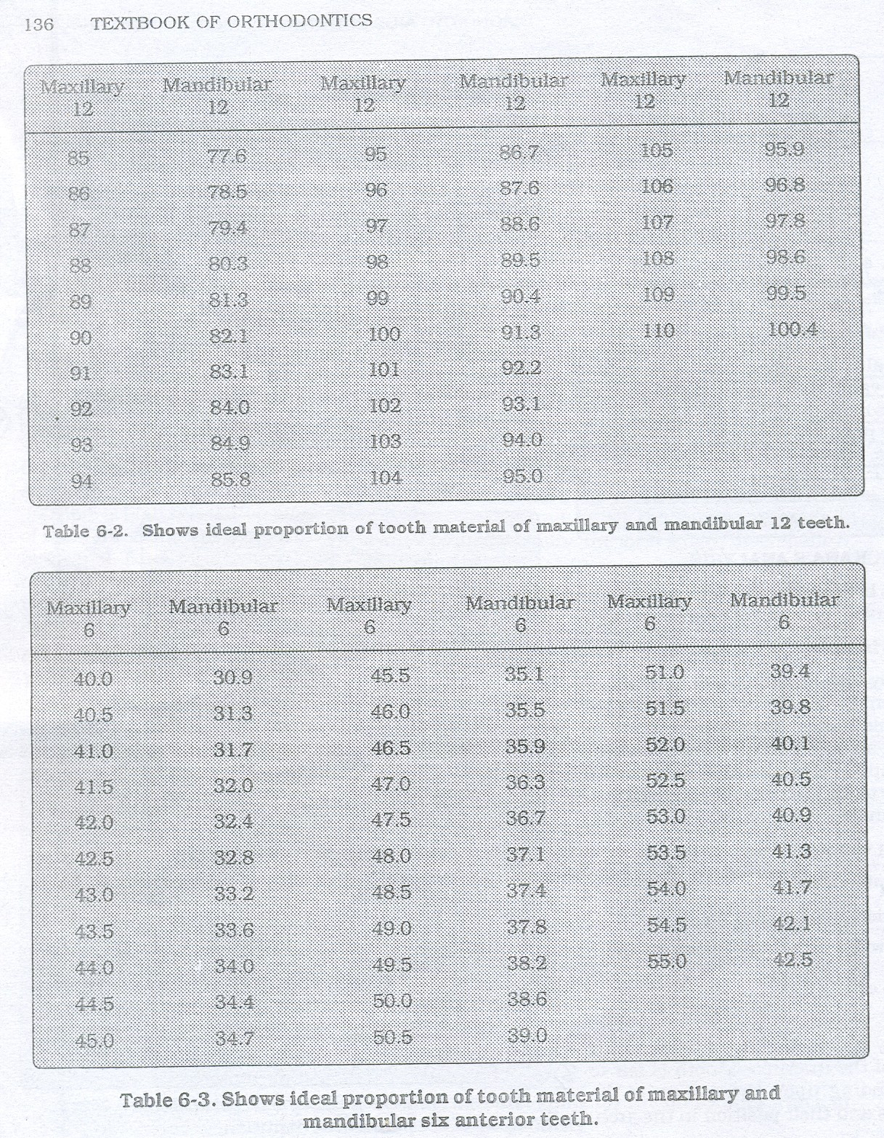

Slide 85
Sanin-Savara tooth size analysis
They devised a simple and ingenious procedure to identify individual and group tooth size disharmonies.
It makes use of precise M-D measurements of crown size of each tooth,appropriate tables of tooth size distribution and charts for plotting the patients’s measurements.

Slide 86
TOOTH SHAPE DISHARMONY

Slide 87
Peck & Peck Index [Mand. Arch]
He observed that the persons with ideal incisal arrangement had smaller M-D width & comparatively larger F-L width of mand incisors.
Procedure;
Measure the M-D width of mand, incisors
Measure the F-L width of mand, incisors
Calculate the proportion = M-D width x 100
F-L WIDTH

Slide 88
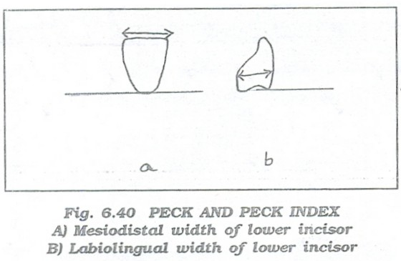
Mean value for mand, CI should be 88-92%
Mean value for mand LI should be 90-95%
Inference ;
If the value is > mean value,
- then M-D width > F-L width &
- hence proximal stripping is indicated.

