Slide 1
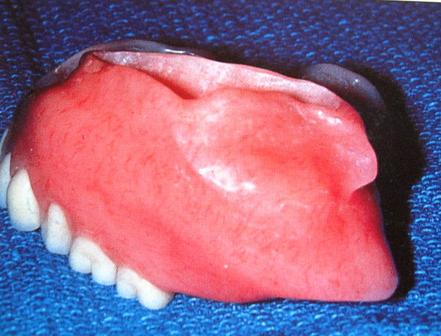
OBTURATORS FOR ACQUIRED MAXILLARY DEFECTS
DR. KINJAL SOLANKI
DEPT. OF PROSTHODONTICS, CROWN AND BRIDGE
AMC DENTAL COLLEGE AND HOSPITAL

Slide 2
INTRODUCTION
The most common intra oral defects are in the form of cleft or opening in the palate. These defects may be acquired or congenital. Acquired is due to injuries or surgical excision of tumor. Congenital is due to malformation.
Definite restoration involving fixed or removable prosthesis is needed to replace missing teeth, to stabilize and align the arch segment, restore the occlusal function, provide facial support and helps in speech.
All this is usually aided with the help of an OBTURATOR.

Slide 3
TYPES OF OBTURATOR
Obturator for congenital defects of palate
Obturators for acquired defects
-surgical
-interim
-definitive
Obturator for lateral segmental defect with no palatal opening
Two piece hollow obturator
One piece hollow obturator
Snap on prosthesis for marginal defects
Snap on prosthesis for anterior segmental defects
Obturator for edentulous/dentulous mouth

Slide 4
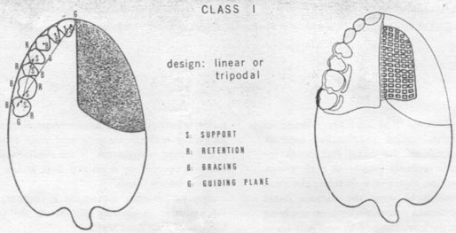
PRINCIPLES OF OBTURATOR DESIGN FOR PARTIALLY EDENTULOUS ARCHES
CLASS I DESIGN
Design can be either linear or tripodal
Two or three anterior teeth are splinted whenever possible, and support is derived from the central incisor and the most posterior abutment tooth.

Slide 5
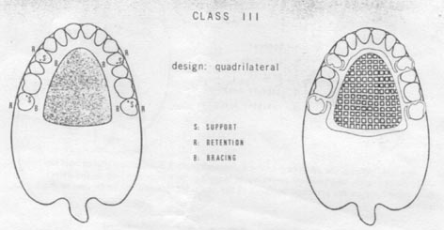
CLASS III DESIGN
Design is quadrilateral.
Support is distributed both on premolar and molars.
Retention is derived from the buccal surface and stabilization from the palatal surface.

