Slide 1
Odontogenic cysts
Dr. Kinnari Patel
Professor and HOD
Department of Oral and Maxillofacial Pathology and Microbiology
AMC Dental College

Slide 2
Kramer (1974) has defined a cyst as “A pathological cavity having fluid,semifluid or gaseous contents and which is not created by the accumulation of pus”
Most cysts, but not all are lined by epithelium.
Pseudocysts

Slide 3
Cysts are classified mainly under three headings:
1.Cyst of the jaws
2.Cysts associated with maxillary antrum
3.Cysts of the soft tissues of the mouth

Slide 4
Cysts of the jaws are divided in to:
Epithelium lined
Non epithelium lined
Epithelium lined cysts are divided in to
Developmental
Inflammatory

Slide 5
I Cysts of the jaws
Developmental
A. Epithelium lined
1.Developmental origin:
(a) Odontogenic
1.Gingival cysts of new born
2.odontogenic keratocyst
3.Dentigerous cyst
4.Eruption cyst
5.Gingival cyst of adults
6.lateral periodontal cyst
7.Botryoid odontogenic cyst
8.Glandular odontogenic cyst
9.Calcifying odontogenic cyst

Slide 6
(b) Non odontogenic cyst
1.Mid palatal raphe cyst of infants
2.Nasopalatine duct cyst
3.Naso labial cyst
B.Non epithelial lined cyst
1.Solitary bone cyst
2.Aneurysmal bone cyst
Inflammatory
1.Radicular cyst
2.Residual cyst
3.Paradental cyst

Slide 7
Odontogenic cysts are derived from three epithelial structures:
1.Rests of Malassez:Remnants of Hertwig’s epithelial root sheath
2.Reduced enamel epithelium: Surrounds the crown of tooth after enamel formation is complete.
3.Remnants of dental lamina(rest of Serres)

Slide 8
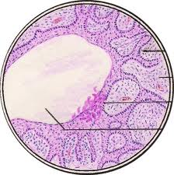
Elements of a Cyst
1.Wall or capsule
2.Lining
3.Lumen

Slide 9
Radicular cyst(Periapical cyst)

Slide 10
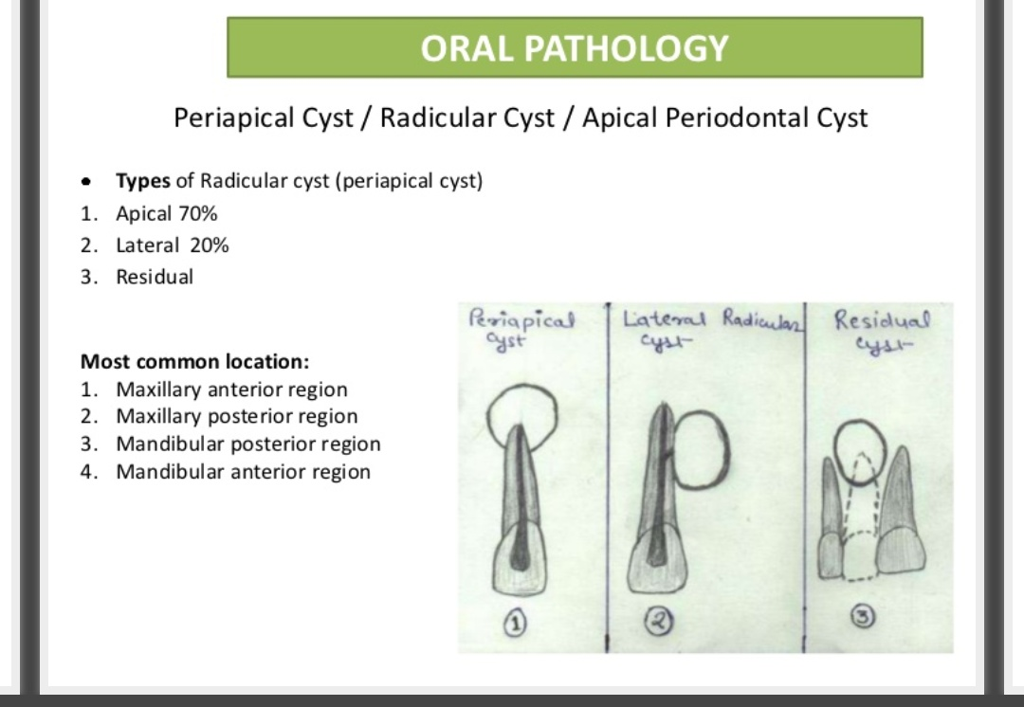

Slide 11
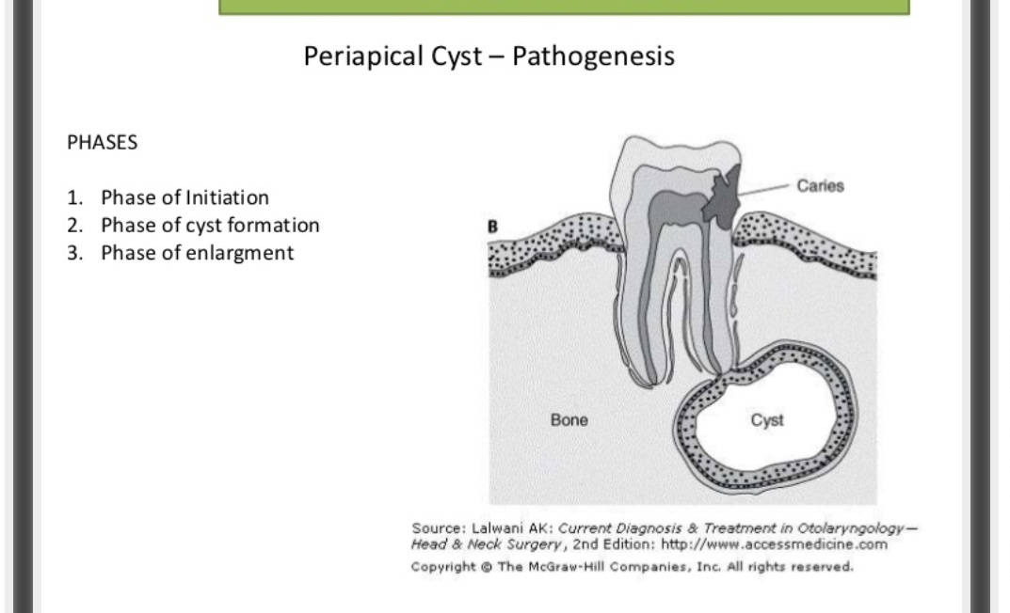

Slide 12
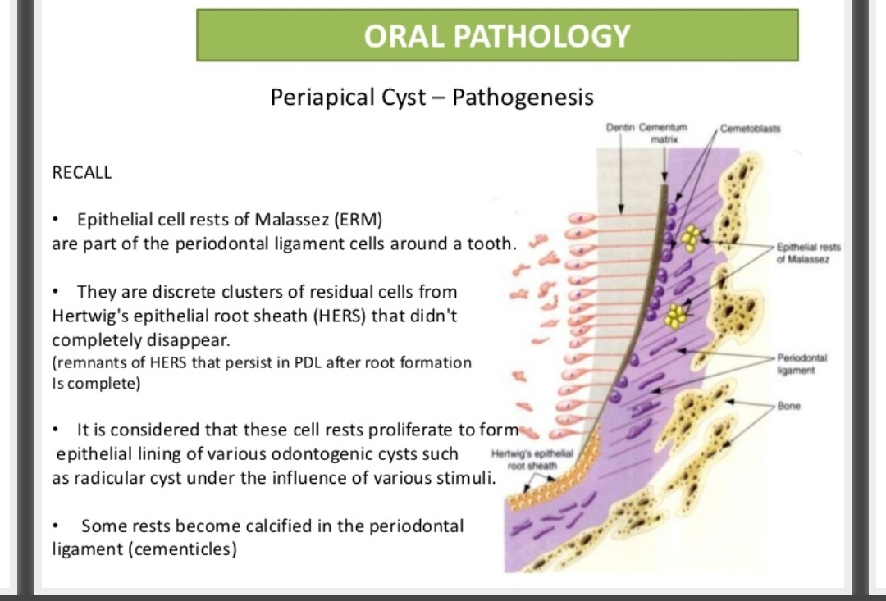

Slide 13
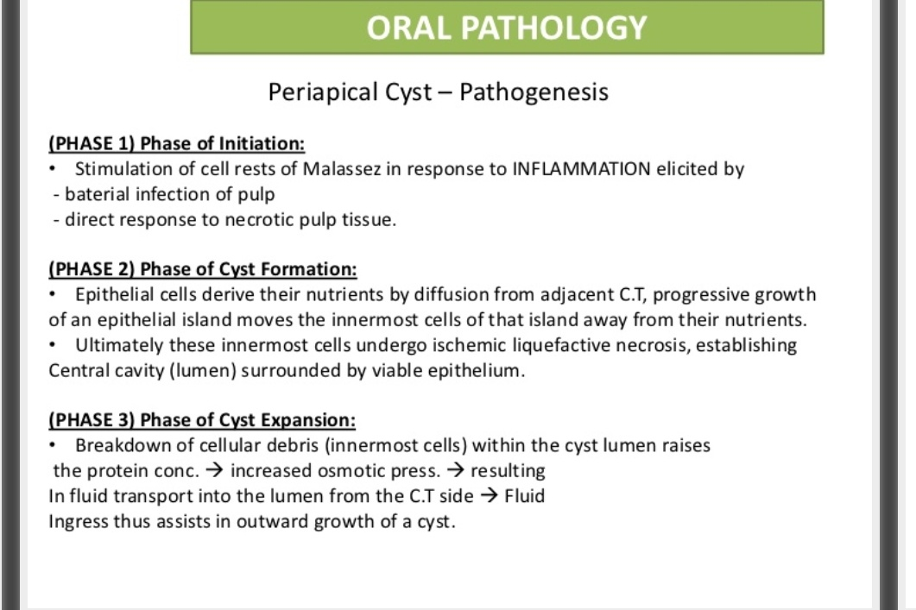

Slide 14
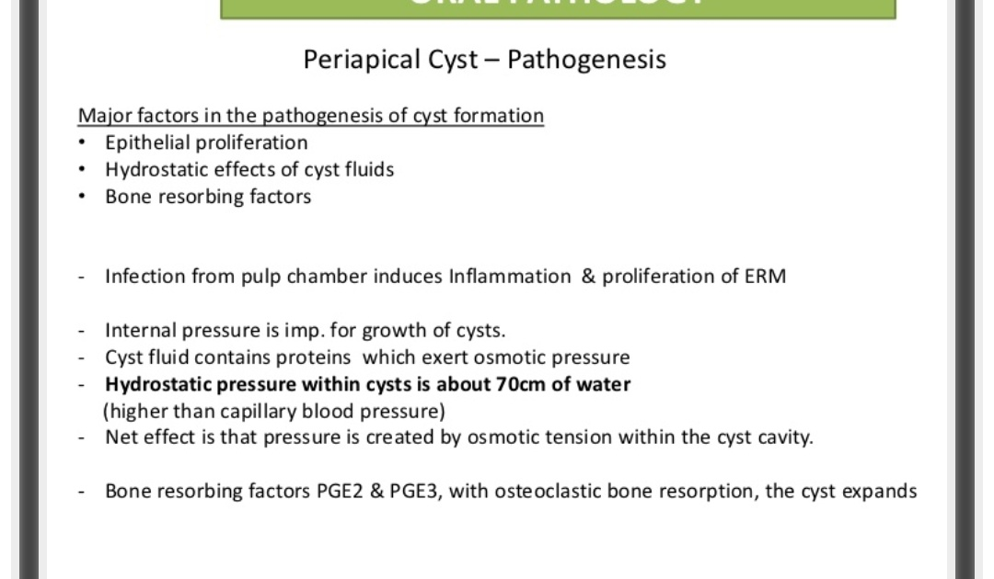

Slide 15
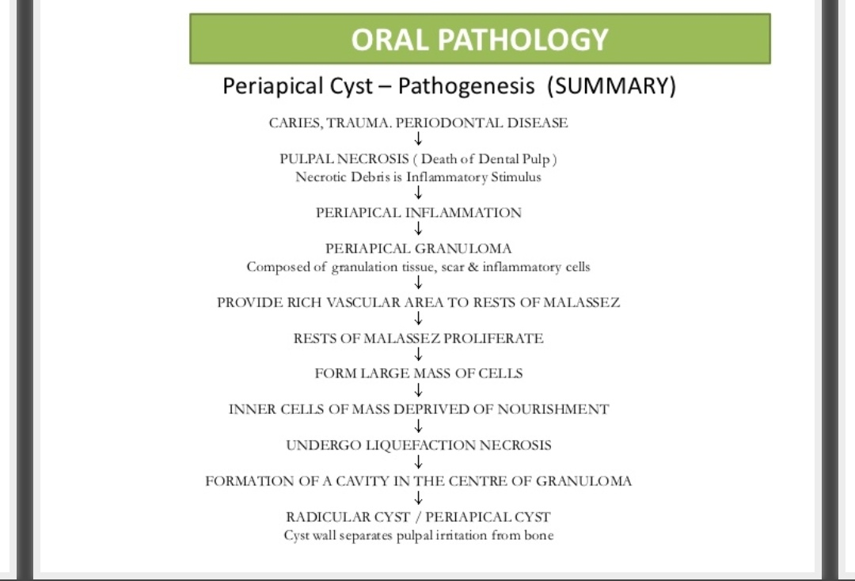

Slide 16
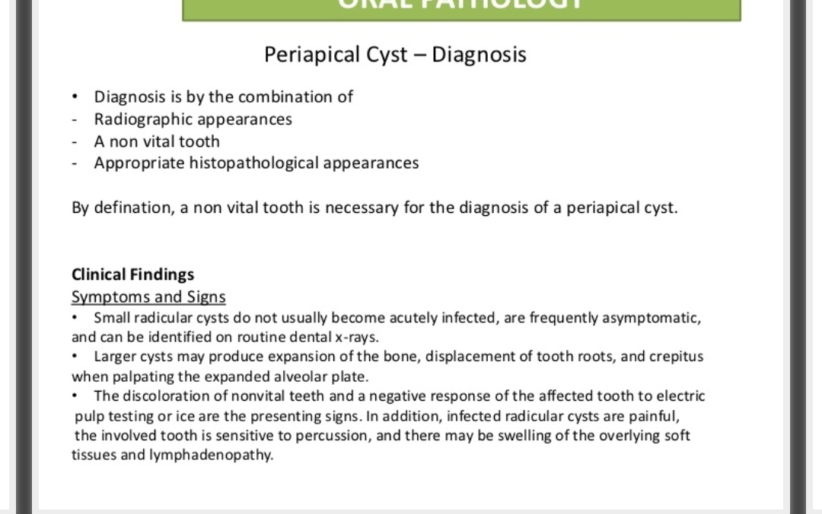

Slide 17
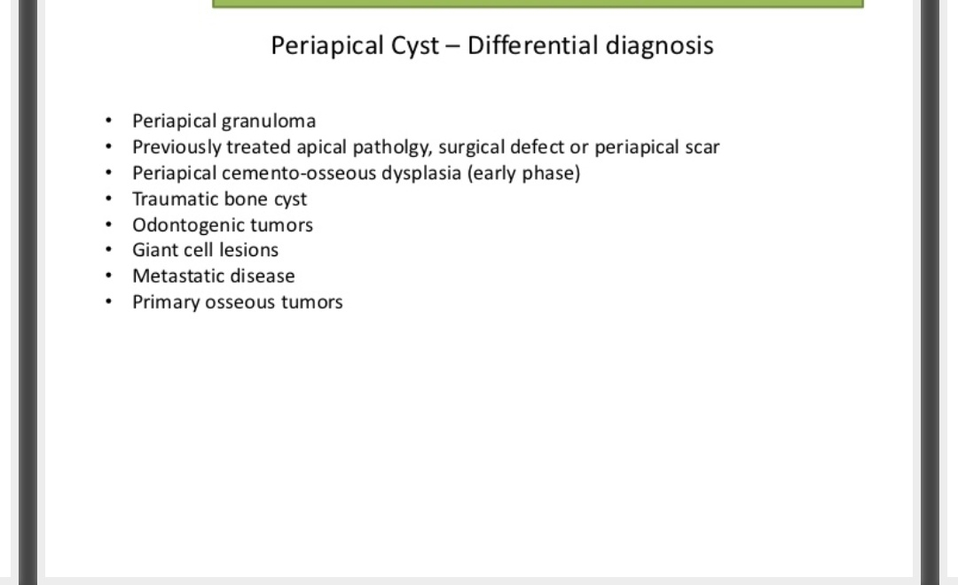

Slide 18
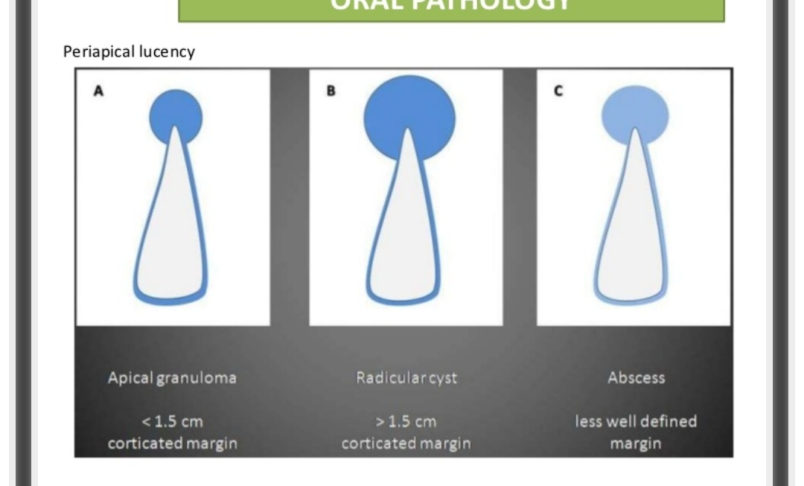

Slide 19
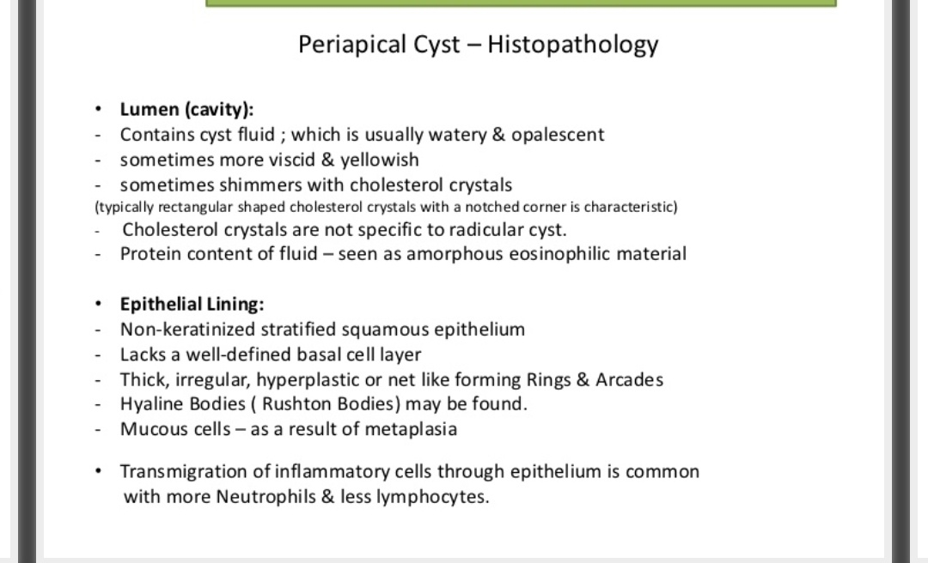

Slide 20
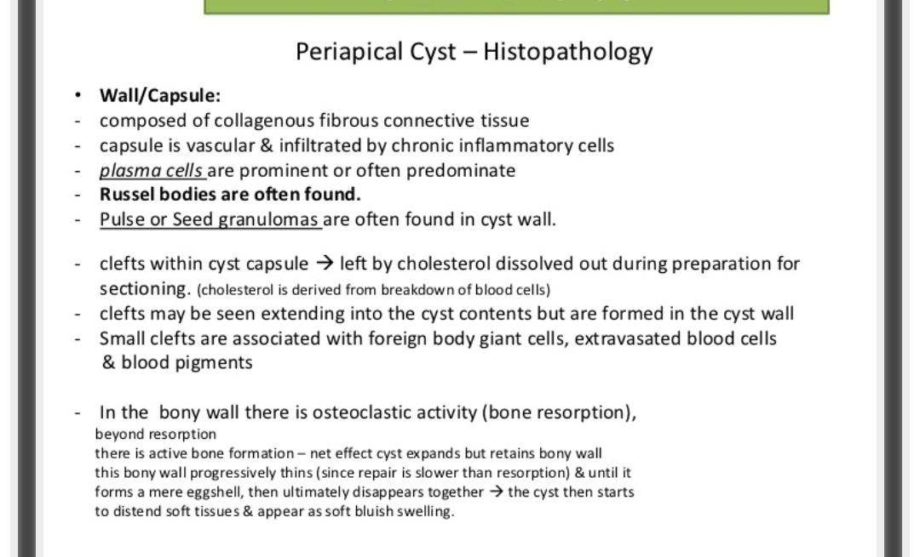

Slide 21
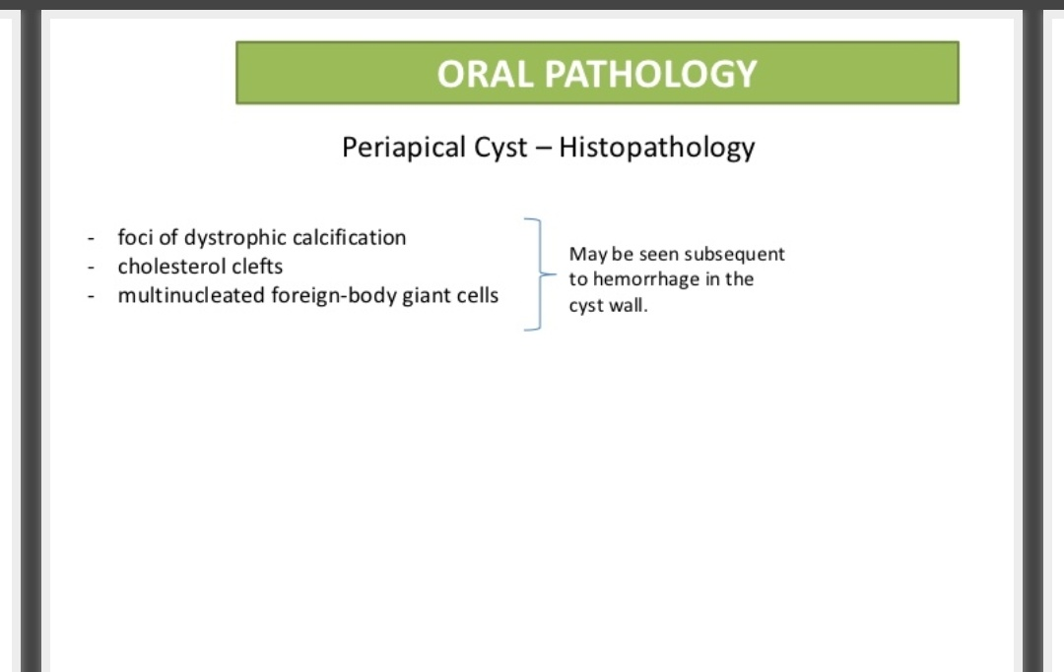

Slide 22
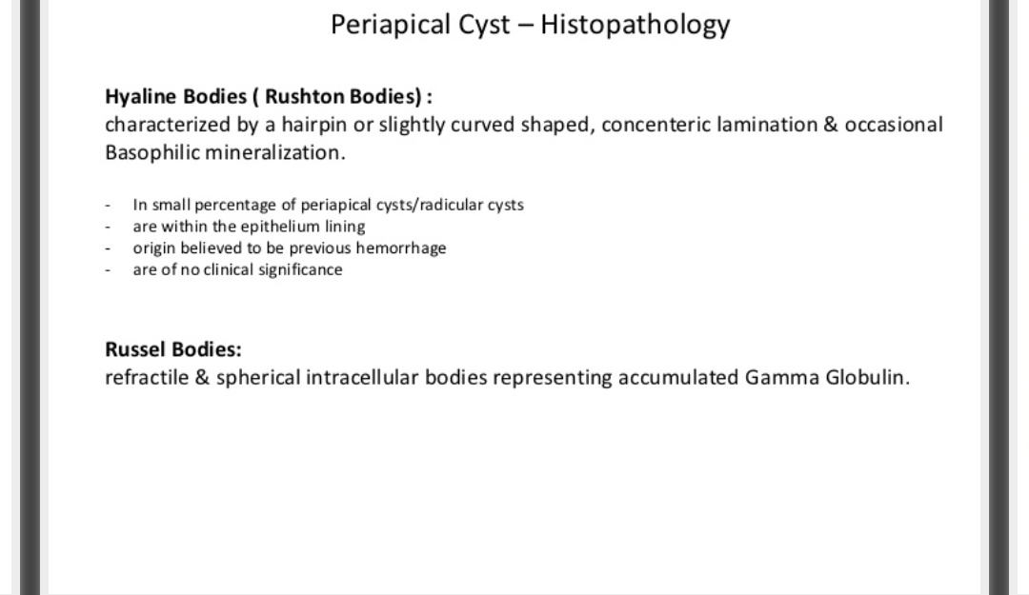

Slide 23
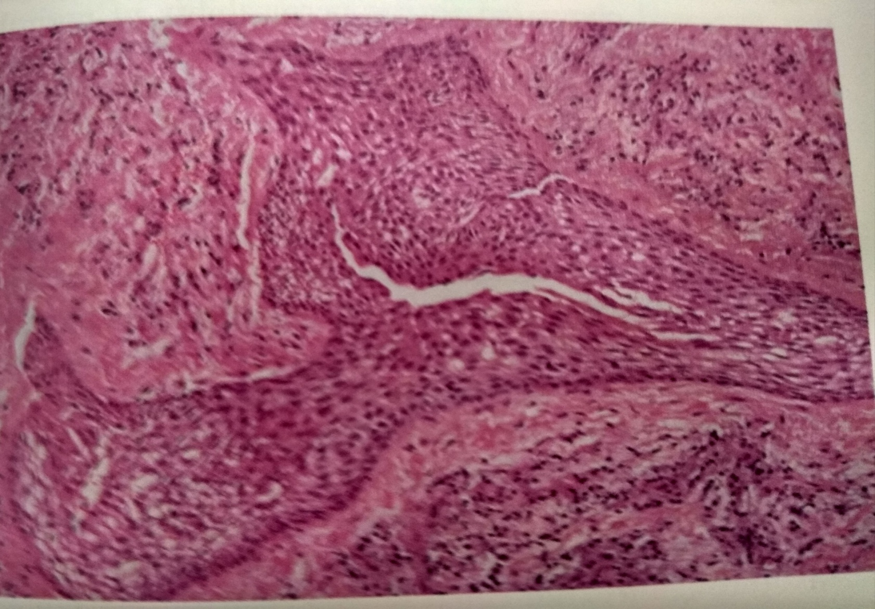

Slide 24
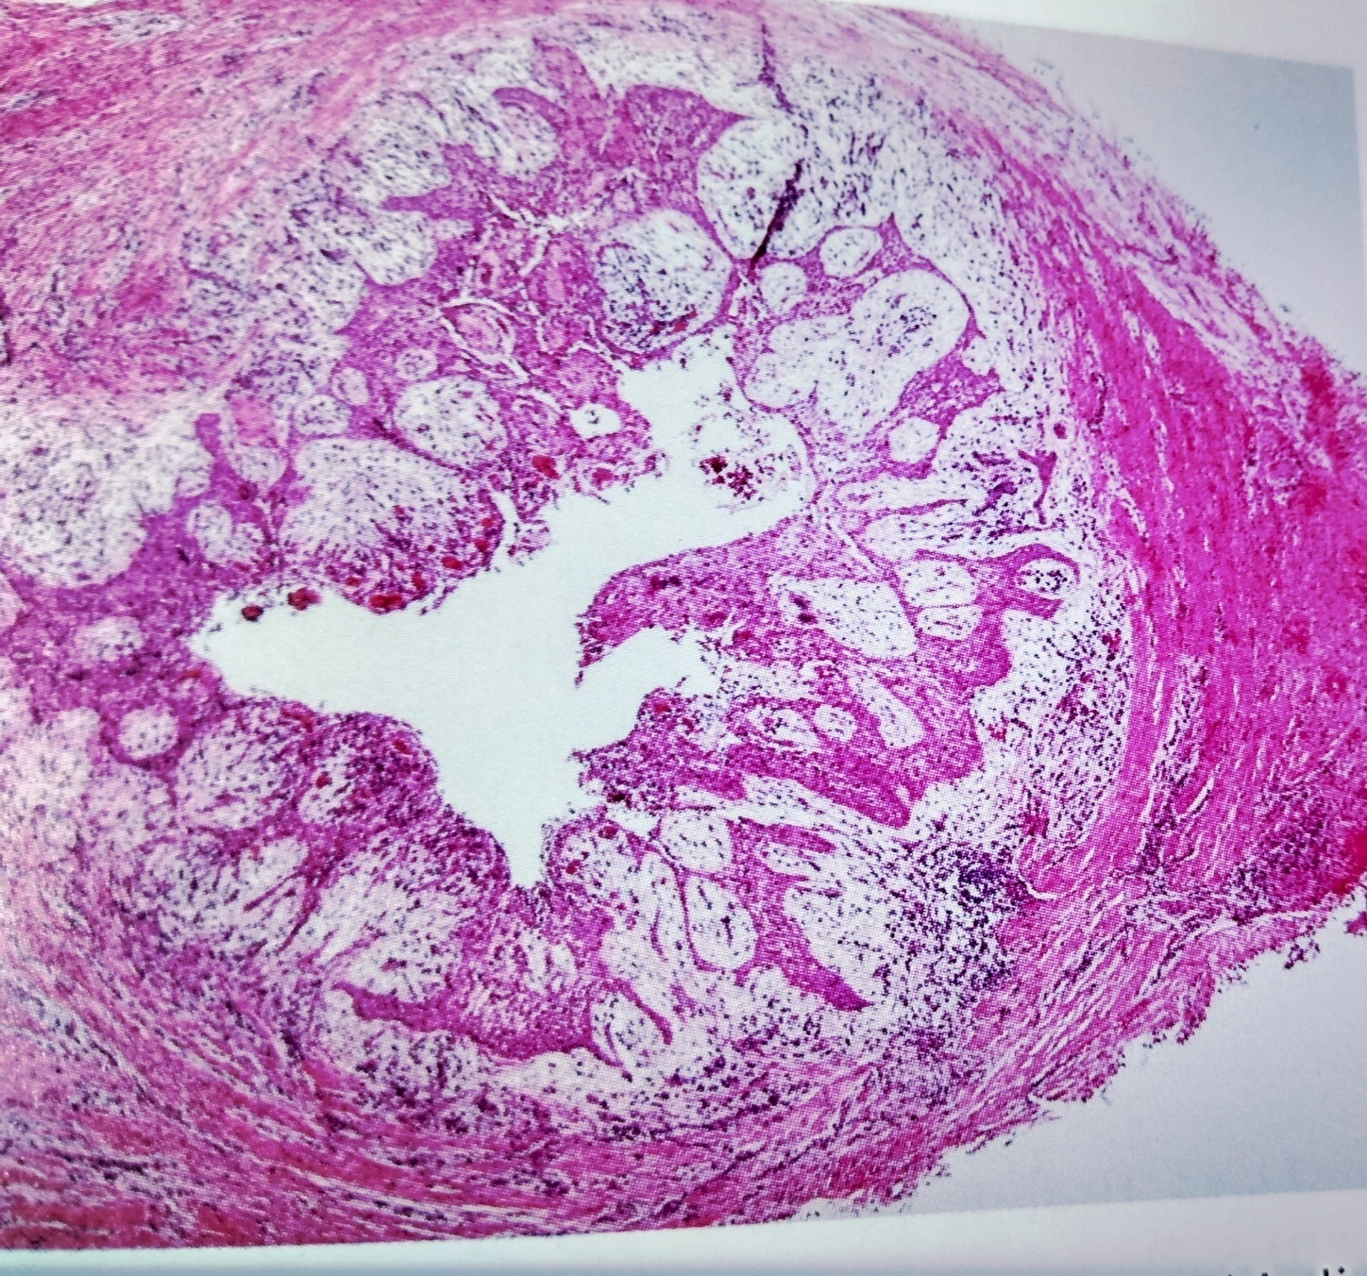

Slide 25
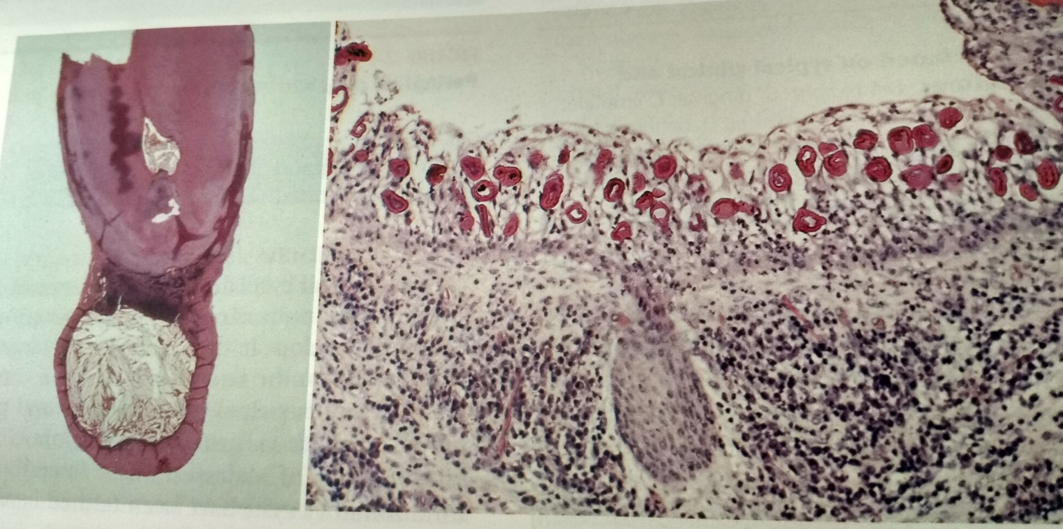

Slide 26
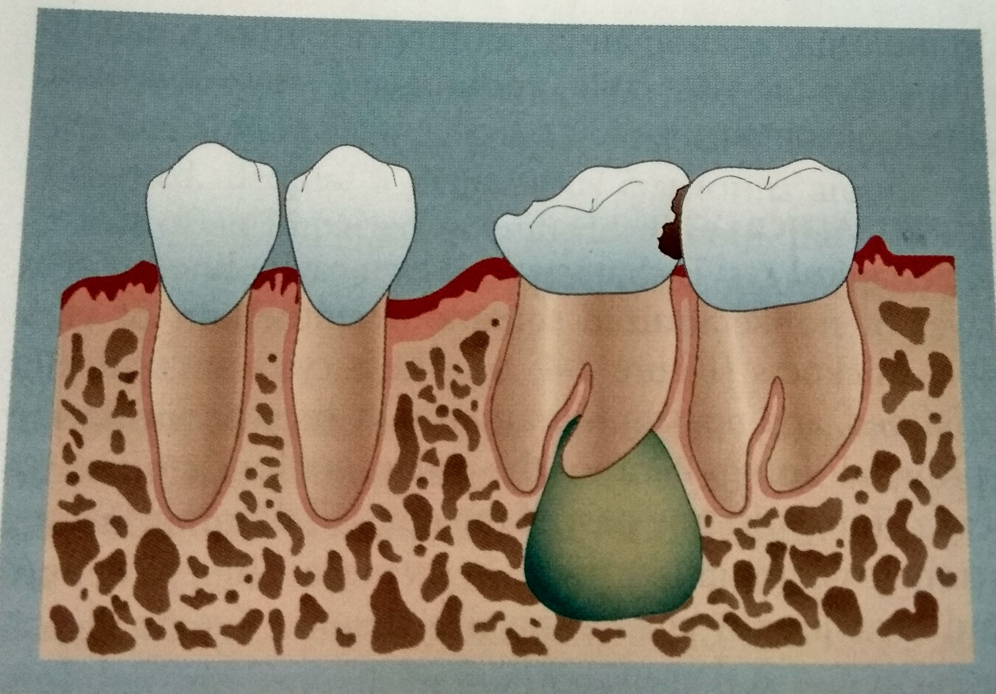

Slide 27
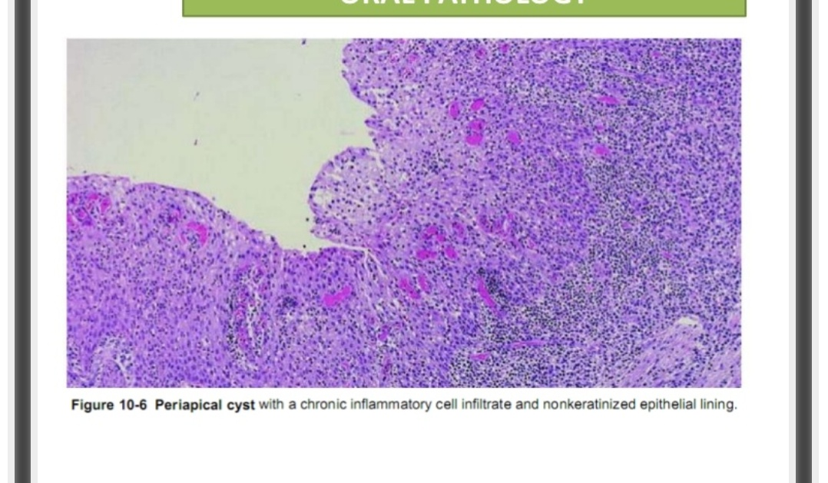

Slide 28
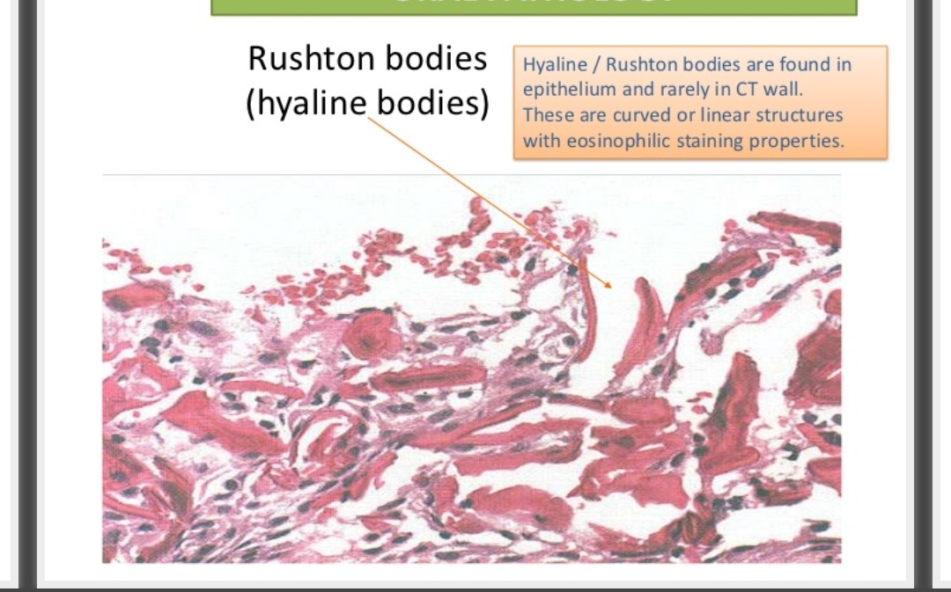

Slide 29
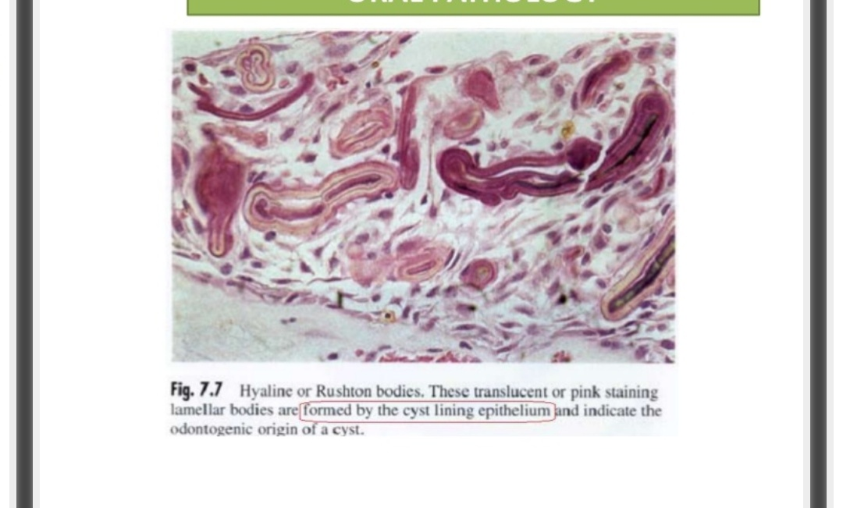

Slide 30
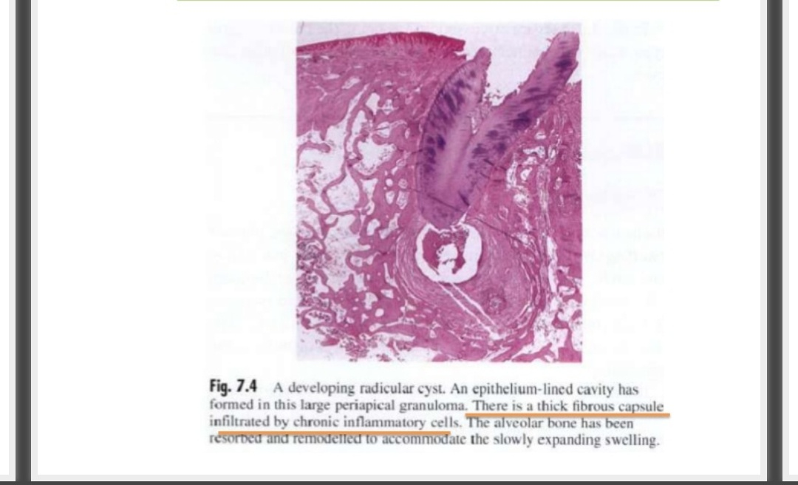

Slide 31
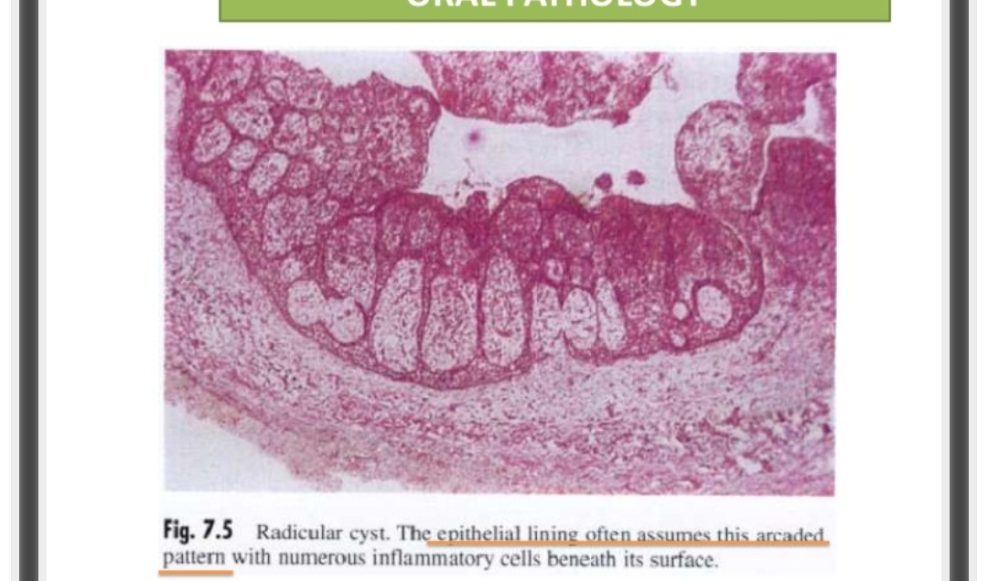

Slide 32
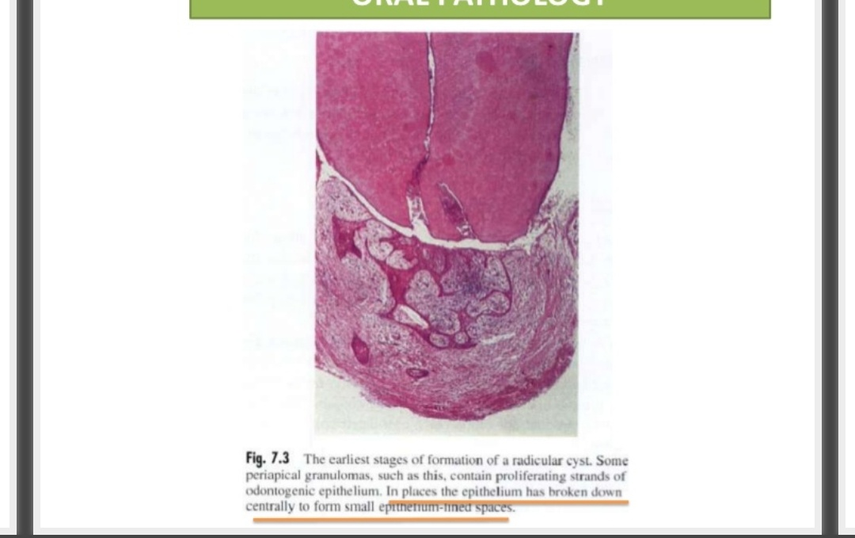

Slide 33
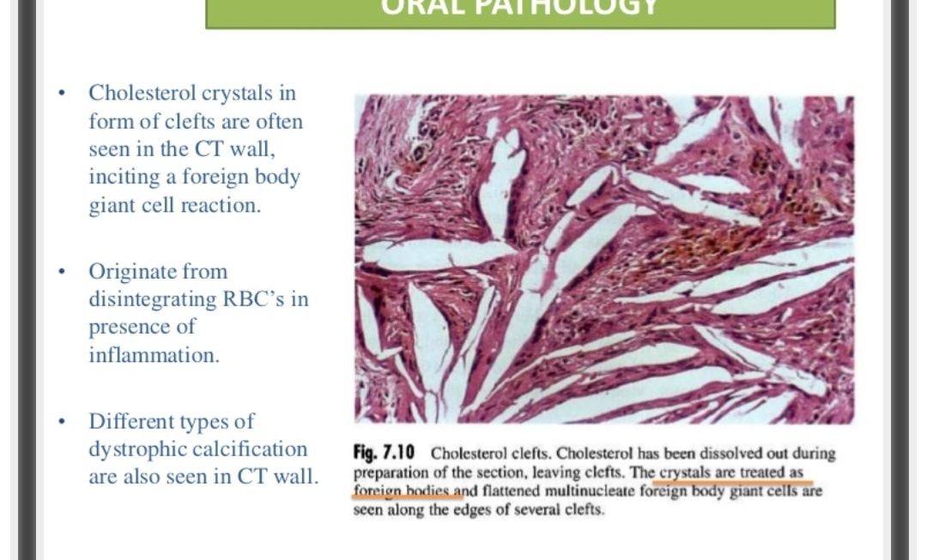

Slide 34
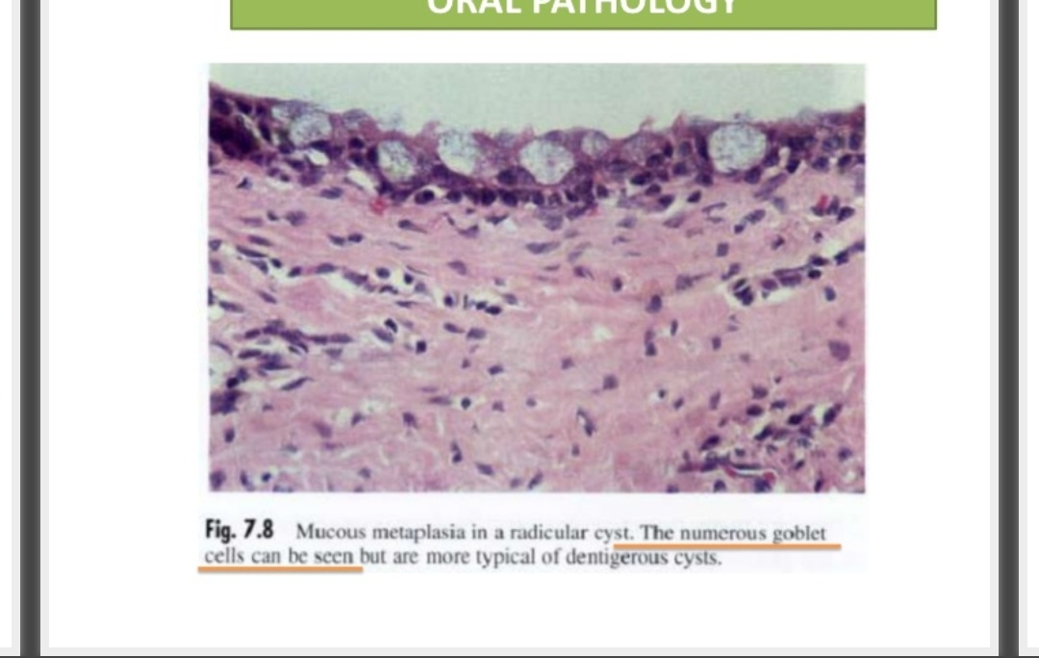

Slide 35
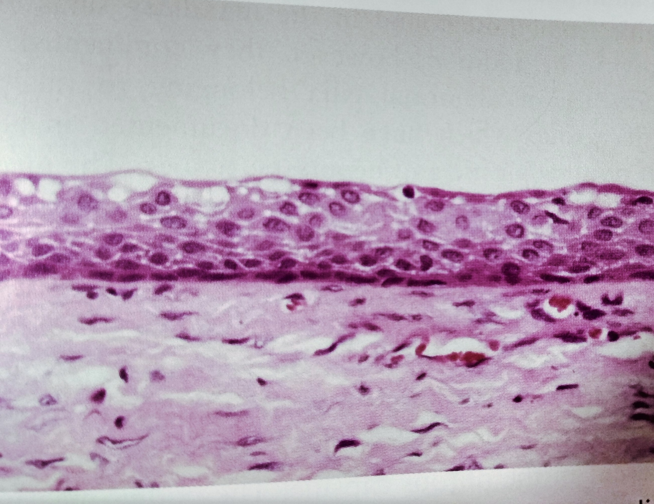

Slide 36
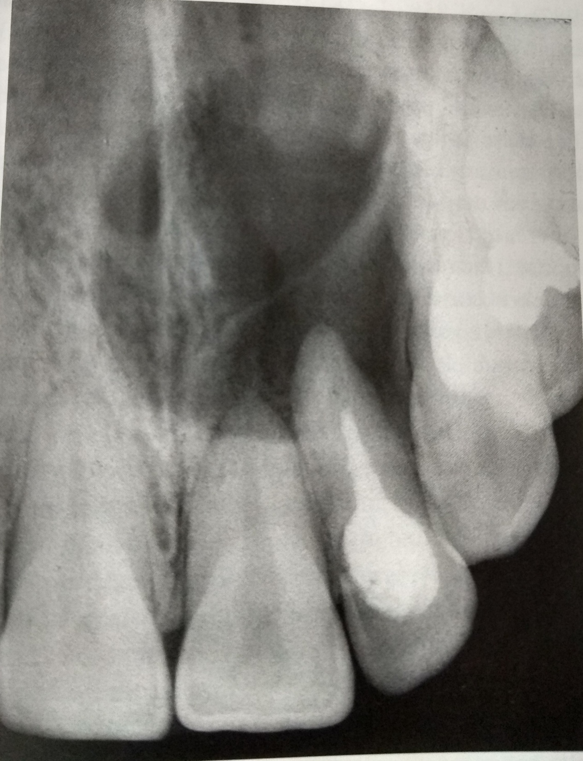

Slide 37
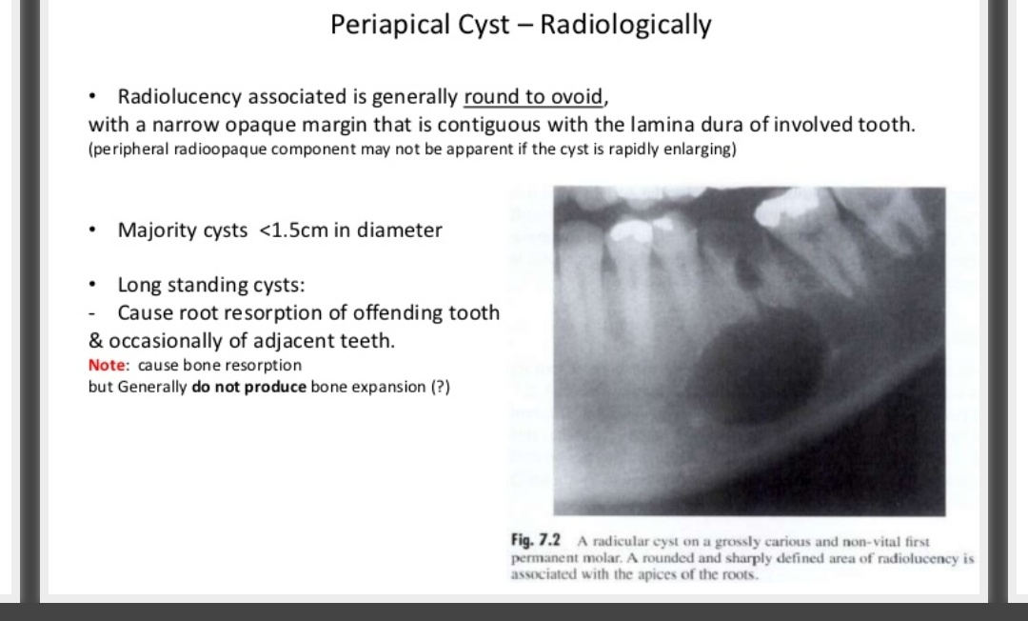

Slide 38
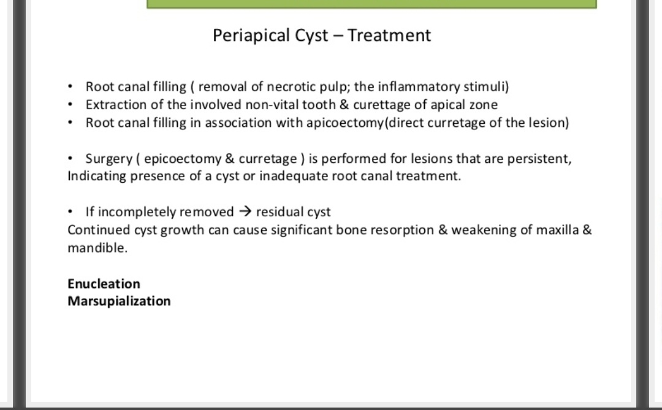

Slide 39
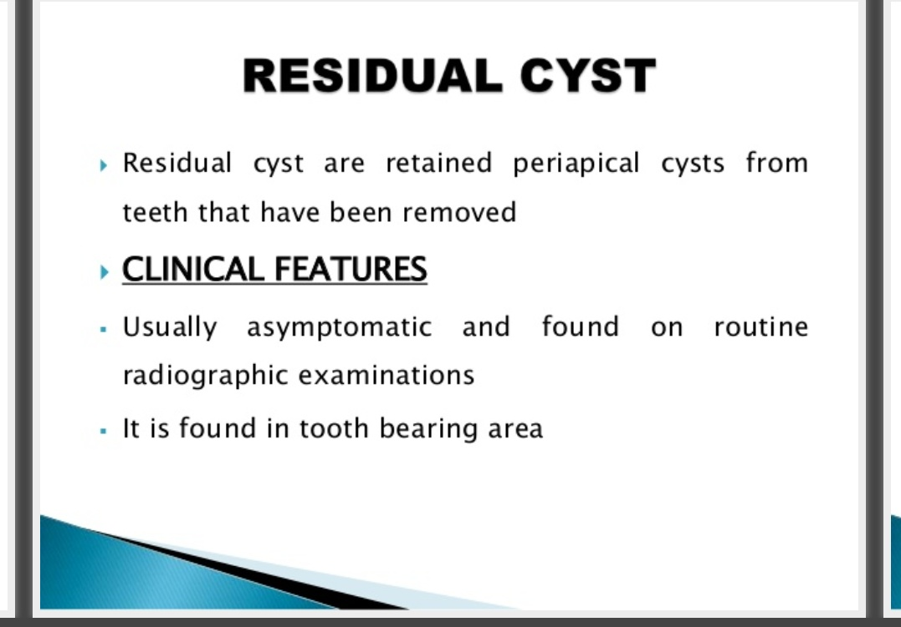

Slide 40
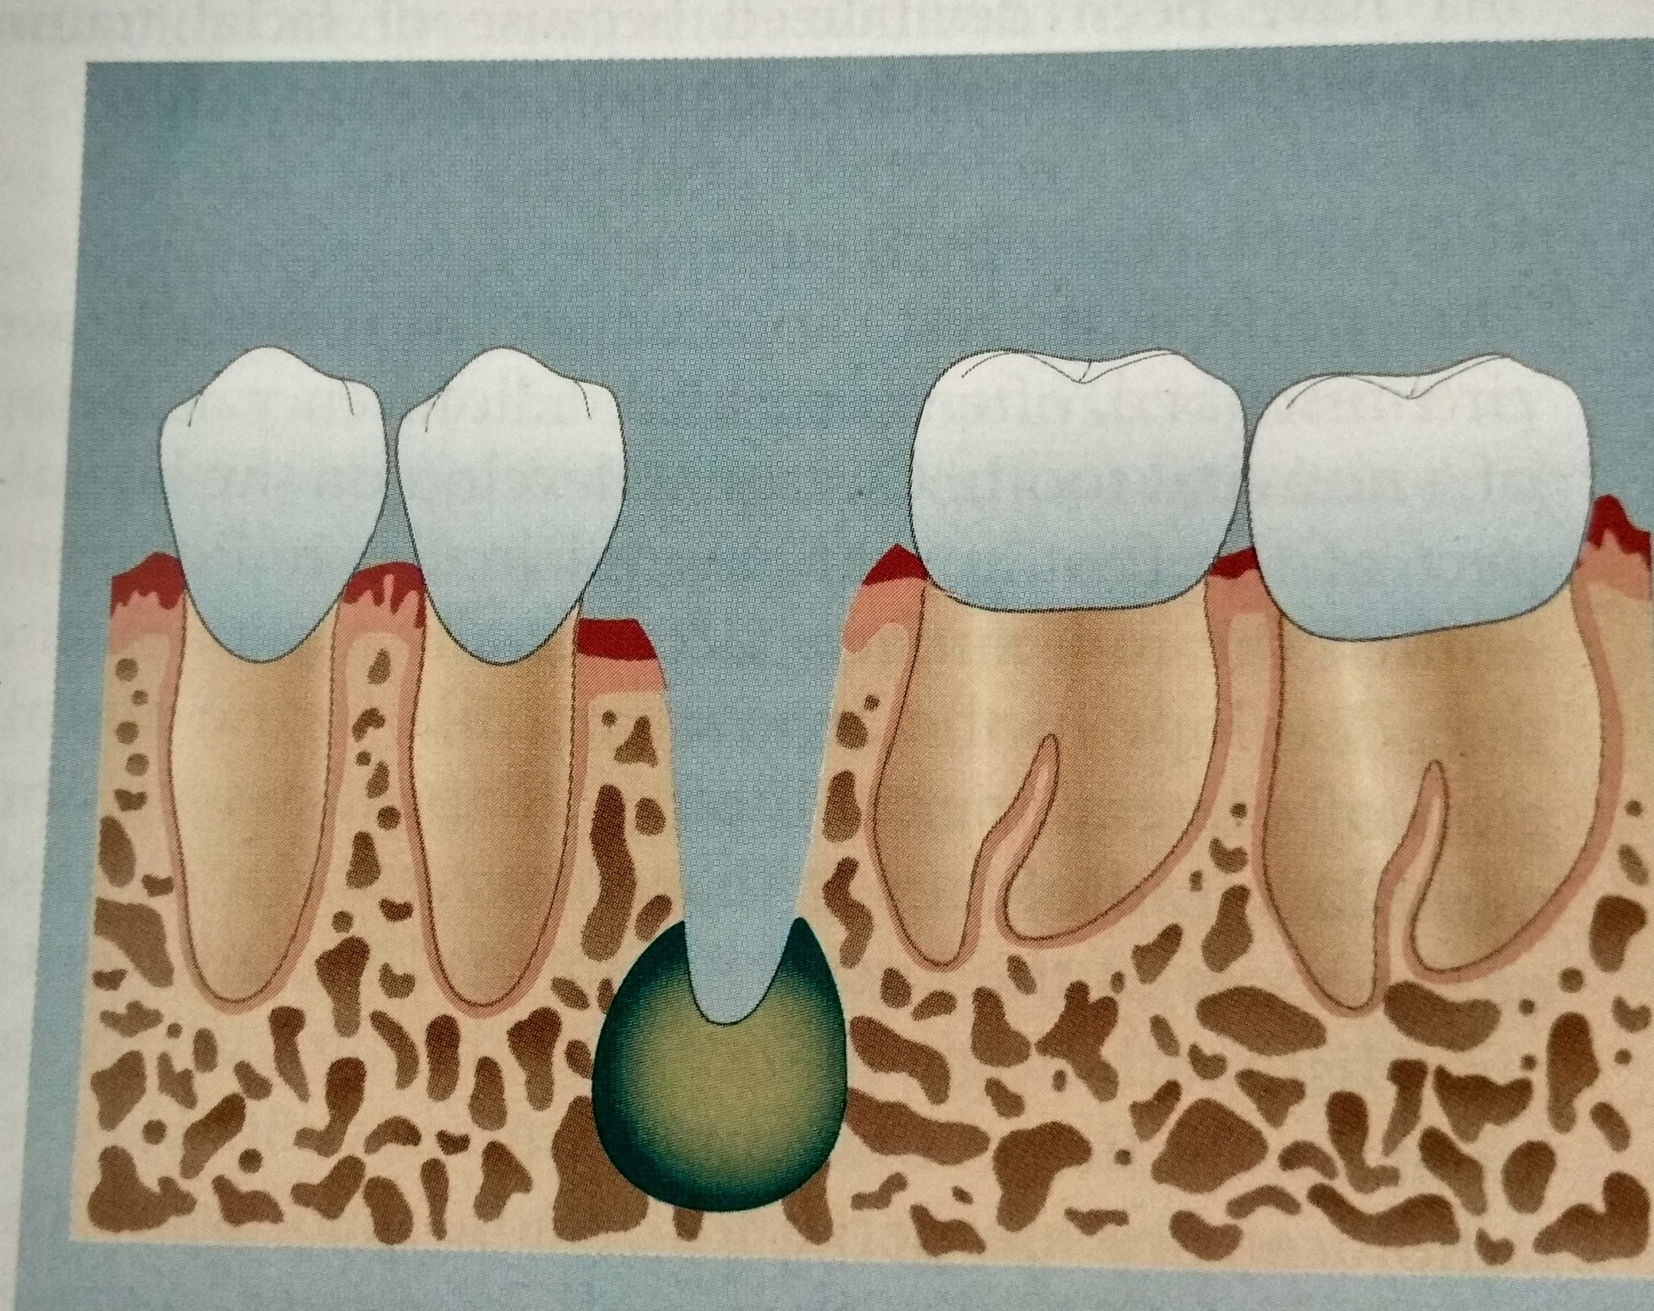

Slide 41
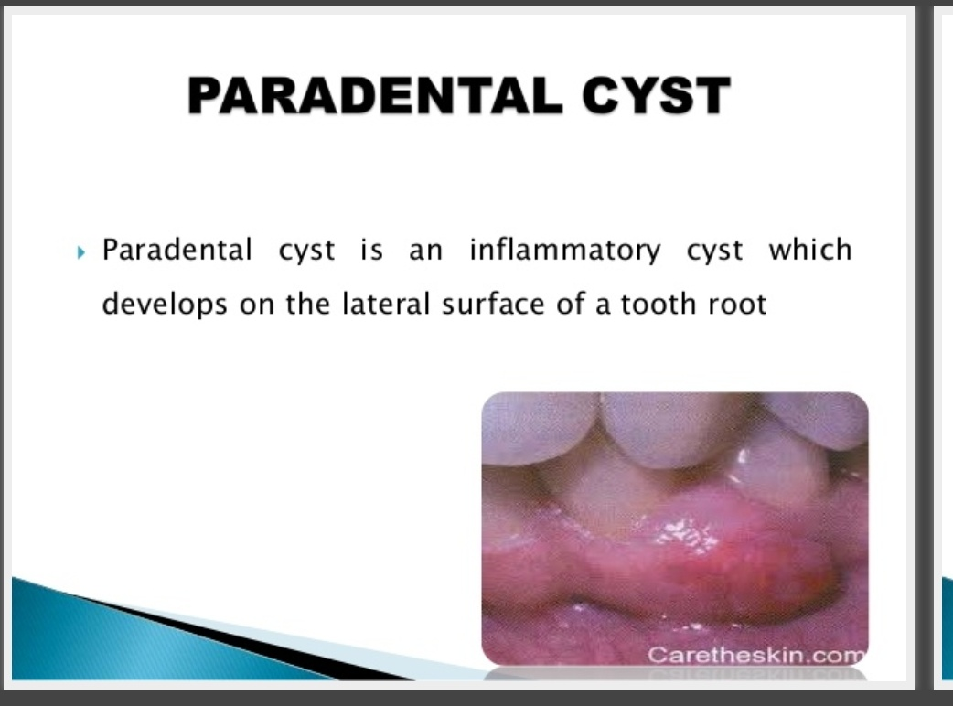

Slide 42
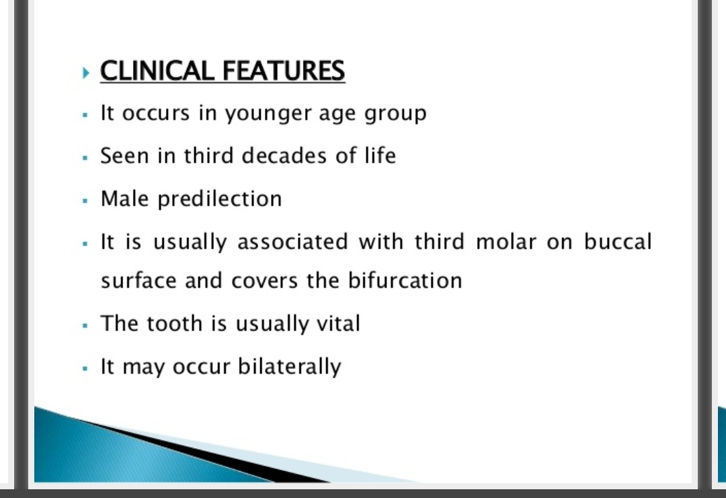

Slide 43
