Slide 1
Maxillary
Canines
Dr. Shikha Jani
Reader
Department of Oral Pathology
AMC Dental College and Hospital, Ahmedabad

Slide 2
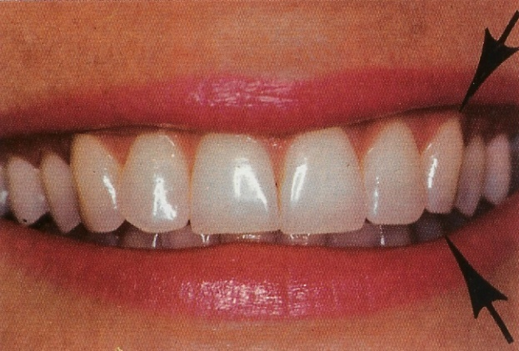
Morphology of Maxillary Canine:
- one of the last teeth to appear in the oral cavity (at the age of 11-12 years).
- larger than the mandibular canine.

Slide 3
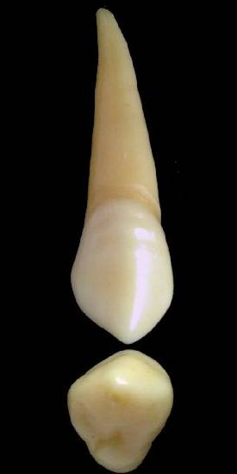
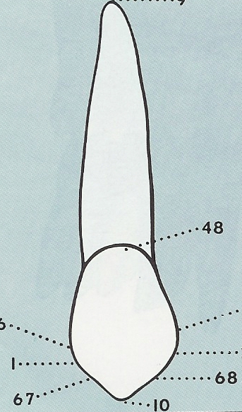
Labial Aspect
1) Crown
The facial side is made up of three lobes (like the incisors), and the cingulum on the lingual side is the fourth lobe.
Surface is roughly pentagonal in shape and convex all over.
Labial ridge and shallow depressions present.
D
M

Slide 4
Labial Aspect
a. Crown Outline:
Mesial OUTLINE: broadly convex in
the middle third and flat in
cervical third.
Distal OUTLINE : convex in the
middle third and slightly
concave in the cervical third.

Slide 5
        Labial Aspect
b. Cusp
* It has a Mesial slope
(Shorter than)
Distal slope
* Cusp tip is centered on the root axis line.
* Cusp slopes and the cusp make up 1/3rd the length of the crown.

Slide 6
Labial Aspect
c. Contact Area
* Mesial at the junction of incisal and middle thirds.
* Distal in the middle third. (more cervically located than Mesial contact area).

Slide 7
2) Root
* It is long, slender and conical.
* The apical third is narrow
Mesio-distally.
* The apex may be pointed and bends distally.

