Slide 1
Red and white lesions
Dr Kosha P Ruparelia
Senior Lecturer, Dept of oral medicine and radiology

Slide 2
Why white lesions are white?
Keratotic lesions
Hyperkeratosis (Increased production of keratin)
Acanthosis (Abnormal but benign thickening of stratum spinosum)
Extracellular accumulation of fluid in the epithelium
Microbes, particularly fungi, can produce pseudomembranes consisting of sloughed epithelial cells, fungal mycelium, and neutrophils

Slide 3
Oral candidiasis
Introduction:
  Most prevalent opportunistic infection affecting the oral mucosa
  Most common HIV associated oral mucosal lesion
Synonyms: Moniliasis
Etiology: Candida albicans (Most common), C. tropicalis, C. glabrata comprise together over 80% of the species isolated from human candidal infection

Slide 4
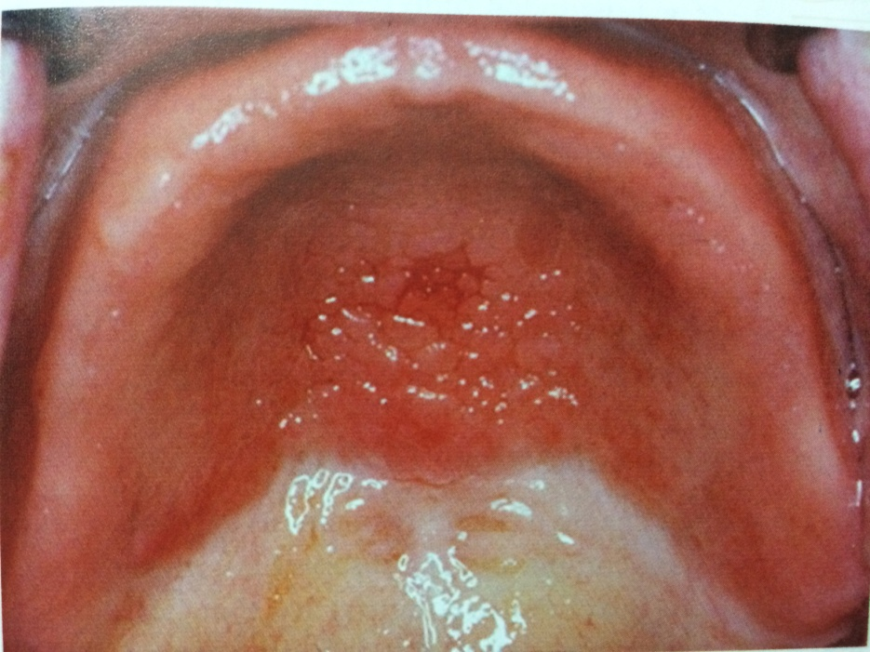
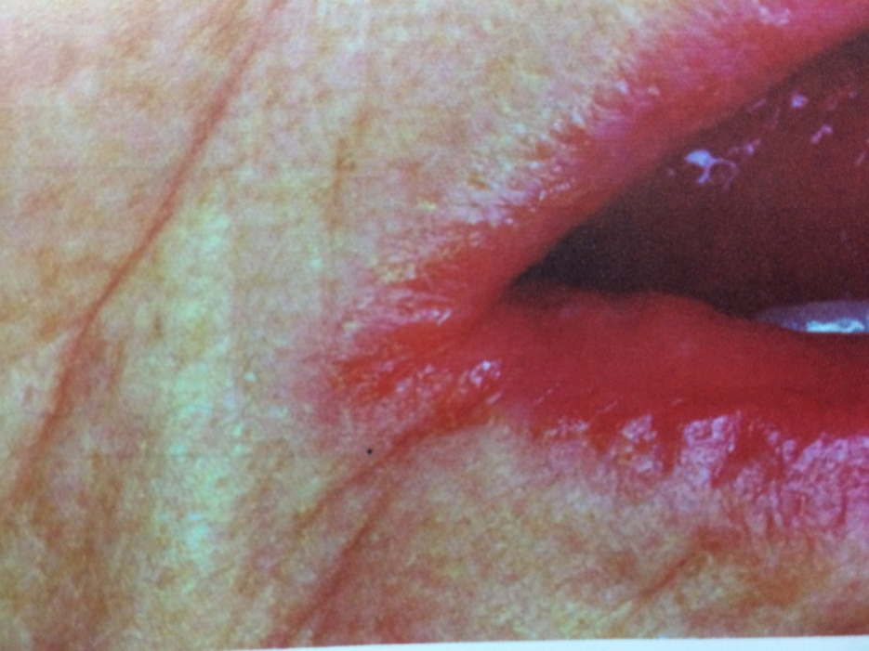
Candida associated lesions
Denture stomatitis
Angular chelitis

Slide 5
Leukoplakia - Types
HOMOGENOUS TYPE
NON HOMOGENOUS TYPE
    A white, often well demarcated plaque with an identical reaction pattern throughout the entire lesion.
    Surface texture:
      Smooth, thin
      Leathery with surface fissures (Cracked mud)
It may have white patches or plaques intermingled with red elements
White component (Small nodular/Large verrucous)
Surface texture: (Homogenous white but contains verrucous, papillary (nodular) or exophytic component)

Slide 6
Leukoplakia- Types
VERRUCOUS TYPE
PROLIFERATIVE VERRUCOUS TYPE
Leukoplakia where the white component is dominated by papillary projections, similar to oral papillomas
Leukoplakia with a clinical appearance of verrucous type but with a more aggressive proliferation pattern
Age & Gender: Old women
Site: Lower gingiva
High malignant potential (Verrucous carcinoma may be present at 1º examination)

Slide 7
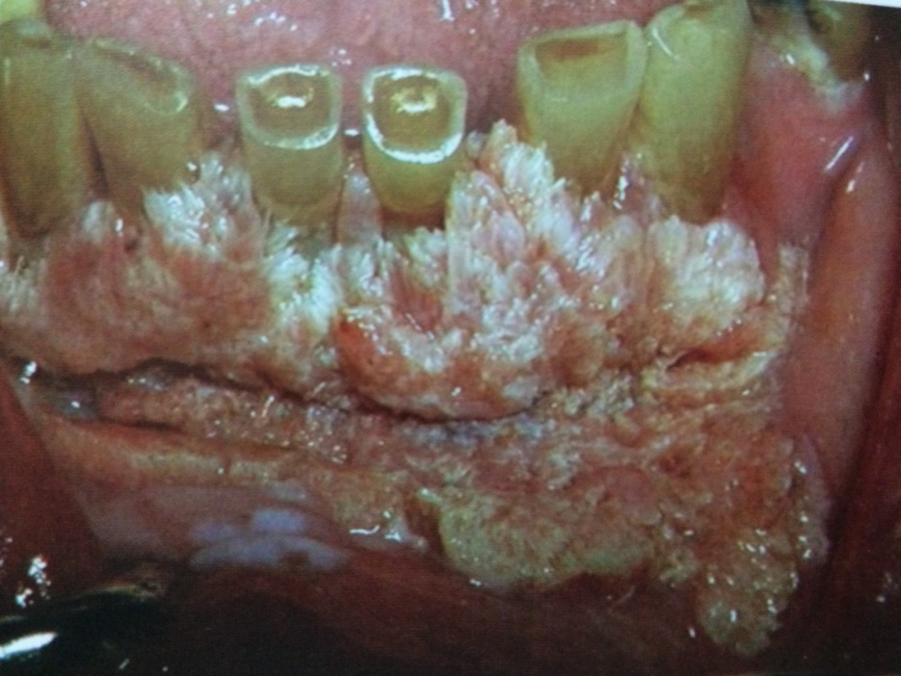
Veruccous leukoplakia
Female
Mandibular gingiva
Habit may or may not be present
Exophytic

Slide 8
Benign hard tissue lesions (Tumors)
Dr Kosha P Ruparelia
Senior lecturer, Dept of oral medicine and radiology

Slide 9
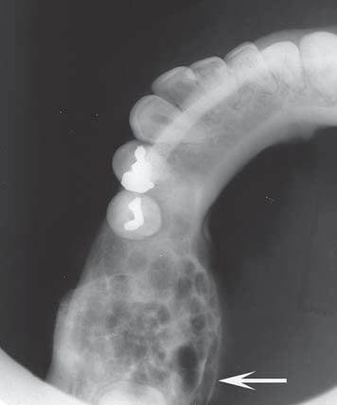
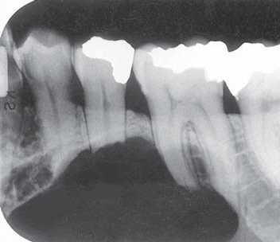
Ameloblastoma
The most common benign tumor
Old age, Male, Post. Mandibular region
Well defined, corticated periphery
Multilocular lesion-Coarse, Curved septa
Honey comb – Ant, Soap bubble – Post
Knife edge root resorption
Bi Expansion, thinning and egg shell effect
High recurrence

Slide 10
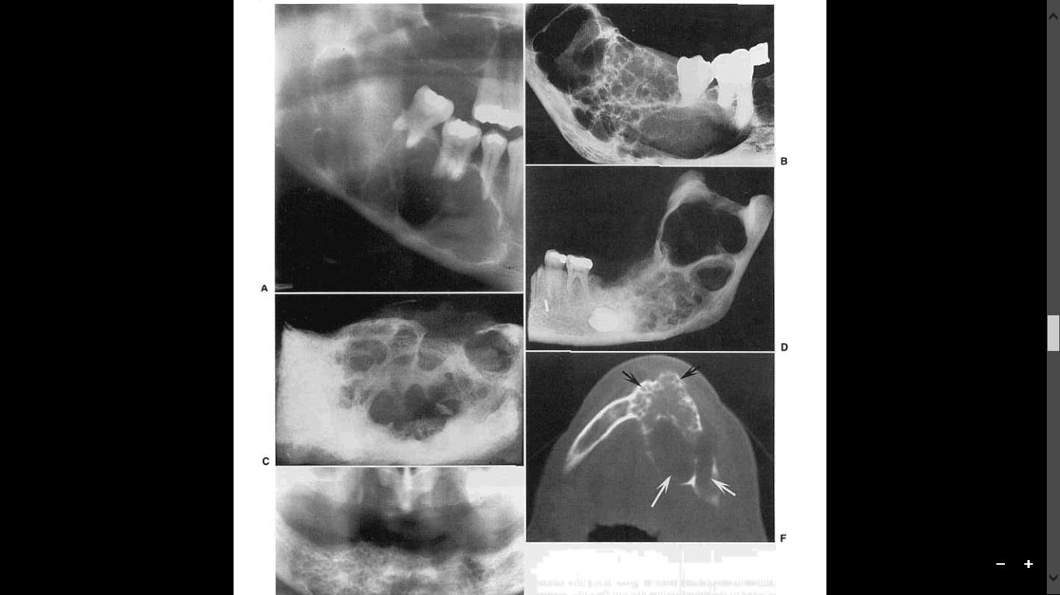
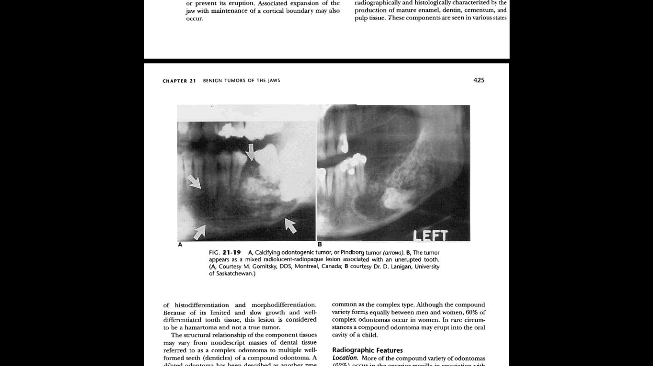
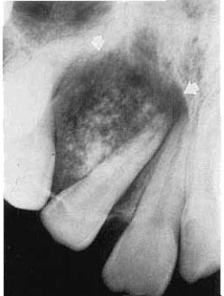
Epithelial tumors
Ameloblastoma
CEOT (Mild)
Coarse, Curved septa
Ameloblastoma
Odontogenic Keratocyst
Hemangioma
Cherubism
Mixed lesions
Osteomylitis
CEOC
CEOT
AOT
Osteosarcoma
AOT

Slide 11
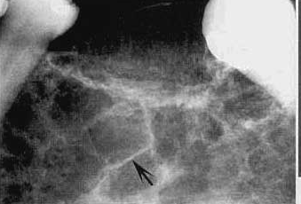
Odontogenic Myxoma
Ameloblastoma
(For comparison)
Straight septa
Tennis racket pattern
Step ladder pattern
Soft tissue
Odontogenic Myxoma
Desmoplastic Fibroma
Sunray appearance
Osteosarcoma
Odontogenic Myxoma
Central Hemangioma
Slow in expansion
Odontogenic Myxoma
Odontogenic Keratocyst

Slide 12
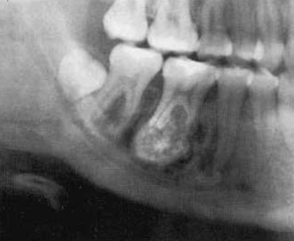
Soft tissue capsule/halo
True cementoma
Odontome
Osteoblastoma
Periapical cemental dysplasia
Florid osseous dysplasia
Cemento-ossifying fibroma
Wheel Spoke pattern /Amorphous pattern
True cementoma
Benign cementoblastoma

Slide 13
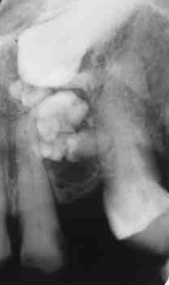
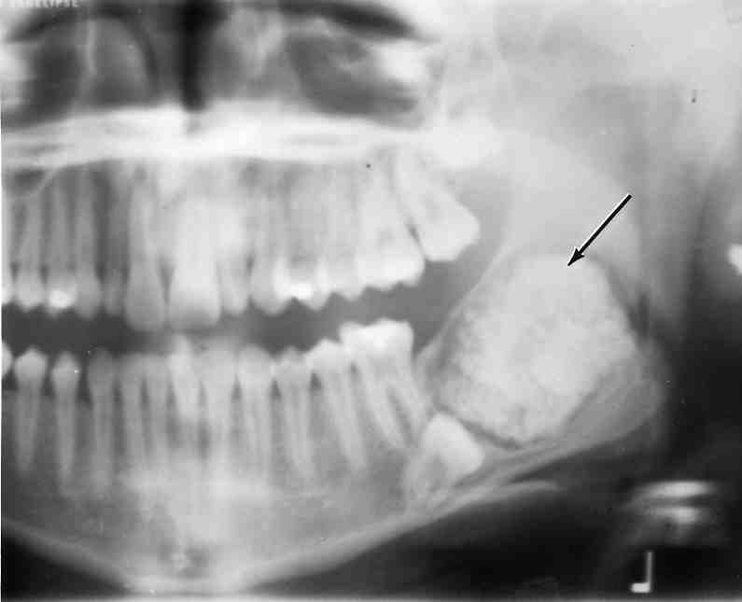
Compound odontome
Complex odontome (F:M = 2:1)
Second
decade

Slide 14
BLEEDING AND CLOTTING DISORDERS
Prepared by – Dr. Kosha P Ruparelia
Senior lecturer, Dept of oral medicine and radiology

Slide 15
INTRODUCTION
Hemostasis is the spontaneous arrest of bleeding from damaged blood vessel.
It is divided into four general phases.
  The vascular phase (Vasoconstriction)
  The platelet phase (Primary hemostasis)
  The coagulation phase (Secondary hemostasis)
  Fibrinolysis (Antithrombotic events)

Slide 16
HISTORY
Past history of bleeding following surgical procedures, including dental extractions
Active medical conditions, including hepatitis, cirrhosis,hematologic malignancy and thrombocytopenia, renal dis.?
Current medications
Family history
History of alcohol intake

Slide 17
CLINICAL FEATURES
Feature | Vascular or Platelet dis. | Coagulation dis.
Bleeding from superficial cuts and scratches | Persistent, often perfuse | Minimal
Spontaneous gingival bleeding | Characteristic | Rare
Delayed bleeding | Rare | Common

Slide 18
Feature | Vascular or Platelet dis. | Coagulation dis.
Petechiae | Characteristic | Rare
Ecchymoses | Characteristic Usually small & multiple | Characteristic Usually large & solitary

