Slide 1
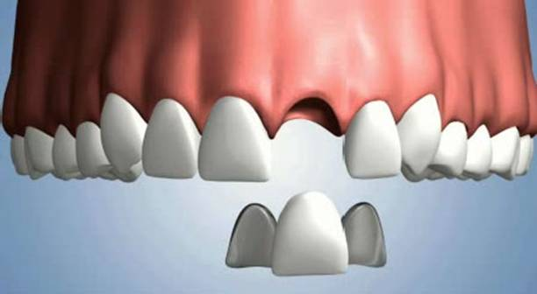
RESIN BONDED
FIXED DENTAL PROSTHESIS
Final year BDS lecture :
By: DR.KINJAL SOLANKI
DEPT. OF PROSTHODONTICS AND CROWN AND BRIDGE
AMC DENTAL COLLEGE AND HOSPITAL

Slide 2
Introduction
Resin bonded fixed Dental prosthesis is a prosthesis that requires a minimal removal of tooth structure, particularly for abutment teeth that are intact and caries free.
The primary goal of the resin bonded FDP is the replacement of missing teeth and maximum conservation of tooth structure.

Slide 3
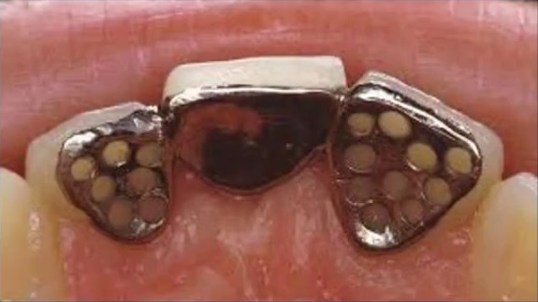
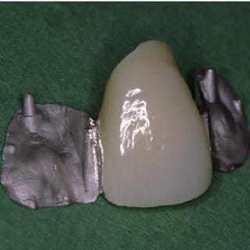
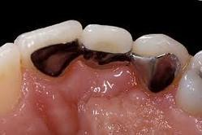
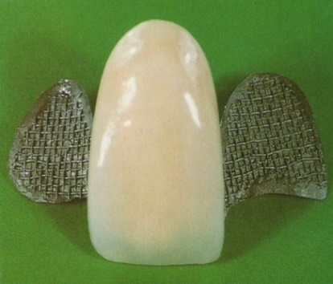
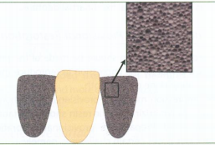
Classification
Based on the type of retention utilized by the retainers
Mechanical (Rochette bridge)
Micromechanical (Maryland bridge)
Chemical (Adhesive bridge)
Macro mechanical
(Virginia bridge)
Macro mechanical
(cast mesh)

Slide 4
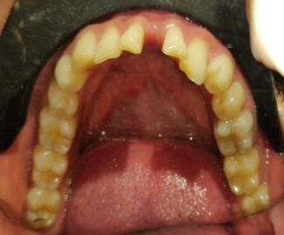
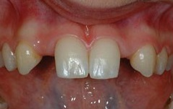
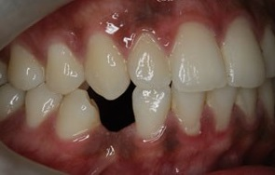
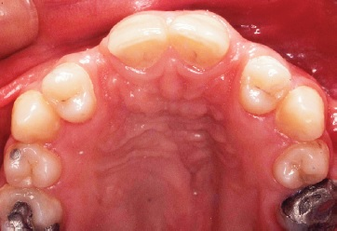
Indications
Replacement of missing anteriors in children and adolescents
Short edentulous spans
Splinting periodontically weak teeth
Significant clinical crown length
Post orthodontic retention
V Rangrajan. Textbook of prosthodontics. Resin bonded fixed partial dentures. 44. 663
Contemporary fixed prosthodintics. Rosensteil, Land, Fujimoto. Fifth edition.699.

Slide 5
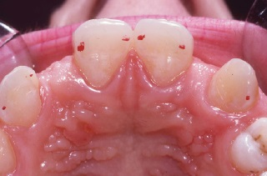
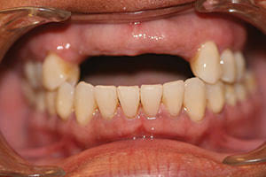
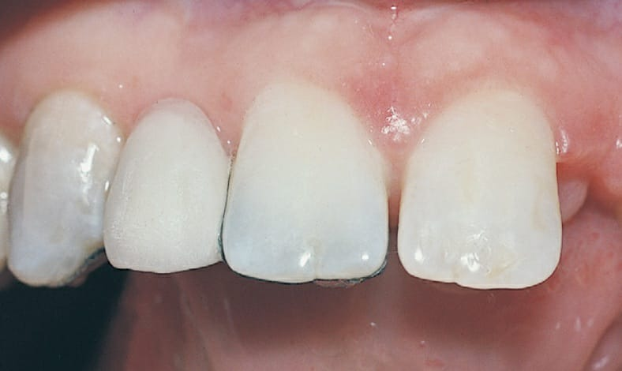
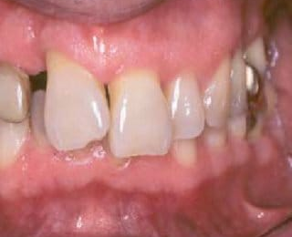
Contraindications
Short clinical crowns
Long span bridges
Thin anterior teeth facio-lingually
Deep bite
Parafunctional habits
Insufficient enamel is available for bonding
due to caries, restorations, hypoplasia
7. Sensitivity to base metal alloys
V Rangrajan. Textbook of prosthodontics. Resin bonded fixed partial dentures. 44. 663
Contemporary fixed prosthodintics. Rosensteil, Land, Fujimoto. Fifth edition.699-702

