Slide 1
Salivary glands
Dr.Kinnari H Patel
Prof and Head,Dept of Oral Pathology,AMC Dental College and Hospital,Ahmedabad.

Slide 2
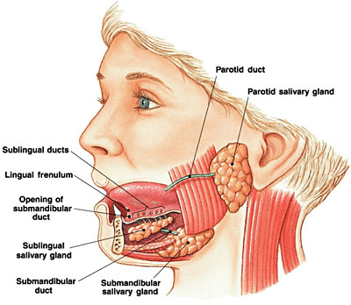
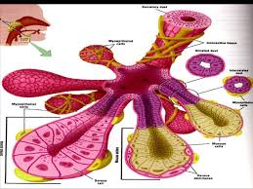
Salivary Glands

Slide 3
Glands are modified epithelial structures which are specialized to manufacture, release and transport macromolecules, ion and water in to its surrounding environment

Slide 4
classification
1.According to number of cells
unicellular
multicellular
2.Acc.to the way of secretion
Endocrine
Exocrine :Merocrine,apocrine,holocrine
3.Acc.to structure: simple and compound
4.Acc.to nature of secretion:Serous,Mucous
5.Acc. To size: major and minor

Slide 5
Exocrine glands are glands that retain ducts to body surfaces
Salivary glands and sweat gland deposit their product on the body surface. Both types of glands are buried in deeper tissues but their products appear on a superficial surface. Connecting the glands to the surfaces are ducts.
Endocrine Glands During development, endocrine glands lose their contacts to embryological surfaces(ducts) and become isolated as small blocks of tissues. Endocrine glands are therefore referred to as "ductless" glands.
The product is released across the cell membrane into interstitial spaces around the cells. Diffusion of the product into capillaries follows.

Slide 6
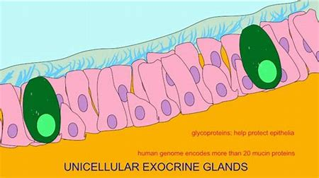
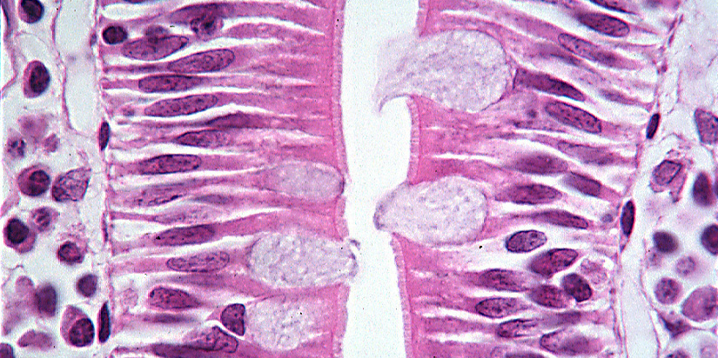

Slide 7
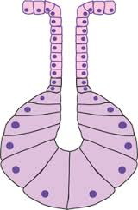
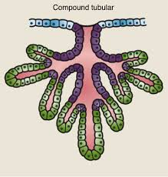
Simple gland has unbranched duct.
Compound gland has branched duct.

