Slide 1
SAMPLING TECHNIQUES
CONDUCTED BY: Dr. Ekta Malvania Damani (M.D.S)
HOD . Department of Public Health Dentistry
AMC DENTAL COLLEGE AND HOSPITAL

Slide 2
CONTENTS
Introduction
Terms used in sampling
Types of sampling designs
Requites for an reliable sample
Advantages
Selection of sampling procedures
Sampling error
Conclusions
References

Slide 3
Terminologies
Population – The population is the entire aggregation of cases that meet specified criteria.
Sampling – The process of selecting a portion of the population to represent the entire population.
Sampling frame – A list of all the elements of the population from which the sample is drawn.
Sample – A subset of a population, selected to participate in a study.

Slide 4
Strata – Populations consist of subproportions, or strata. Strata are mutually exclusive segments of a population based on specific criteria.
Sample size – The total number of study participants participating in a study.
Sampling bias – Distortions that arise when a sample is not representative of the population from which it is drawn.

Slide 5
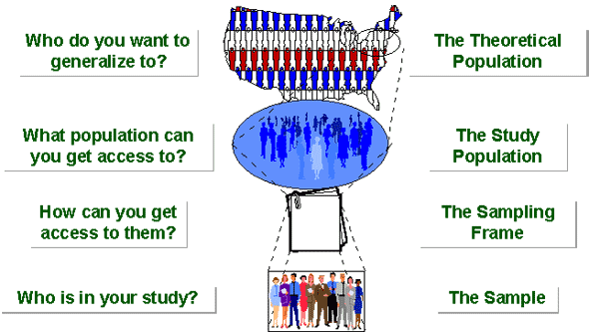

Slide 6
SAMPLING DESIGNS
1. Probability / Random sampling:
- Simple random sampling
- Systematic random sampling
- Stratified random sampling
- Multiphase random sampling
- Multistage random sampling
- Cluster sampling

Slide 7
2. Non-Probability sampling:
- Convenience sampling
- Snowball sampling
- Purposive / Judgemental sampling
- quota sampling

Slide 8
Probability/Random sampling
Here a sample is selected in such a way that all the characteristics in a population is reflected in the sample.

Slide 9

Simple random sampling
It refers to sampling technique in which each and every unit of the population has an equal opportunity of being selected in the sample. Here the selection is determined by chance only.
Applications:
- When the population is small, homogenous or readily available.

Slide 10
METHODS
Lottery method
Table of random number

Slide 11
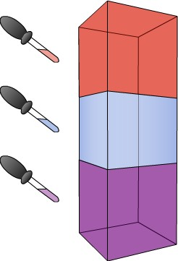
Stratified random sampling
The population is divided into homogeneous groups or strata according to some common characteristics, and sample is then drawn from each stratum by means of simple random sampling method.
Applications:
- When the population is large, heterogeneous.

Slide 12
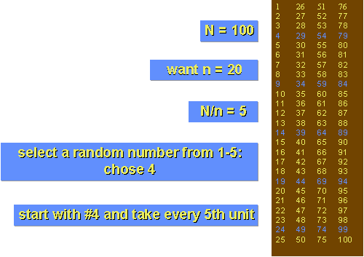
Systematic random sampling
We select one unit at random and then selecting additional unit at evenly spaced intervals till the sample of required size is required.
Applications:
- When the population is large and scattered but the population list available (sampling frame).
- When the population is heterogeneous.

Slide 13
Multistage random sampling
Here the sampling procedures carried out in several stages using random sampling techniques.
Applications
- Applicable for large scale survey like country survey.
District
Talukas
Villages
Units

Slide 14
Multiphase random sampling
Multiphase sampling is used to take basic data from large sample and details from a subsample.
E. g In school health survey
Phase 1:checking of all the children for oral health
Phase 2: children with dental caries
Phase 3: children needing dental treatment

Slide 15
Cluster sampling
This sampling technique involves choosing groups of units or clusters at random. All the units in each group, or samples of them, are then used in the study.
In a large study, this method is simpler administratively and is less expensive than simple random sampling.

Slide 16
Non-Probability sampling
Non-probability sampling carries the risk that it will not be possible to ascertain the probability that an individual unit will be included in the sample.
Thus, it will not be possible to tell whether or not the sample truly represents the reference population.

Slide 17

Convenience sampling
Entails using the most conveniently available people as participants.

Slide 18

Snowball sampling
It is a technique of building up a list or a sample of special population by using an initial set of its members as investigators.

Slide 19

Purposive/Judgemental sampling
Choosing the sample items depends exclusively on the judgement of the investigator.
Selection is based on the predetermined criterion.

Slide 20
Quota sampling
General composition of the sample is decided in advance
The only requirement is to fill these quotas by the right number of people
Purpose is to include the particular segment of population

Slide 21
Golden rule of sample statistics
Sample should be evaluated with respect to size, diversity and randomness.
Questions asked are:
- How representative of the target population are the samples?
- Was the sample selected randomly or were there factors present that could lead to biased selection?
- How large is the sample?
- How much diversity exists in the sample?
- Does it cover all the groups that make up the population?

Slide 22
Requisites for an reliable sample
There are 8 basic characteristics for an reliable sample.
Efficiency – This means the ability of the sample to yield the desired information.
Representativeness – A sample should be representative of the parent population so that the inferences drawn from the sample can be generalized so that population with measuarble precision and confidence.
Measurability – The design of the sample should be such that valid estimates of its variability can be made.

Slide 23
4. Size – A sample should be large enough to minimize sample variability and to allow estimates of the population characteristics to be made with measurable precision.
5. Coverage – Adequate coverage of the sample is essential if it is to remain representative.
6. Goal orientation – Sample selection and estimation procedures should be oriented towards the study objectives and research design and conditions.

Slide 24
Feasibility - The design should be simple enough to be carried out in practice.
Economy and cost efficiency – The design of the sample should be such that appreciable savings in time and cost can be achieved without undermining the study objectives.

Slide 25
Advantages
Sampling reduces the cost of the investigation, time required and the number of personnel involved.
Sampling is especially important when the tests used in the study are highly technical or detailed or must be administered or interpreted by experts.
Sampling allows thorough investigation of the units of observation.
Sample can be covered more adequately and in more depth in a research project than can a total population.

Slide 26
Errors in sampling
Error
sampling
Faulty design
Small sample size
Non sampling
Coverage
Observational
Processing

Slide 27
Thank
u!!!!

Slide 28
References
Health research methodology : a guide for training in research methods, World health organization regional Publications, 1993.
Denise F. Polit, Cheryl Tatano Beck. Essentials of Nursing Research Methods, Appraisal, and Utilization, Sixth edition, Lippincott Williams and Wilkins Publishers, 2006.
Brunette D. M. Critical thinking Understanding and evaluating dental research, Quintessence Publication, 1996.
Hiremath S. S.Textbook of Preventive and Community Dentistry, Elsevier publication, 2007.

