Slide 1
ORAL AND MAXILLOFACIAL SURGERY
ANKYLOSIS OF
TEMPOROMANDIBULAR
JOINT
DR. RAMITA SOOD (M.D.S)
PROFESSOR AND HEAD OF THE DEPARTMENT
AMC DENTAL COLLEGE AND HOSPITAL

Slide 2
ANATOMY
The TMJ is a diarthrodial, ginglymus, synovial joint that is capable of both rotational and translatory movements.
It is formed by the articulation of the glenoid fossa of the temporal bone and the head of the condyle.

Slide 3
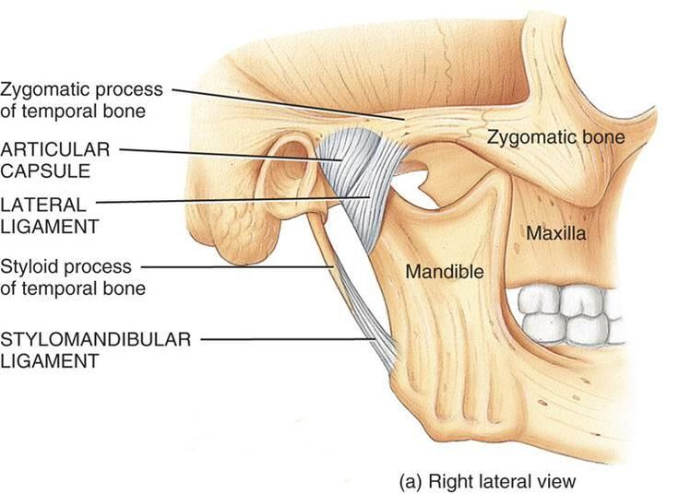
TMJ ARTICULATION CONSISTS OF:
Bony component:
Glenoid fossa
Condyle
Intra articular disc Joint fibrous capsule
Extracapsular ligaments
- lateral ligament
sphenomandibular ligament
stylomandibular ligament
fibrous capsule

Slide 4
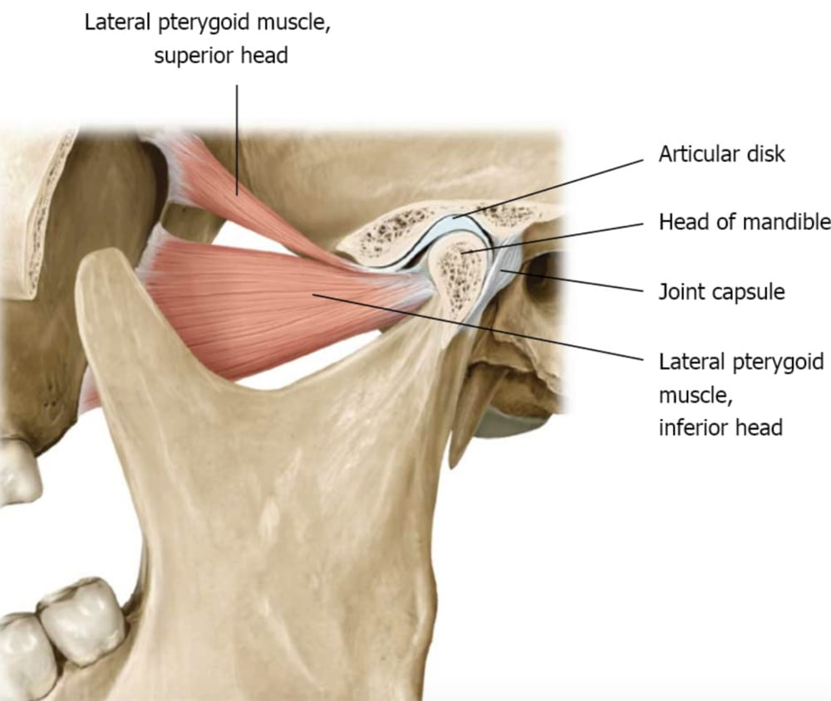

Slide 5




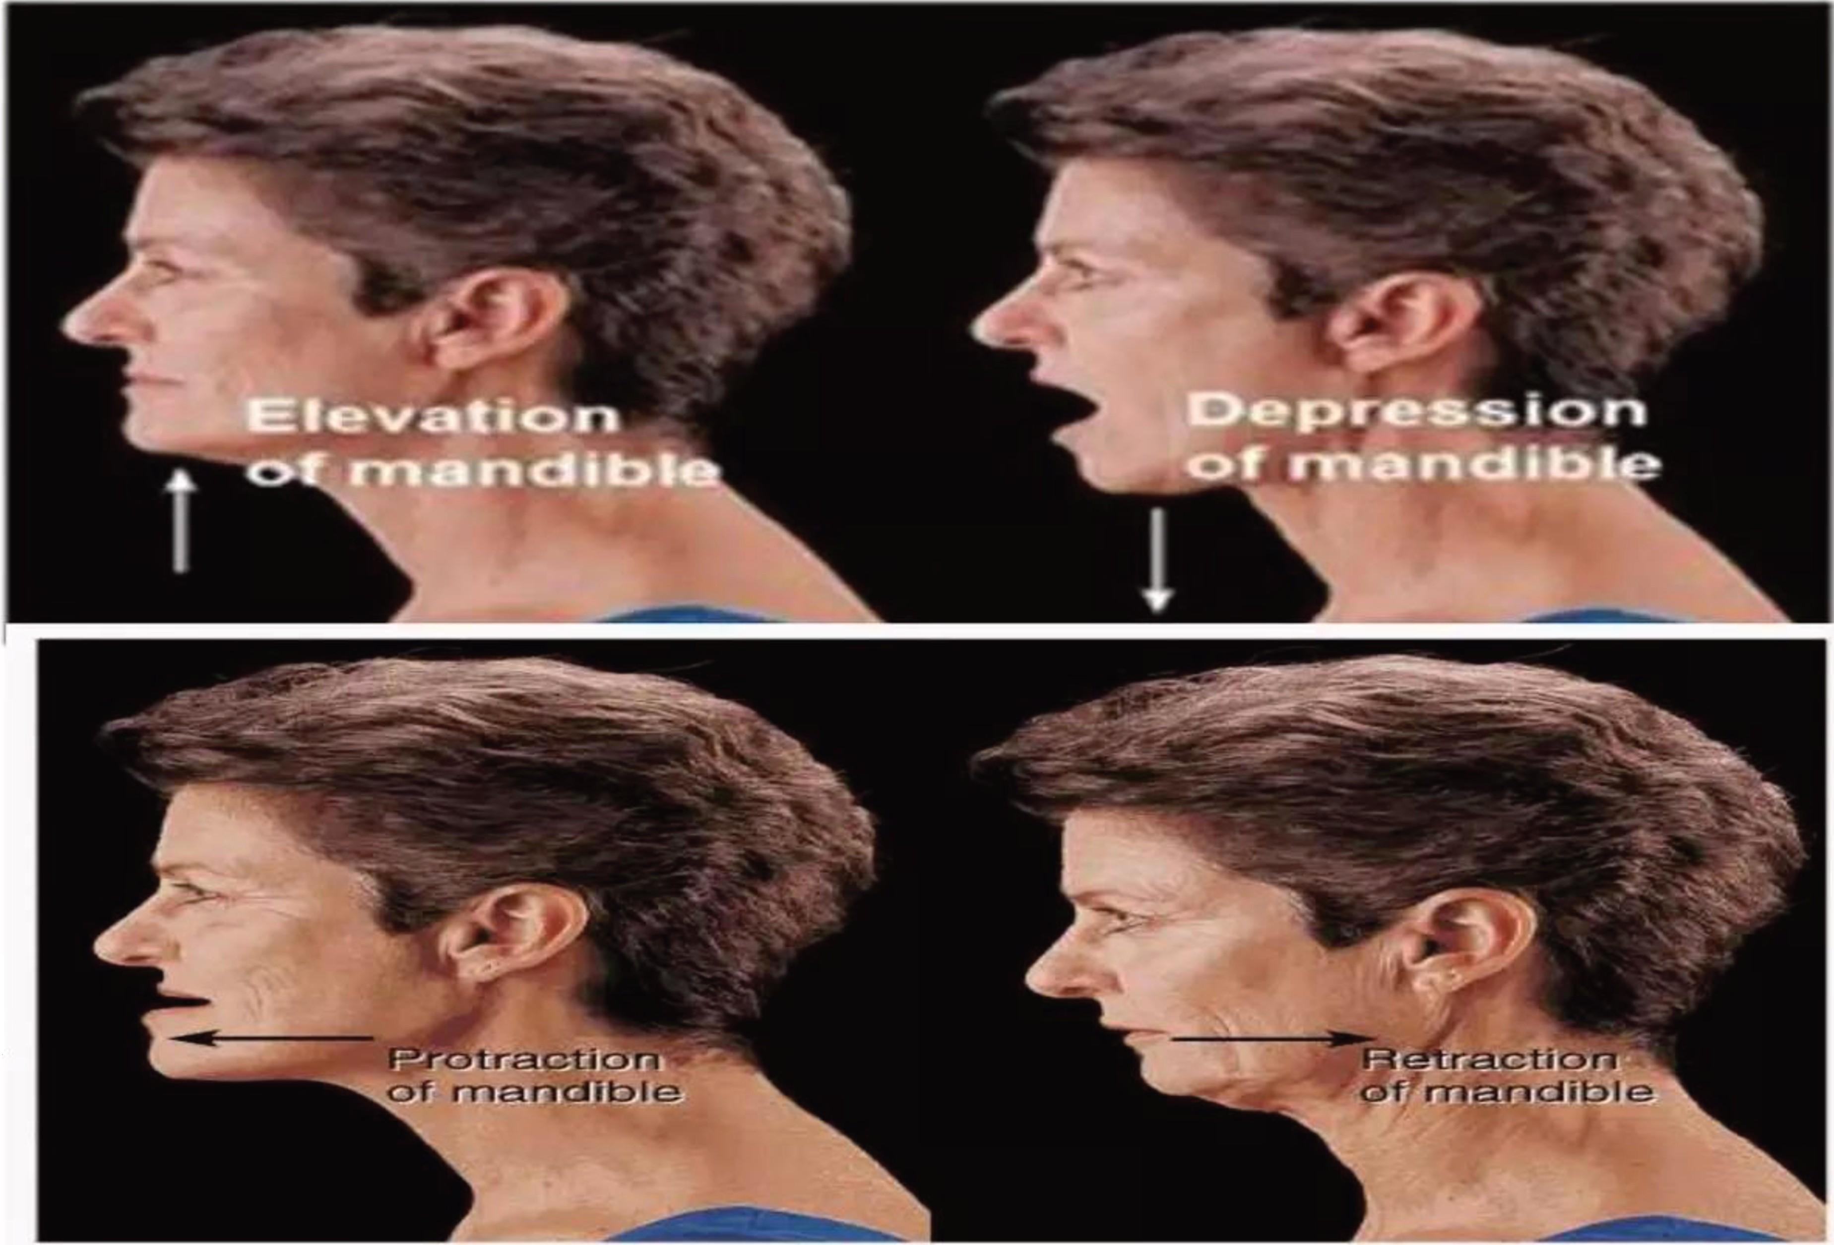
Elevation
Depression
Protrusion
Retrusion
Lateral Excursion

Slide 6
Ankylosis is a Greek word that literally means a ''stiff joint''.
It refers to partial or complete inability to open the mouth which results in functional or growth deformities of the mandible.
Ankylosis may range from a simple fibrous restriction of jaw movement to a bone formation within the joint restricting
movement completely

Slide 7

TRAUMA (most common)
Forcep delivery
Intracapsular fractures
- Congenital
INFECTION AND INFLAMMATION
Otitis media
Parotitis
- Mastoiditis
SYSTEMIC CAUSES
- Scarlet fever
- Meningitis
- Small pox
OTHERS
- Post surgery
- Malignancies
- Trismus

Slide 8

INTRACAPSULAR FRACTURE OF BONE
BLEEDING WITHIN JOINT CAVITY (HEMARTHROSIS)
BONE FRAGMENTS WITH VERY HIGH OSTEOGENIC POTENTIAL
ORGANISATION OF HAEMATOMA WITHIN JOINT
CONVERSION TO FIBROUS TISSUE SUBSEQUENTLY TO BONE

Slide 9




Based on the type of tissue causing the ankylosis:
  Fibrous ankylosis
  Bony ankylosis
Based on the side involved :
  Unilateral
  Bilateral
Based on the severity of the ankylosis:
  Partial
  Complete
Based on the type of etiology for trismus:
  Pseudoankylos is
  True ankylosis

Slide 10
KAZAN J I AN C L A S S I F I C A T I O N
Intra a rtic ular or true ankylosis
Extra a rticula r or fa lse ankylosis

Slide 11
SAHNEY 'S GR ADING OF ANKYLOSIS
TYPE 1: Flattening or deformity of the condyle with
little joint space seen on the radiograph. Extensive fibrous adhesions seen during operations.
TYPE 2: Bony fusion of the outer edges of the articular surfaces with no fusion in the deeper areas of the joint.
TYPE 3:A bridge of bone is seen between ramus of the mandible and zygomatic arch.
TYPE 4: Entire joint is replaced by a mass of bone.

Slide 12
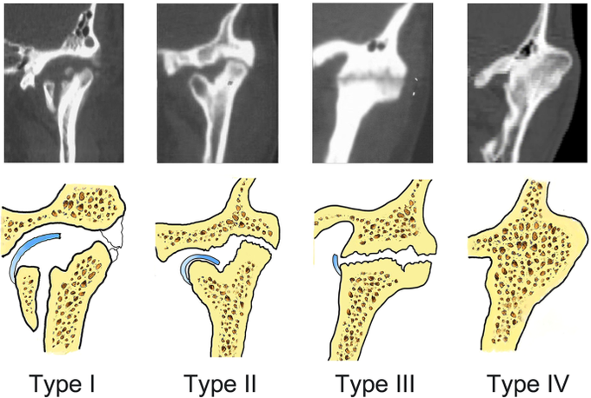

Slide 13
DIAGNOSIS
History
Clinical examination
Investigation

Slide 14



Accurate history is important to differentiate the conditions of pseudoankylosis & true ankylosis.
History of the trauma either directly to the join t or indirectly to the chin.
Duration of trismus should be asked.
Extracapsular causes such as an untreated zygomatic arch fracture should be ruled out.
History of ear infection in childhood.
History of forceps delivery of the child.

Slide 15



Restricted mouth opening, patient will complain of difficulty in mastication
Protrusive movements are absent on involved side
Partial mobility or complete immobility of the condyle is noticed on palpation

Slide 16




Facial asymmetry
Affected side appears normal
Opposite side appears flat
Chin deviated to ankylosed side
Deep antegonial notch on ankylosed side
Reduced condylar movements on affected side
Class I malocclusion on affected side
Decreased mouth opening
Posterior cross bite
Poor oral hygiene
Facial asymmetry
Affected side appears normal
Opposite side appears flat
Chin deviated to ankylosed side
Deep antegonial notch on ankylosed side
Reduced condylar movements on affected side
Class I malocclusion on affected side
Decreased mouth opening
Posterior cross bite
Poor oral hygiene

Slide 17
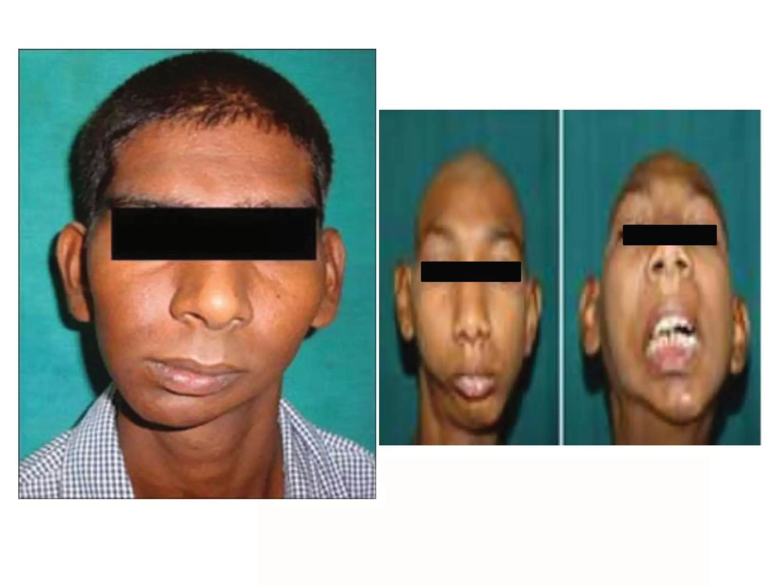
Decreased mouth opening
Facial asymmetry, Chin deviated to ankylosed side

Slide 18





Bird face
Trismus
Class Imalocclusion
Deep antegonial notch
Poor oral hygiene
Crowding of teeth
Protrusion of upper anterior teeth
Anterior open bite
No condylar movements palpable

Slide 19
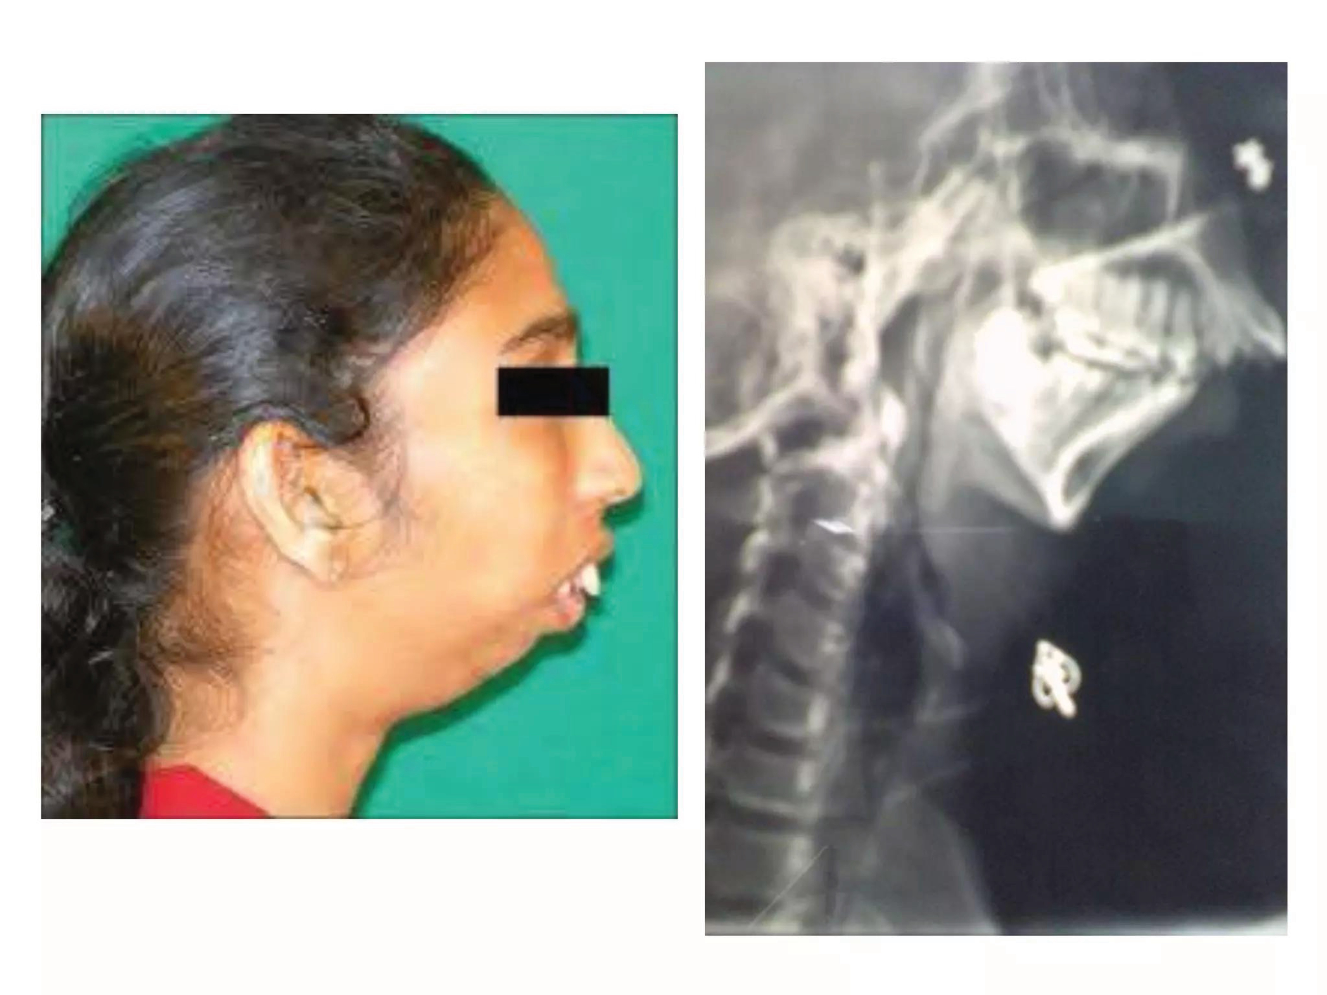
Bird face, Protrusion of upper anterior teeth,
Prominent anti gonial notch
No condylar movements palpable, Trismus

Slide 20


Radiographic finding- are important in arriving at a final diagnosis
Orthopantomograph - will show both the joints picture which can be compared in unilateral cases.
Lateral oblique view- will give anteroposterior dimension of the condylar mass. Elongation of coronoid process can be seen.
Cephalometric radiograph- is taken to evaluate the associated skeletal deformities
Posteroanterior radiograph- will reveal the medio lateral extent of the bony mass. It will also highlight the asymmetry in unilateral cases
CT scan- very helpful guide for surgery. Relation to the medial cranial fossa, the anteroposterior width, mediolateral depth can be assessed.
Any presence of fractured condylar head on the medial aspect of ramus
can be located

Slide 21
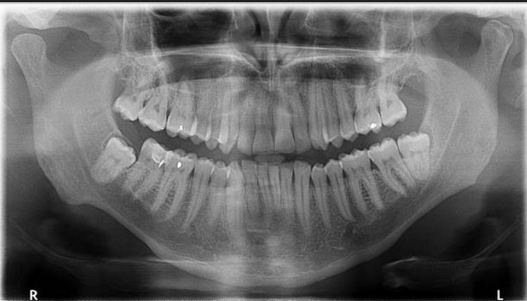
Orthopantogram

Slide 22
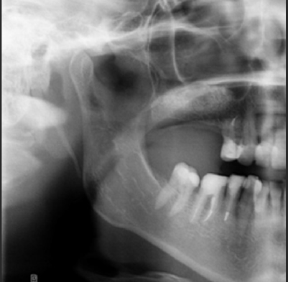
Lateral oblique view

Slide 23
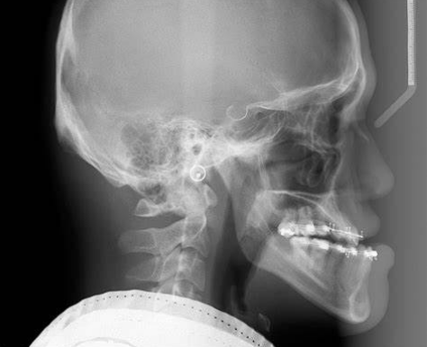
Lateral cephalometric

Slide 24



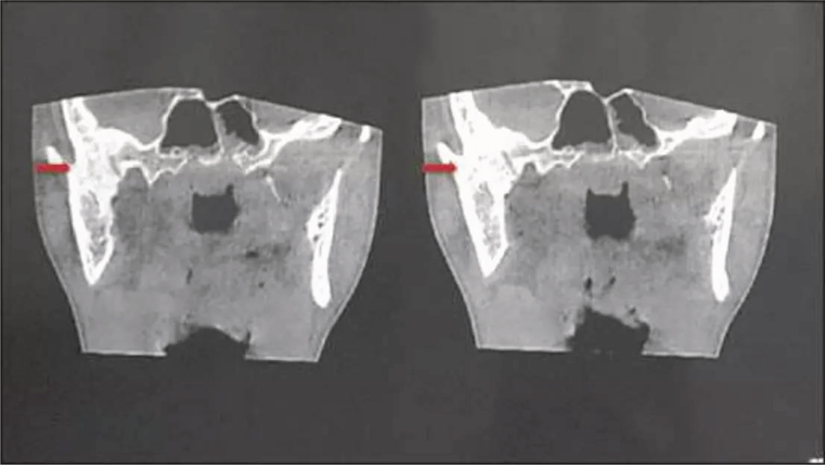
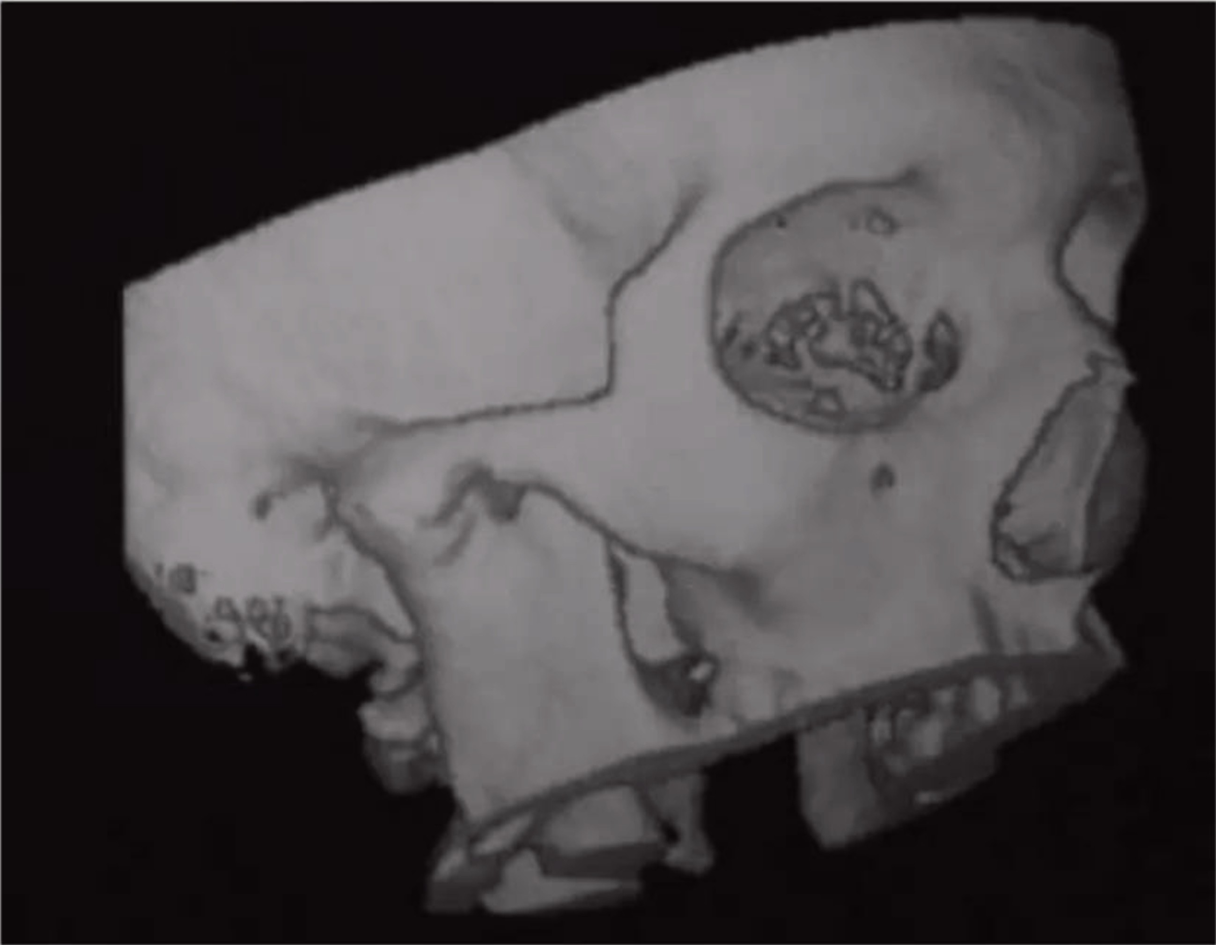
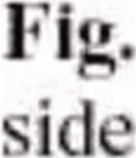


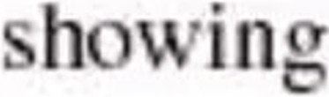

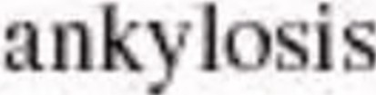

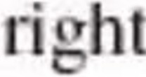
This is helpful as it gives an accurate picture of the
proximity of the ankylotic mass to
important structures that cannot be seen on a radiograph.
The proximity with
internal carotid
artery medially is very essential for surgical purpose.

Slide 25
SEQUELAE OF UNTREATED
ANKYLOSIS
Facial deformity
Speech difficulty due to decreased mouth opening, maloccluded teeth and tongue position.
Nutritional deficiency
Respiratory distress
Malnutrition
Malocclusion
Poor oral hygiene

Slide 26
MANAGEMENT OF TMJ ANKYLOSIS
BASICALLY THREE TYPES:
Condylectomy
Gap Arthroplasty
Interpositional Arthroplasty

Slide 27
PREOPERATIVE EVALUATION OF THE PATIENT
A detailed surgical profile of the patient with ankylosis.
Preanasthetic evaluation with specific importance to adequacy of mouth opening for intubation.
Temporal shave for procedure involving temporal muscle/ fascia grafts.

Slide 28
ANASTHETIA FOR AN ANKYLOSIS PATIENT:
ALTERNATIVE METHODSARE USED SUCH AS:
Blind nasal/ awake nasal intubation
Use of fiberoptic intubation
Retrograde intubation
In case where all these methods are not possible, a temporal elective tracheostomy is planned.

Slide 29





Preauricular incision
Postauricular incision
Hemicoronal
Submandibular incision
Post ramal
Endaural incision

Slide 30
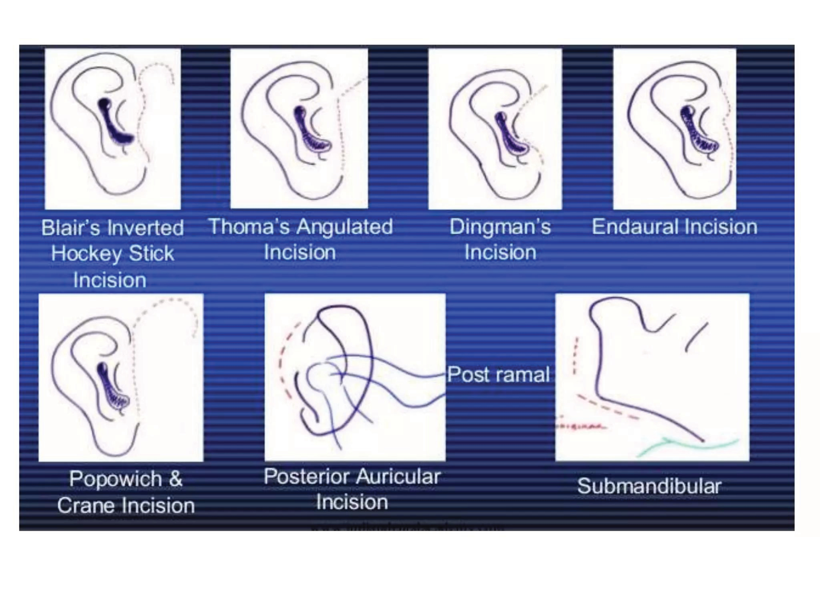

Slide 31
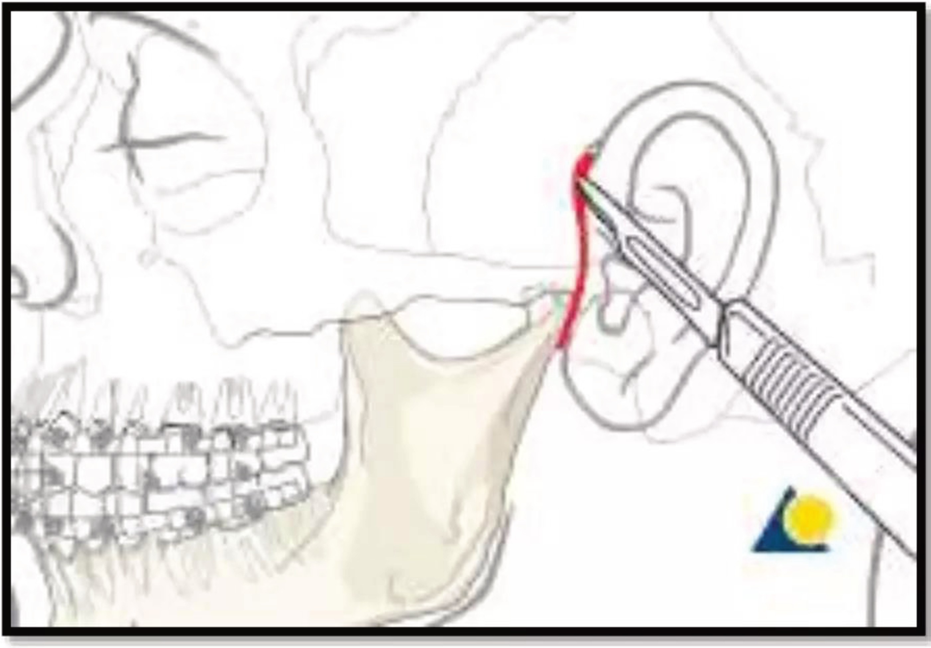
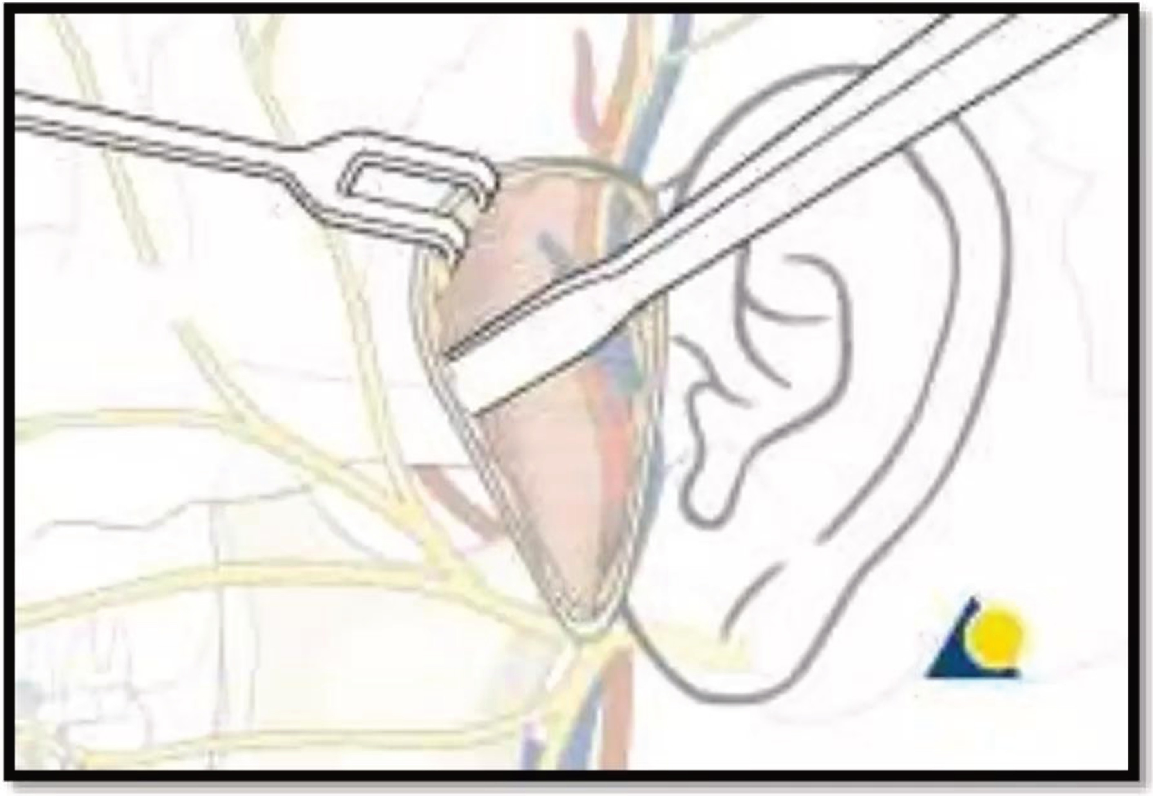
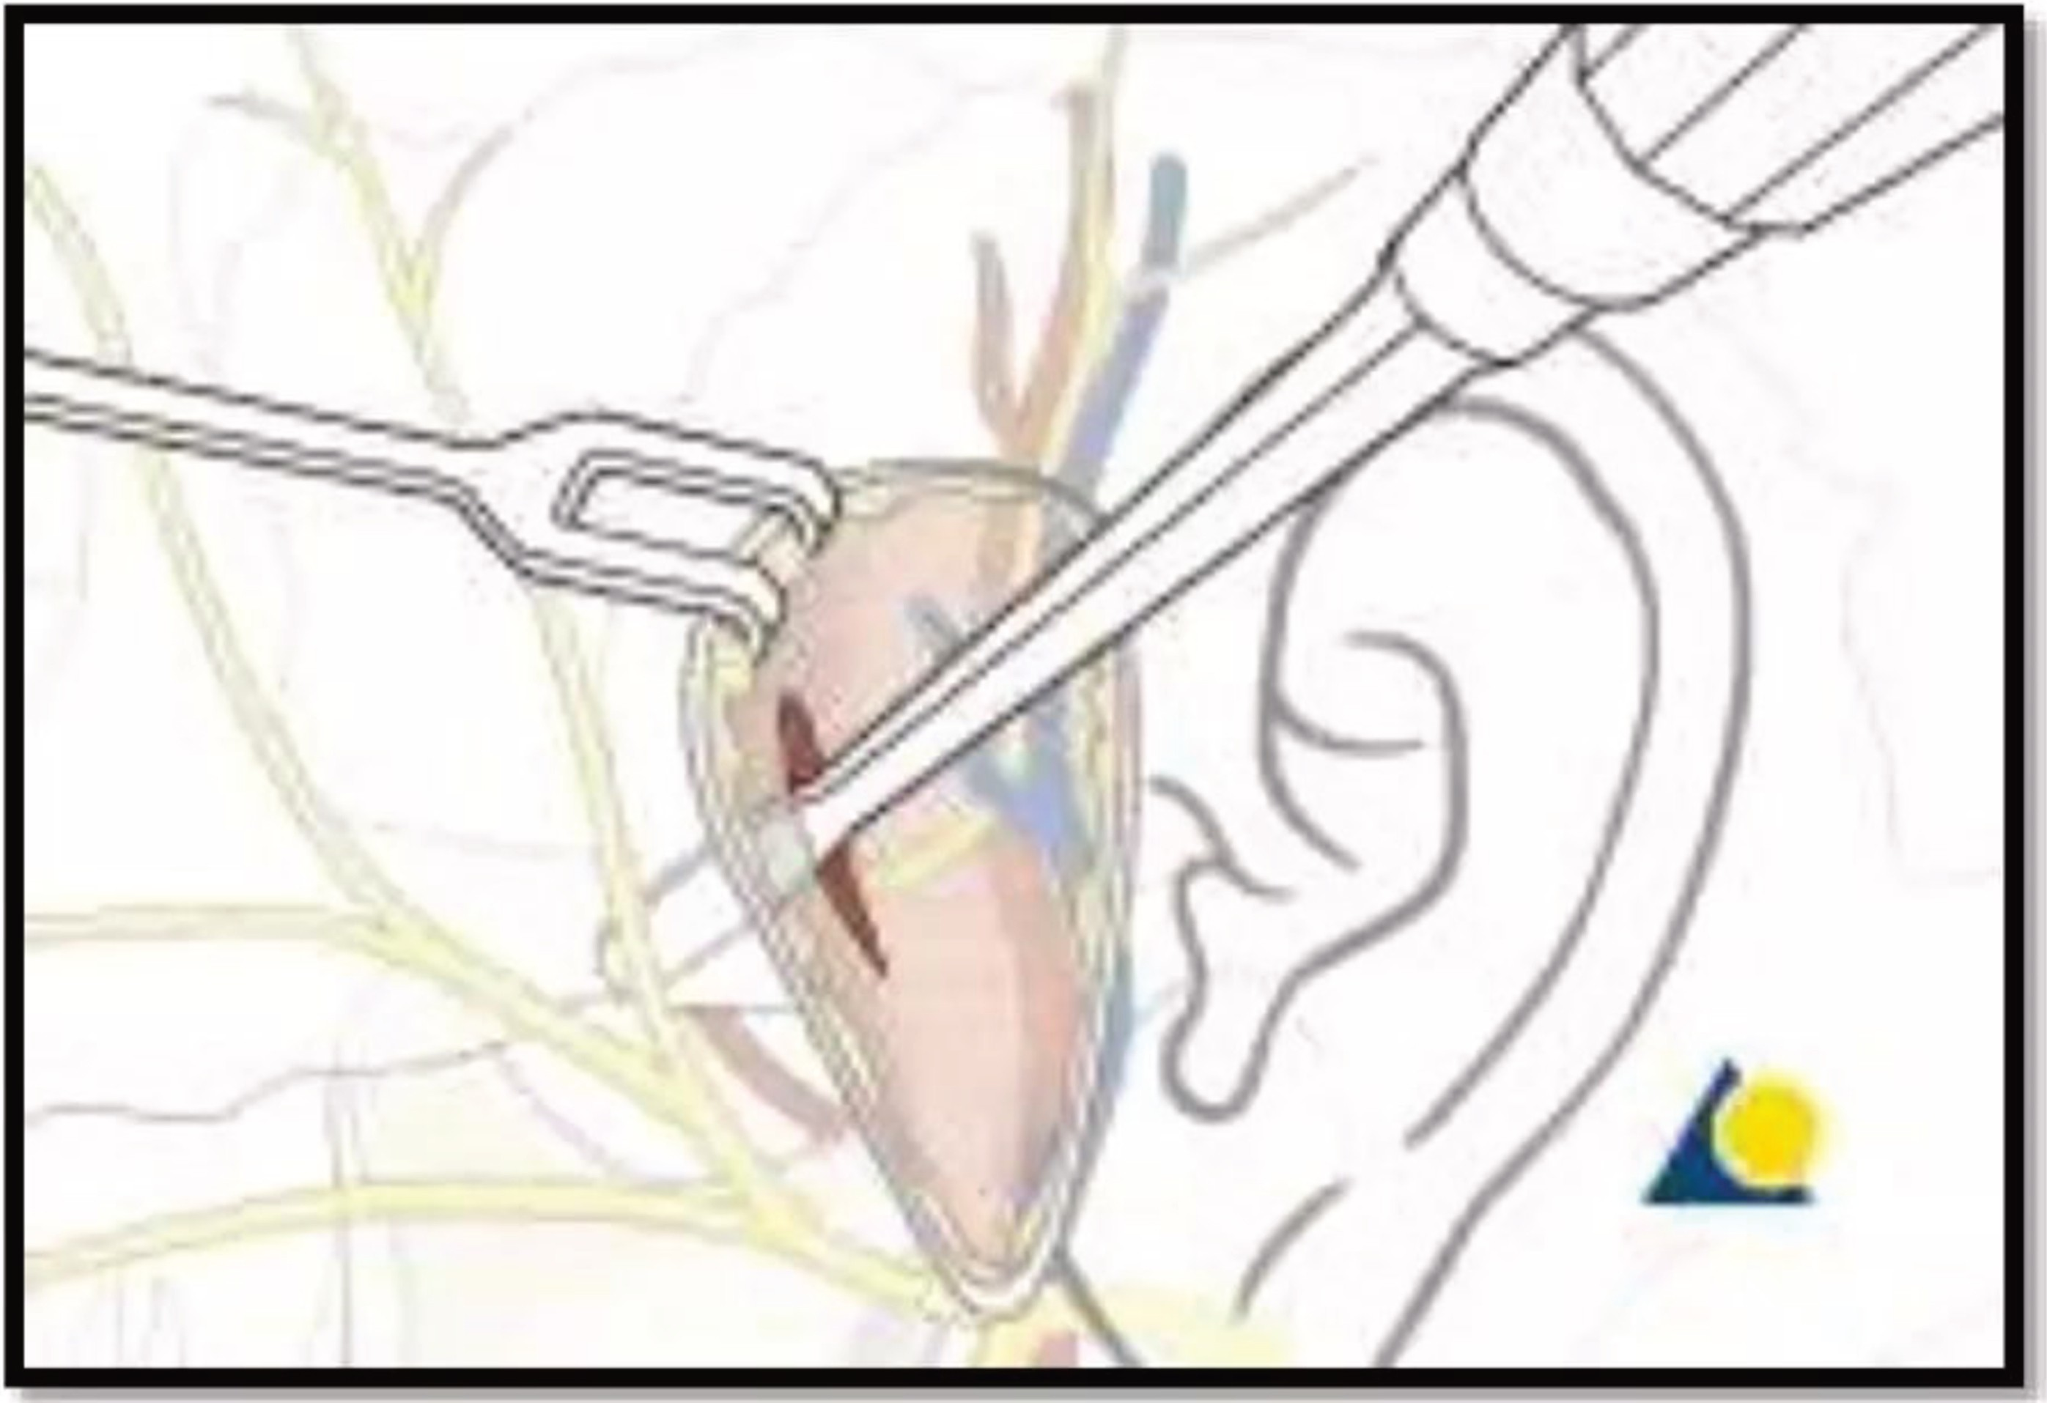
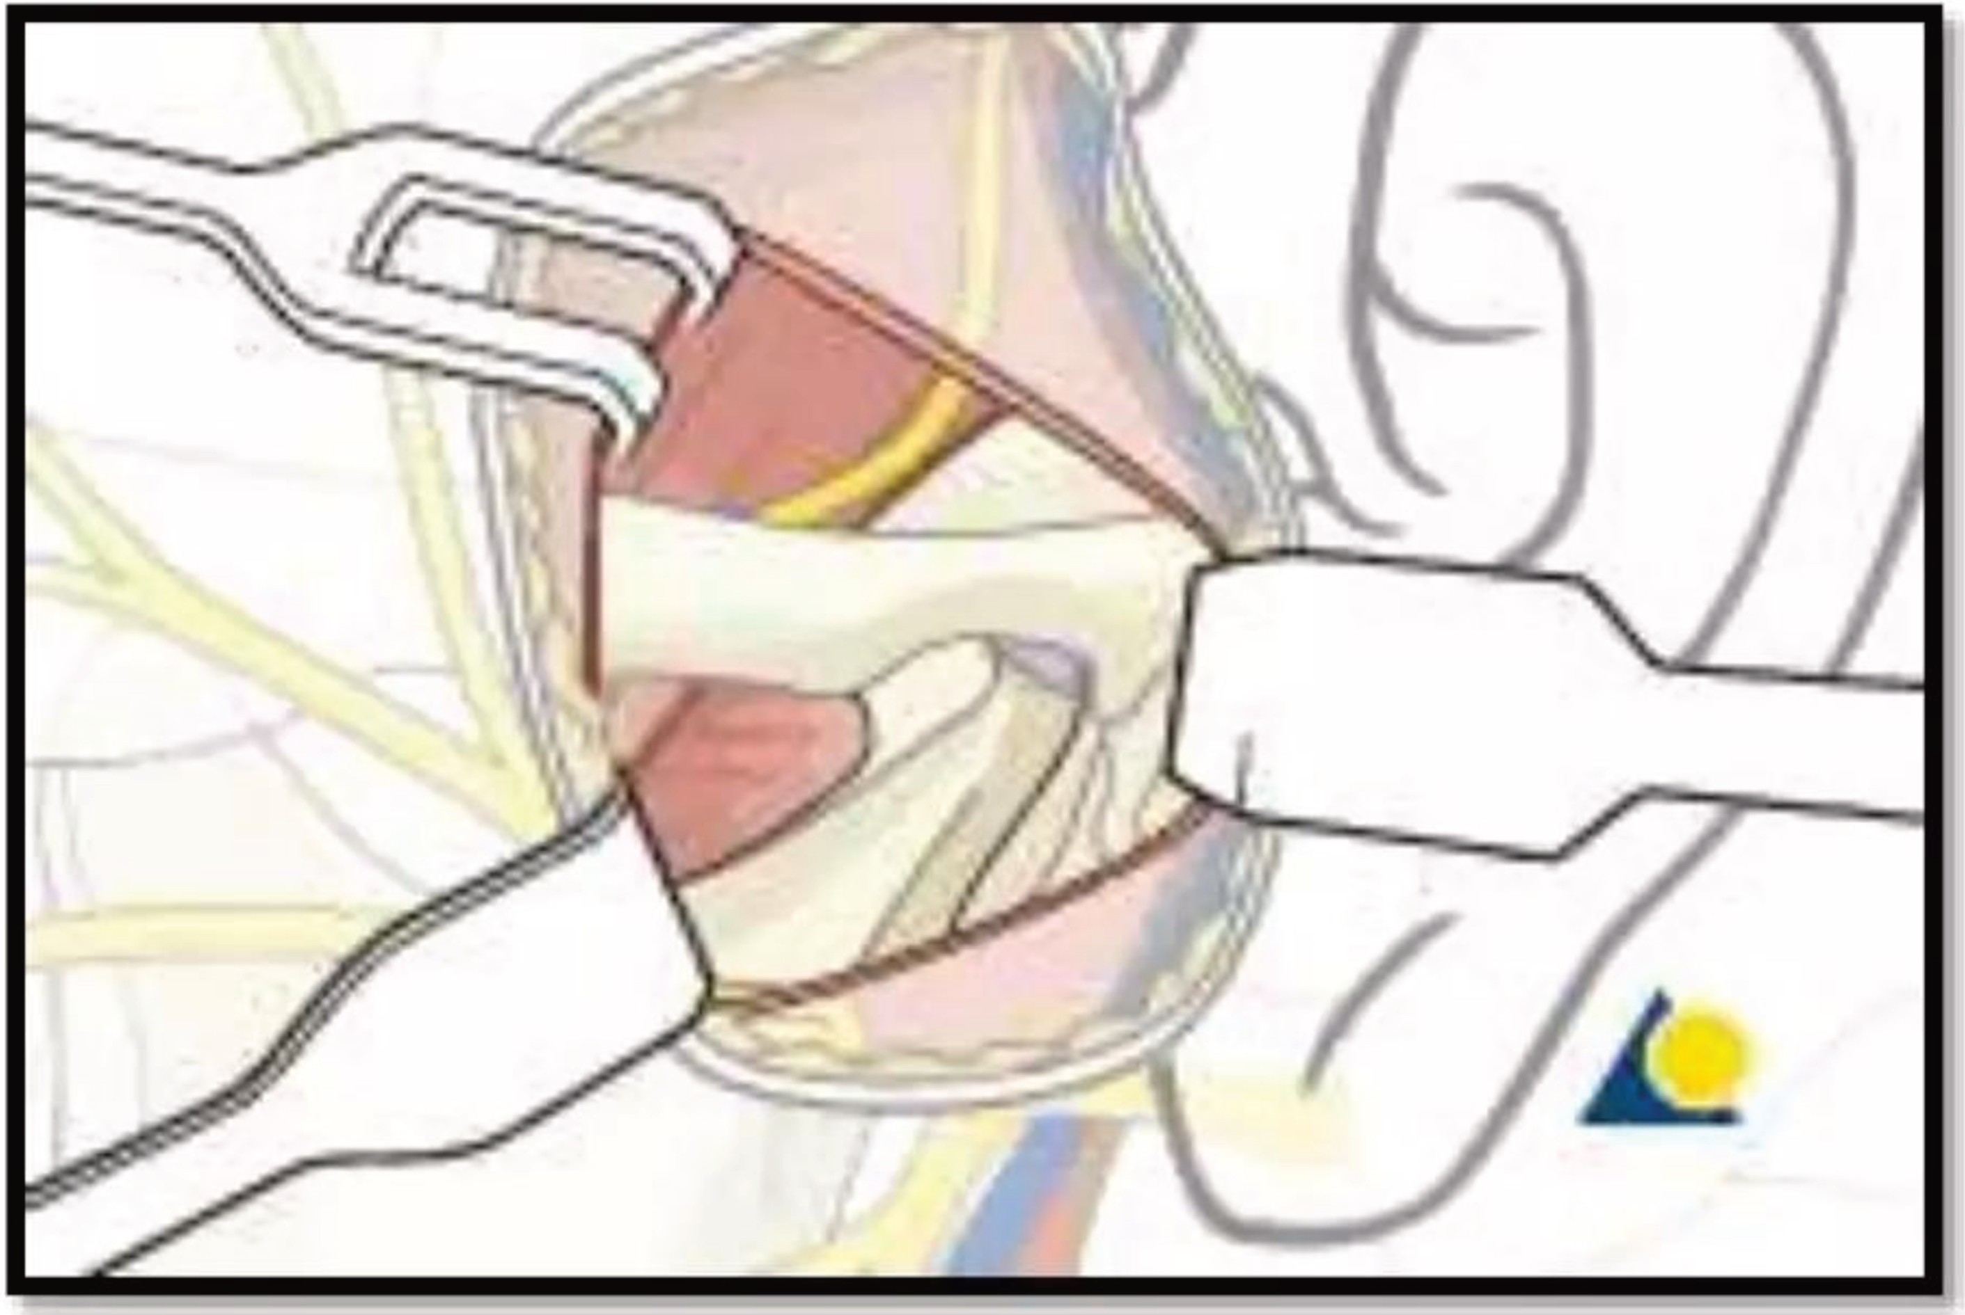
PRE AURICULAR APPROACH

Slide 32
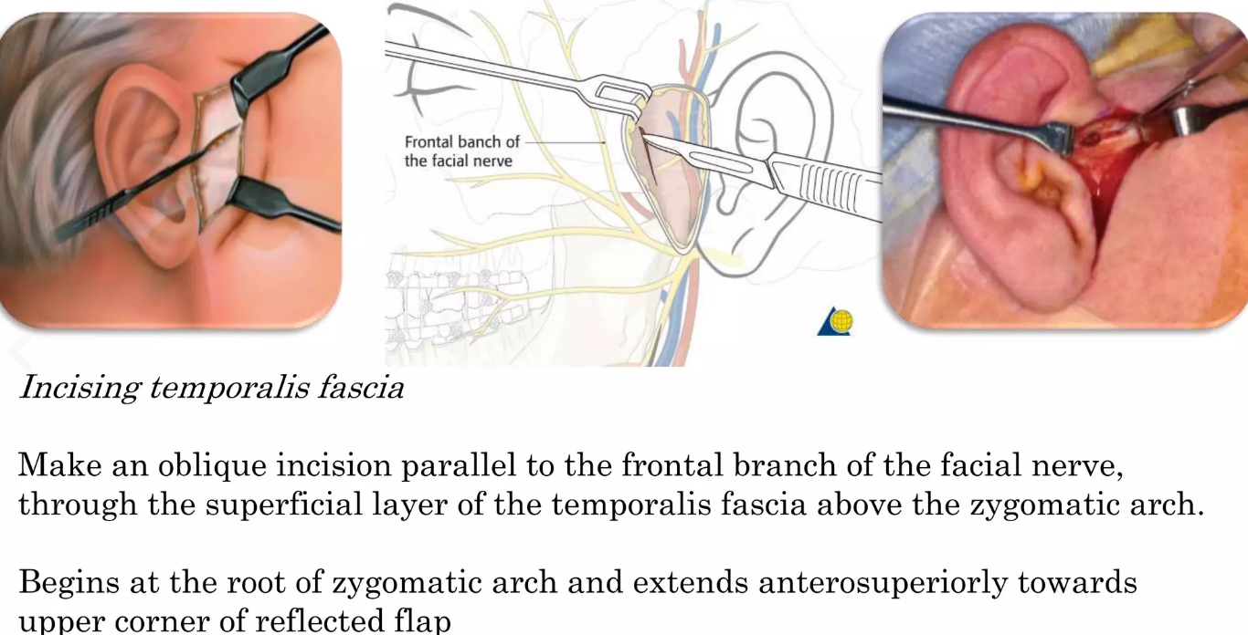
Pre auricular approach dissection

Slide 33
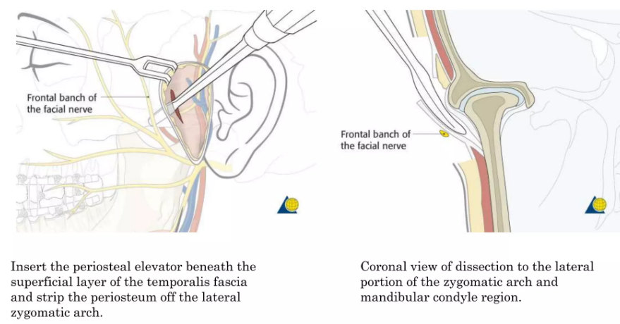

Slide 34
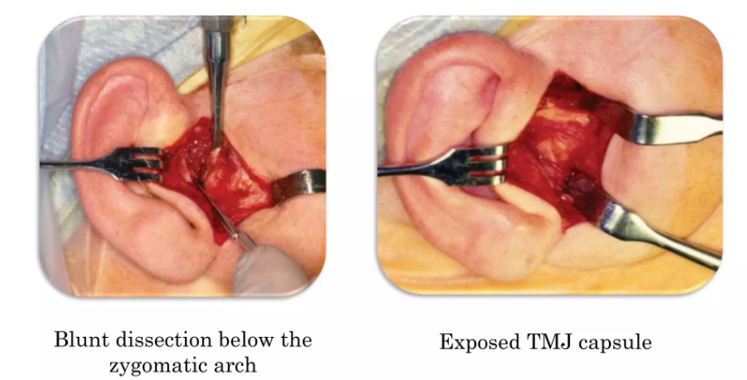

Slide 35
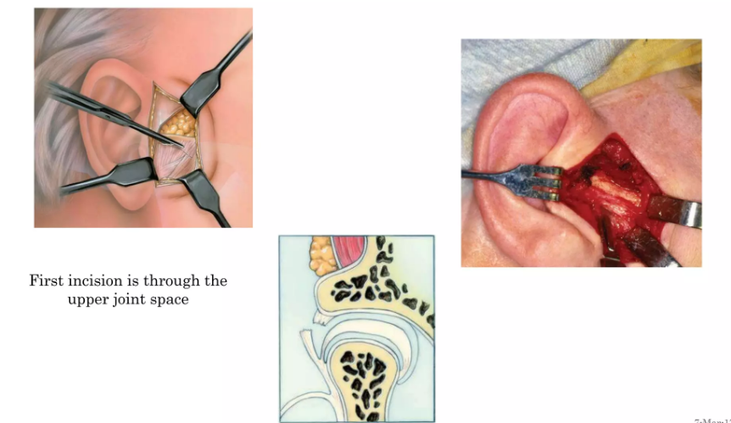

Slide 36
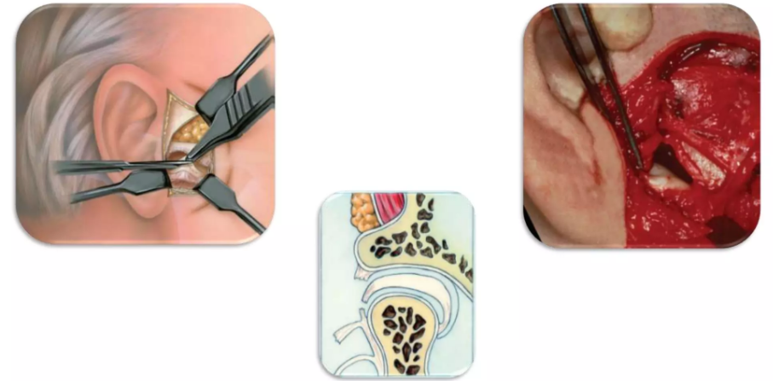
2nd incision through the lower joint space

Slide 37
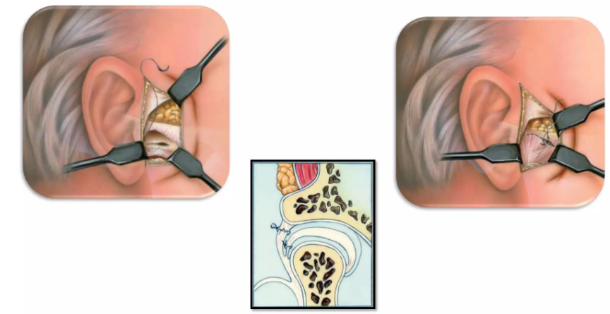
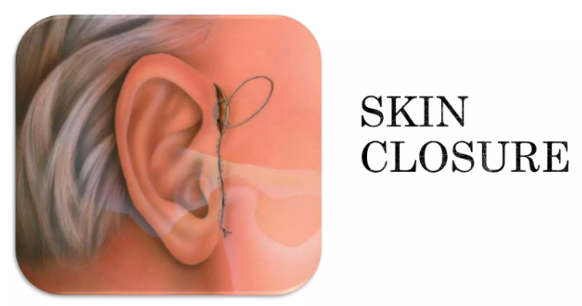
Closure of the capsule

Slide 38
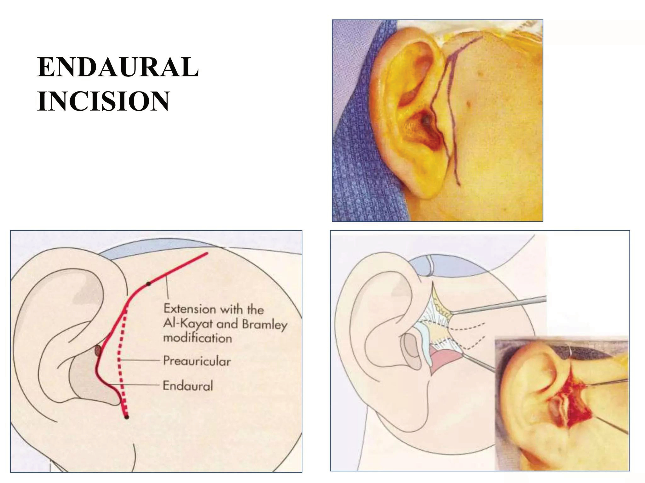

Slide 39
CONDYLECTOMY
Done in cases of ankylosis where anatomic features of TMJ are not completely changed. As in case of fibrous or partial ankylosis.
An incision is placed and the condylar region is exposed.
A horizontal cut is made at the region of the neck of the condyle.
The head of the condyle is sectioned at the level of the neck and carefully separated.

Slide 40
Since the superior attachment is not firm, it maybe detached, and the entire head of the condyle is separated and removed.
The stump of the condyle at the neck is smoothened and thus a new joint is created there.

Slide 41
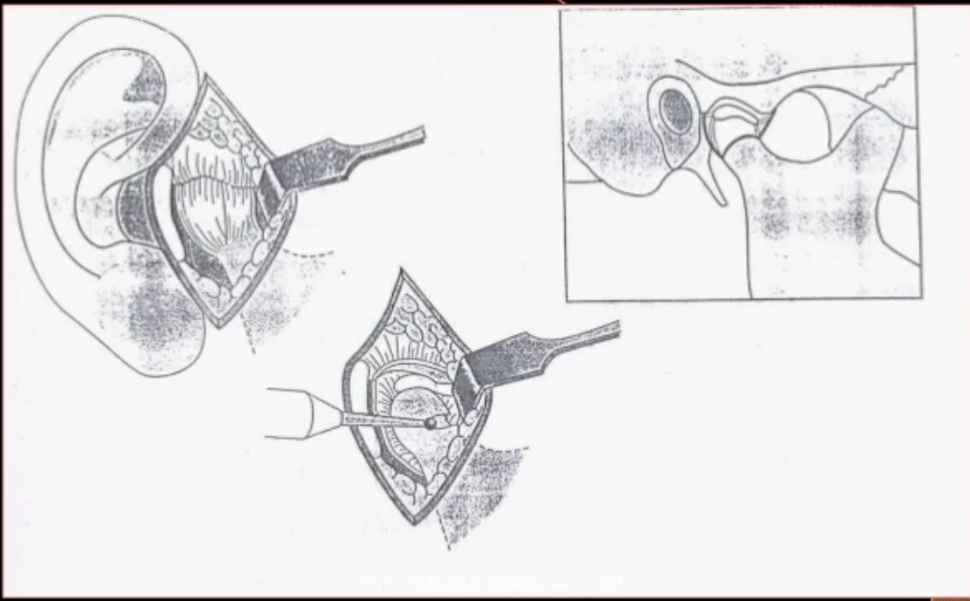

Slide 42
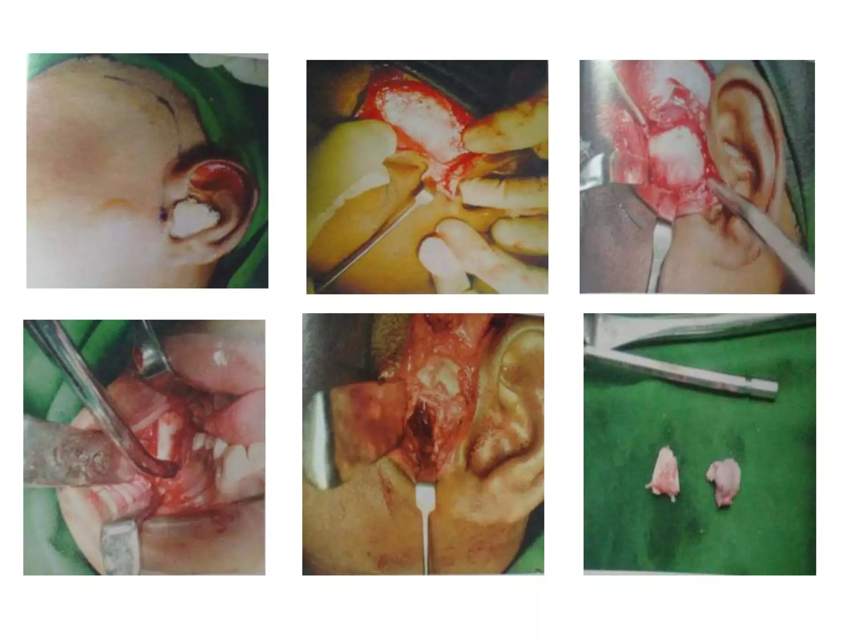

Slide 43
COMPLICATIONS
Loss of vertical height of the ramus.
In the case of bilateral condylectomy, it may create an anterior open bite.
In unilateral cases, there may be deviation of the jaw on opening.

Slide 44
GAP ARTHROPLASTY
Gap arthroplasty involves creation of an anatomical gap in the ankylosed segment to form an artificial joint space.
Commonly done in cases of complete ankylosis.
A gap in the bone is created to separatee the ramus from the ankylosed mass in the glenoid fossa.
2 Horizontal bony cuts are made in the most superior aspect of the ramus and the wedge of the bone between these 2 cuts is removed.
Care should be taken while removing the bone from the medial aspect as it is close to the maxillary artery and carotid canal.

Slide 45
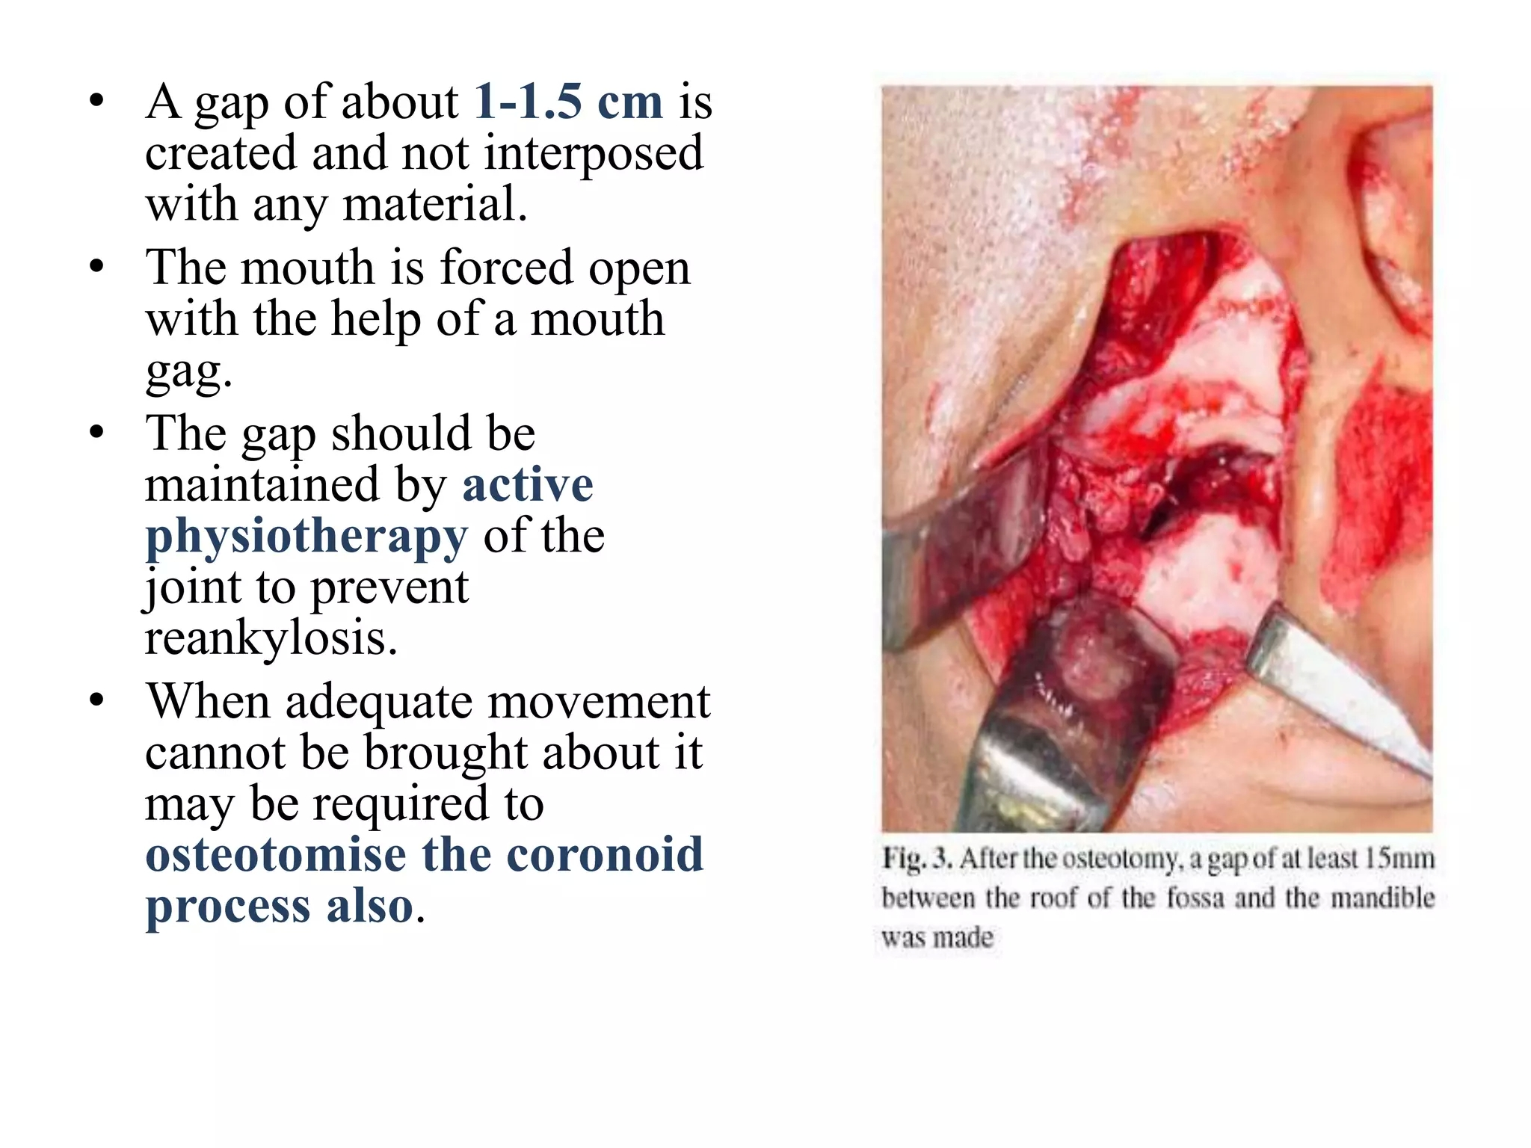

Slide 46
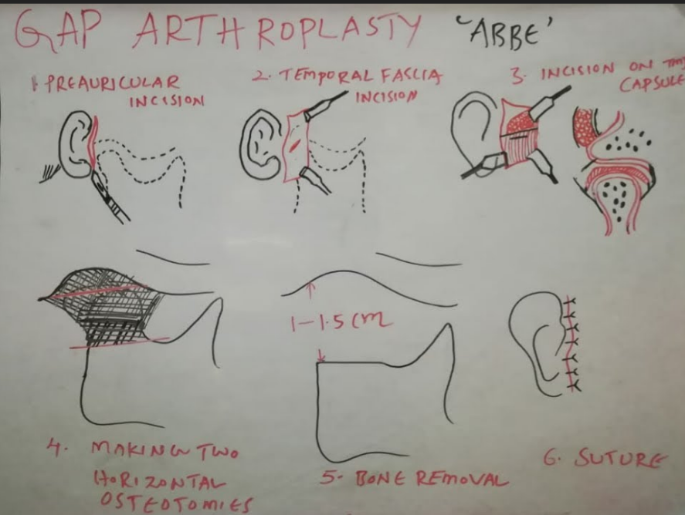

Slide 47
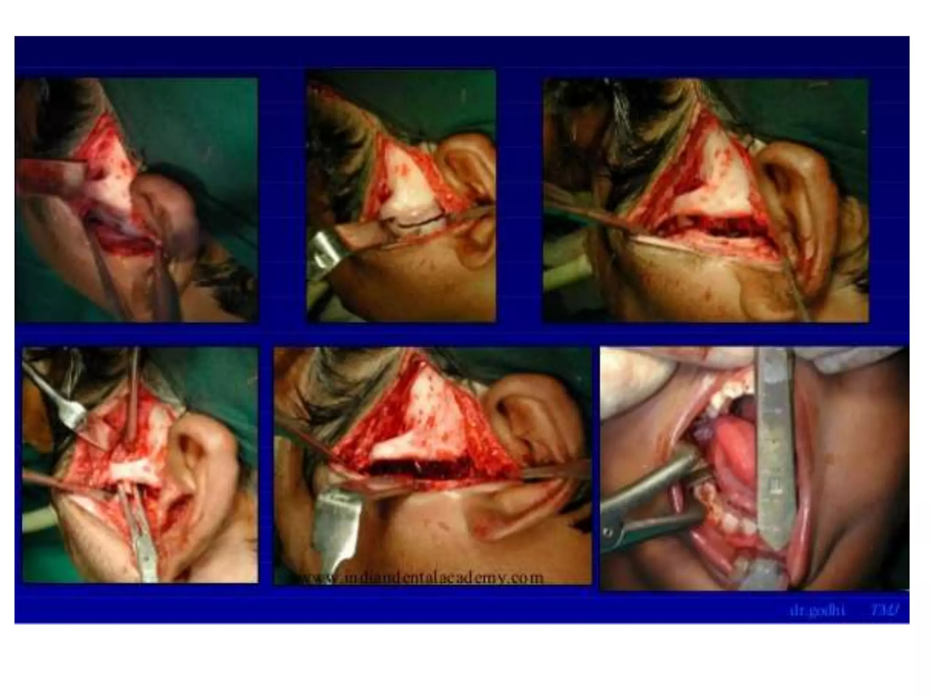

Slide 48
COMPLICATIONS
• It is difficult to remove the actual extent of the ankylotic mass as it is not properly assessed medially.
• Chances of creating excessive gap and reducing vertical height of ramus.
• Anterior open bite due to excessive bone removal.
Reankylosis due to bony contact between the cut ends.

Slide 49
INTERPOSITIONAL ARTHROPLASTY
• When gap arthroplasty is done to release ankylosis, there are chances of contact between the bone ends to form a reankylosis.
• So an interpositional material is to be placed in between them to avoid contact and minimize chances of reankylosis.
• Materials which can be used are either alloplastic or autogenous materials.
• Procedure involves creating a gap and then inserting an interpositional material and stabilizing it.

Slide 50
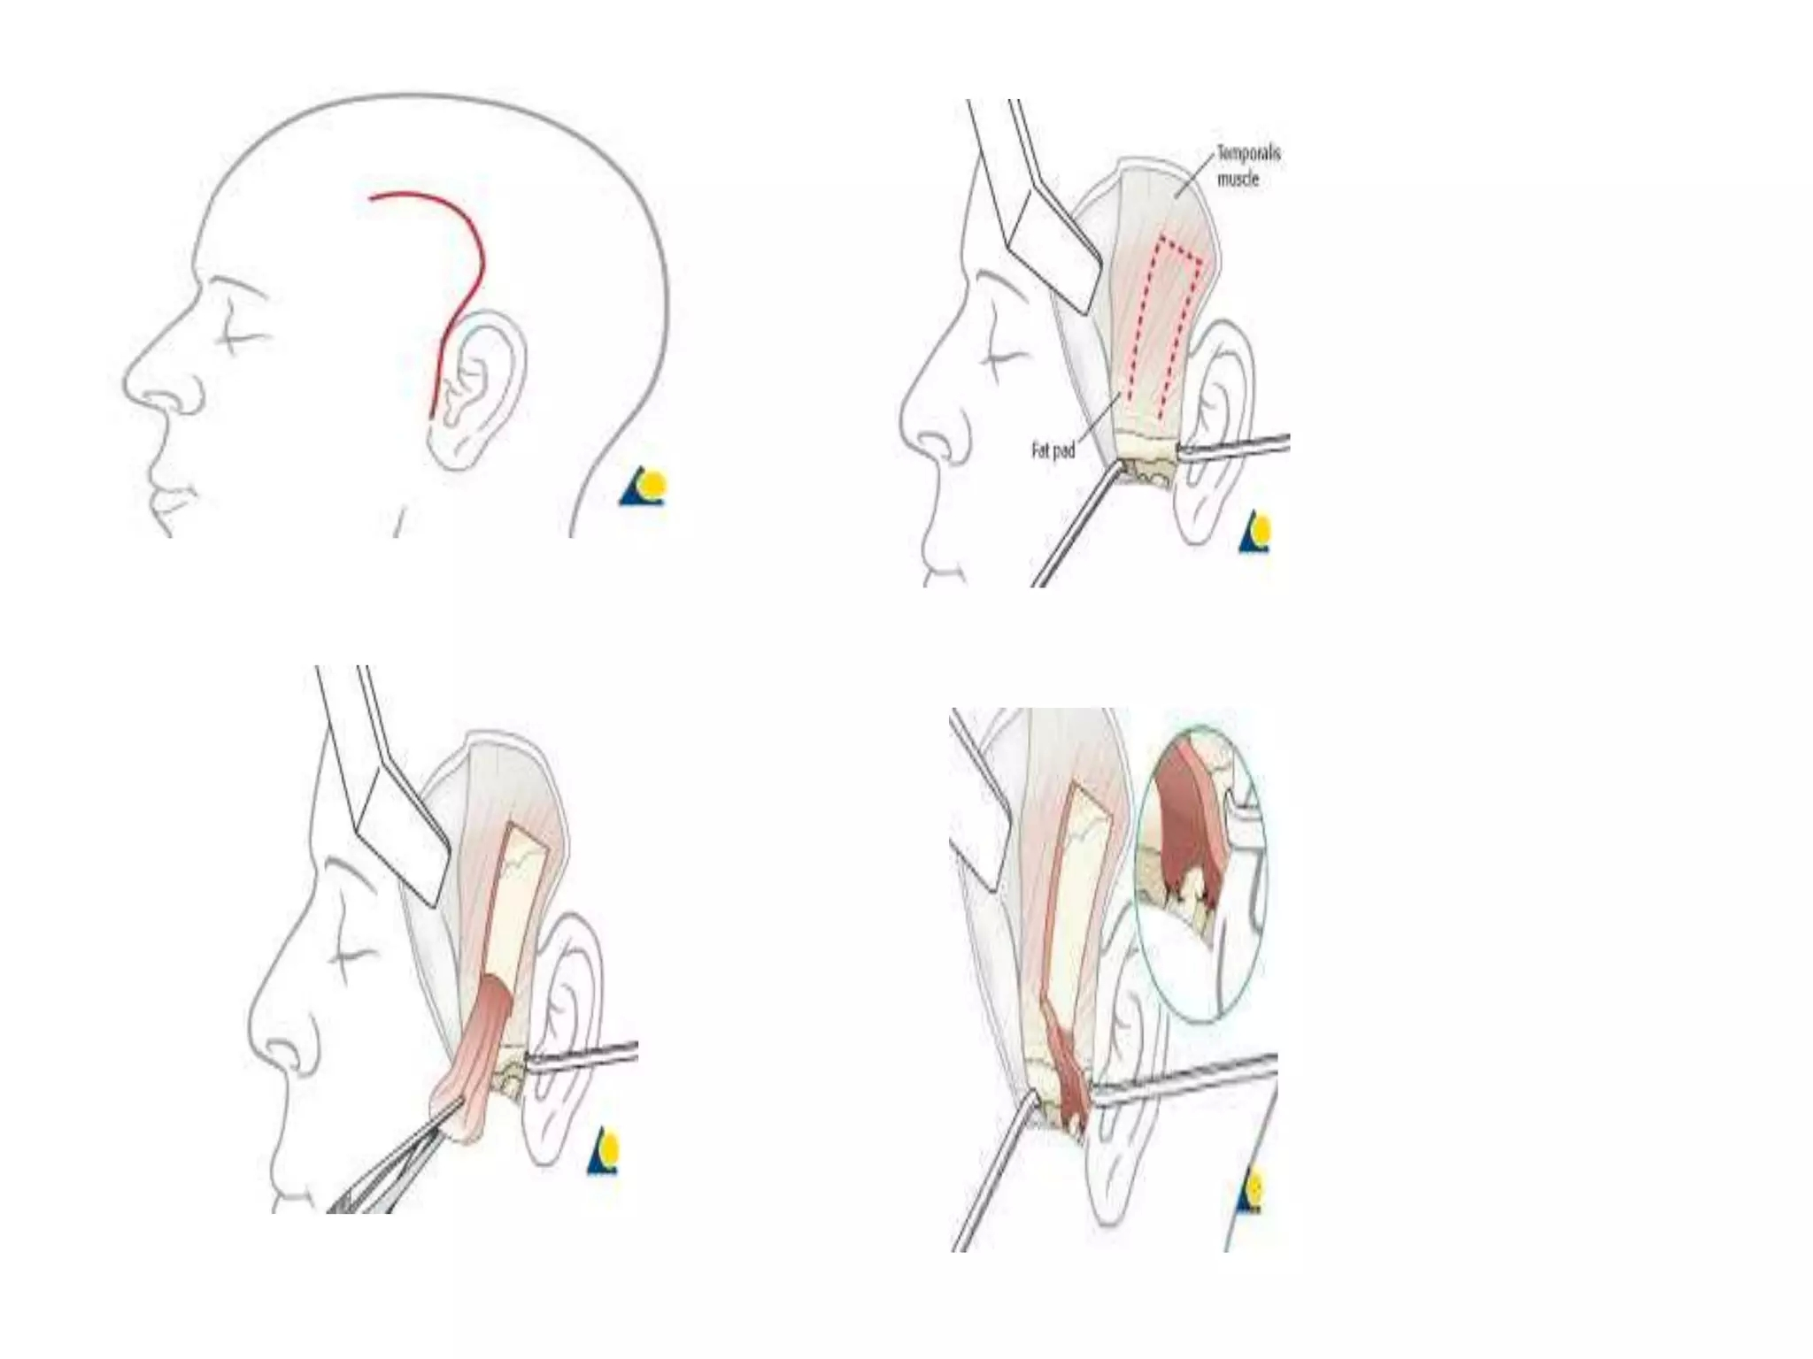
Alkayet brahmley incision with interpositional arthroplasty

Slide 51
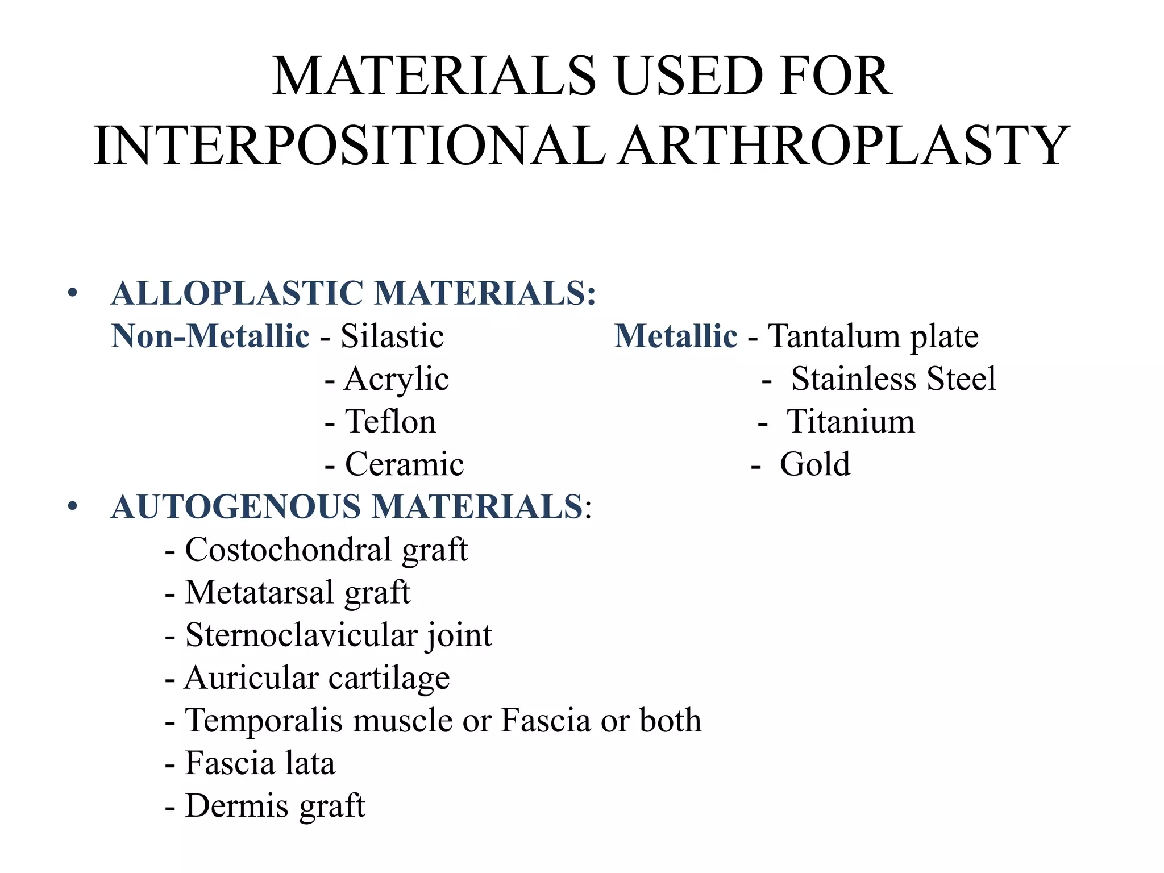
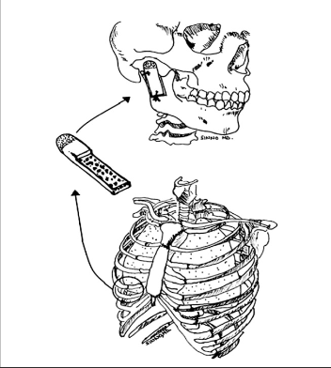

Slide 52
COMPLICATIONS
• Foreign body reaction with alloplastic materials placed in surgical gap.
• Difficulty in suturing from the medial aspect.
Complications associated with second surgical site in case of autogenous graft.
• Other complications as in gap arthroplasty.

Slide 53
KABAN'S PROTOCOL
Aggressive total excision of the ankylotic segment in condylar region.
Coronoidectomy on affected side to avoid temporalis muscle restriction.
Lining with temporalis muscle or fascia or disc.
If step 1,2,3 don't create enough opening, coronoidectomy of opposite side is done.
Reconstruction of ramus with costochondral junction.
Creation of open bite to permit settling of graft for 3-6 months.
Aggressive physiotherapy

Slide 54

POST OPERATIVE PHYSIOTHERAPY
Very important.
Encourage the patient to start active exercise of the jaw as soon as it can be tolerated.
Initially: pressure with finger or simple finger exercises to gently force the mouth open.
Later: stick, tongue blade, mouth gag can be used for forceful mouth opening.
Medications can be given to relieve pain and enable movements.
Heat application to the region prior to exercise permits easy movement to relieve muscle spasm.

Slide 55
CAUSES OF RECURRENCE OF ANKYLOSIS
Improper or inadequate surgical resection.
Fracture of costochondral graft.
Improper graft fixation.
Inadequate physiotherapy.
Increased osteogenic potential of the resected segments.

Slide 56
THANK YOU!

